Slide 1
2023 Cookie Program Troop Training
Notes:
Housekeeping:
-keep on mute
-if you have a question place it in the chat
-please keep side conversations out of the chat so we can keep it open for questions only
-at the end of the presentation we will be offering break out rooms if you would like to stay on and meet with your PPM
Team Introduction
Introduce Anne

Slide 2
2023 Theme and Recognitions

Slide 3
Notes:
Our theme for 2023 is Go Bright Ahead! Let’s encourage girls to be their most courageous cookie seller this season!
Our mascot this year is a bottle nose dolphin

Slide 4
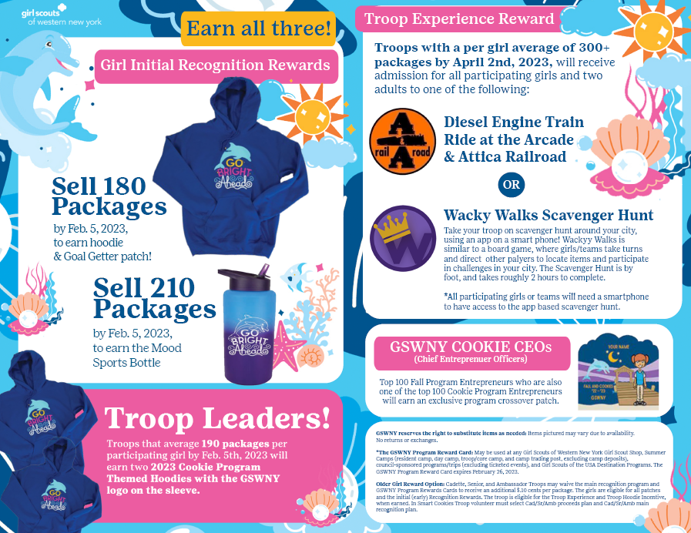
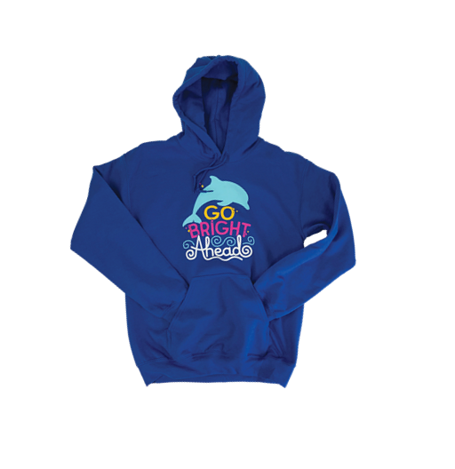
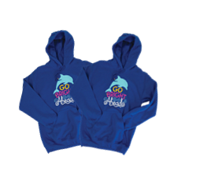
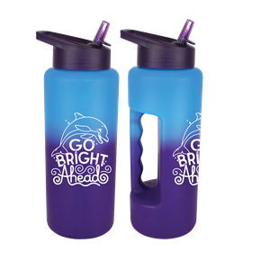
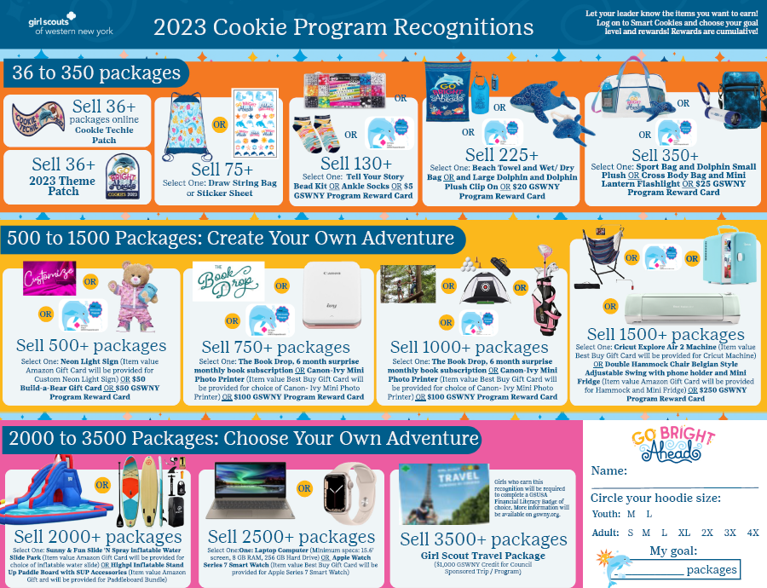
Initial Recognitions by February 5th
Earn All three!
Troop Reward
180 packages earns a hoodie & Goal Getter Patch!
210 packages earns a Mood Sports Bottle!
Troop Average 190+ packages by Feb. 5
2023 Cookie Program Recognitions
Troop Experience Reward
Troops who average 300+ pkgs by April 2nd choose their experience
Darien Lake Theme Park
Diesel Engine Train Ride
Wacky Walk Scavenger Hunt

Slide 5
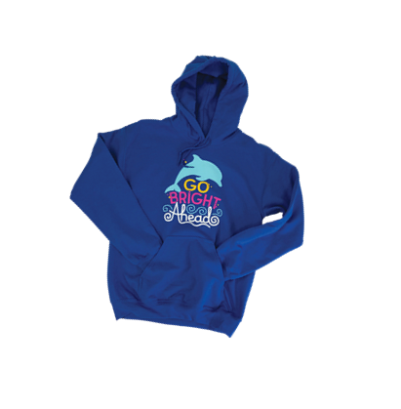
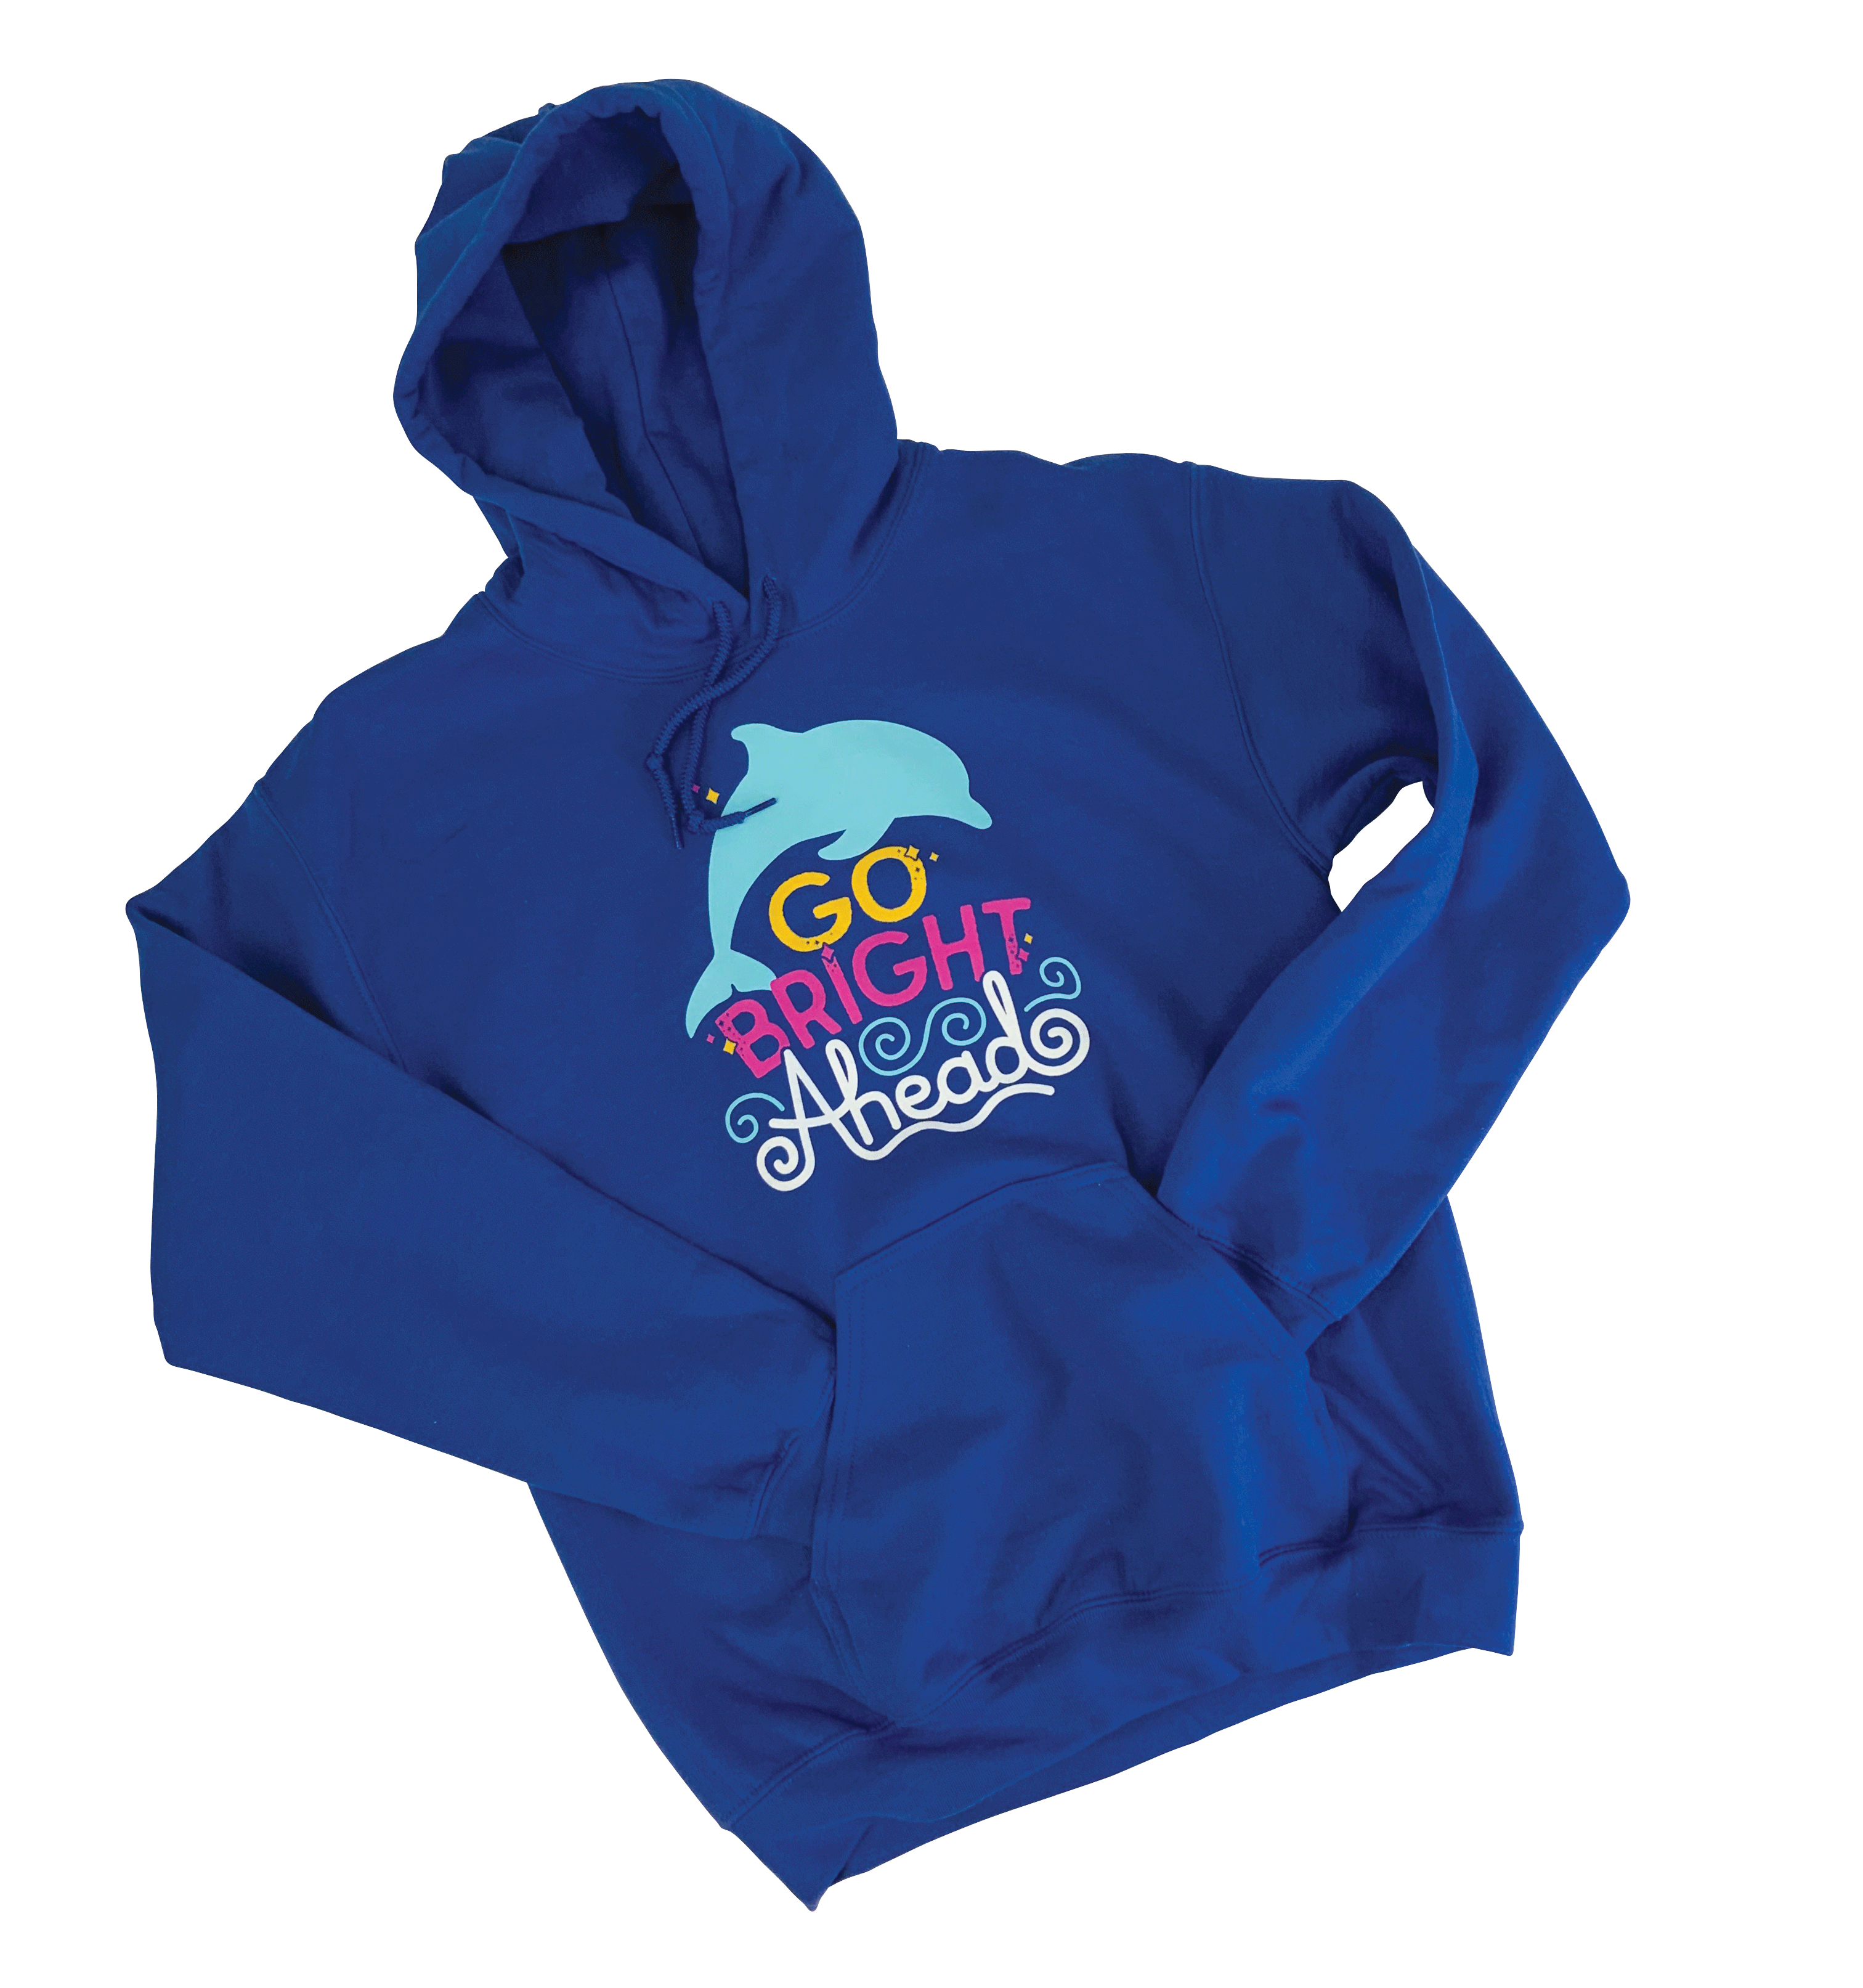
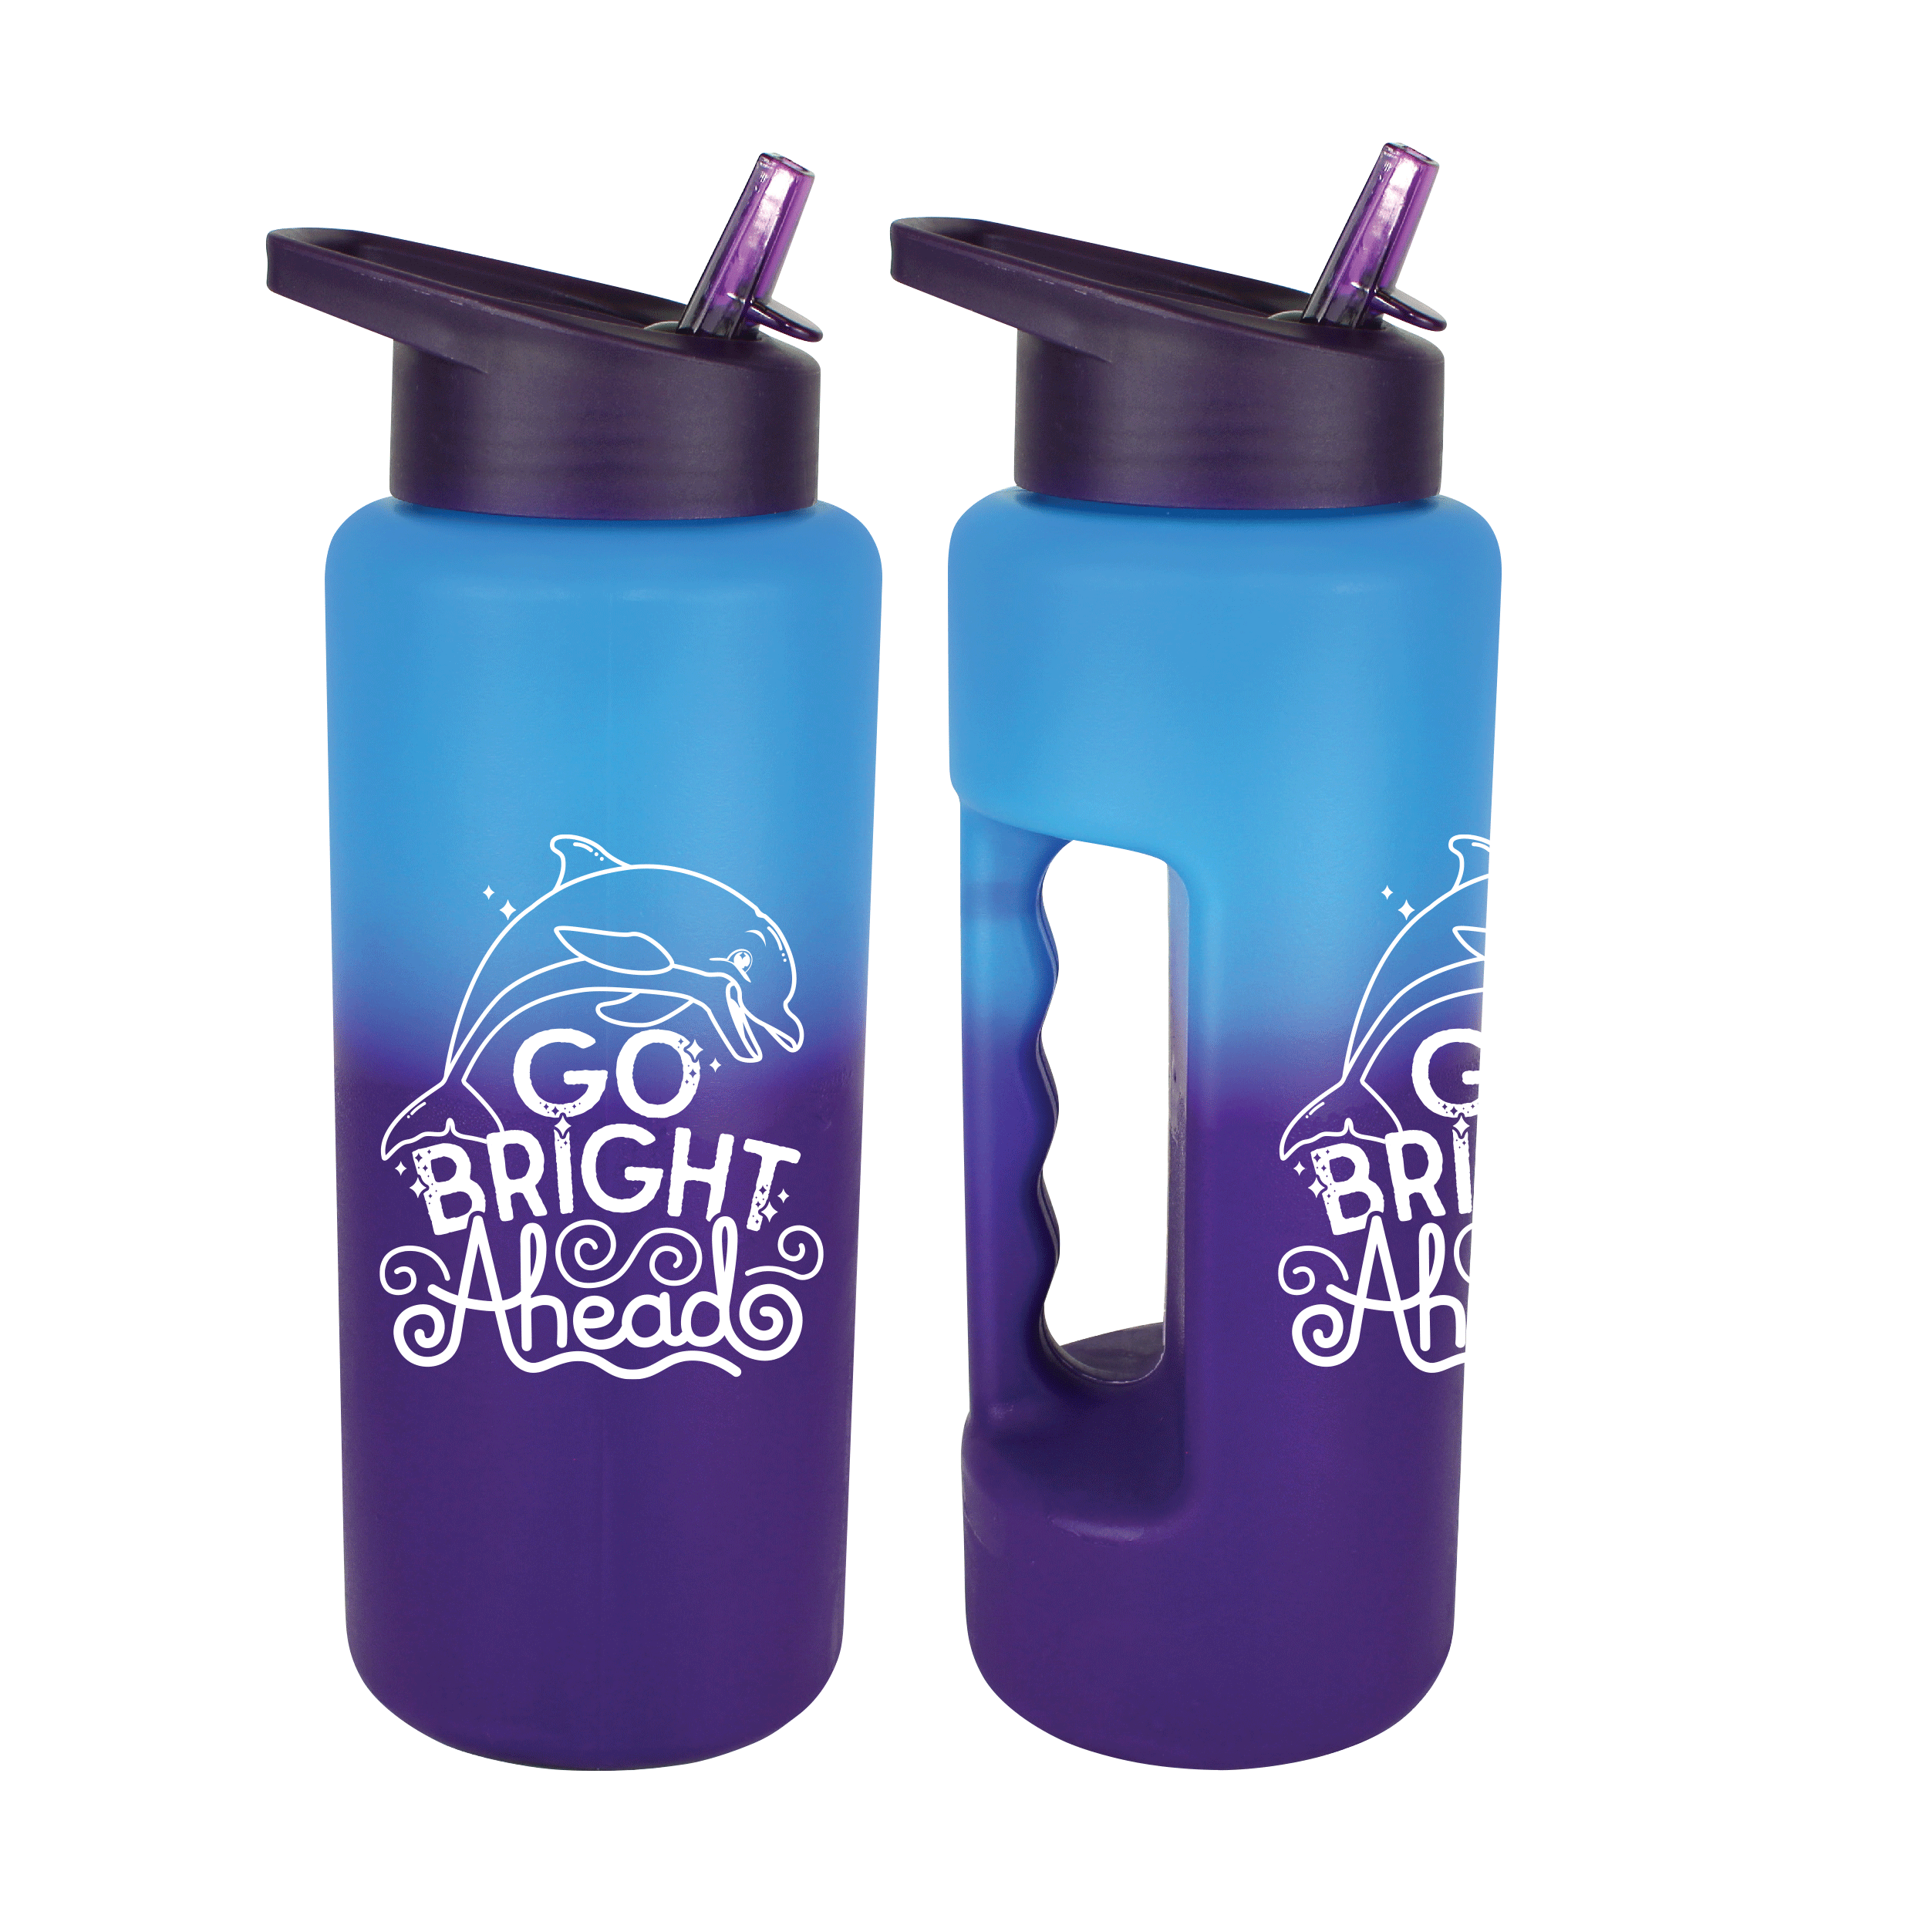
Early Rewards by February 5th
Girl Rewards
Troop Reward
210 packages by Feb. 5, earns the Mood Sports Bottle!
180 packages by Feb. 5, earns a hoodie & Goal Getter Patch!
Average 190 packages by Feb. 5 to earn 2 Leader hoodies

Slide 6
Type here to enter the presentation section name.
Girl Scouts love finding adventure, trying new things, and HAVING FUN!
2023 Cookie Program Recognition Experiences
Troop Experience Reward:
Troops with a PGA of 300+ Packages
Wacky Walls Scavenger Hunt
Diesel Engine Train at the Arcade & Attica Railroad
Darien Lake

Slide 7
2023
Girl Scout Convention
Orlando, Florida
Girls who choose the Girl Scout Convention reward level will waive all main recognitions
Recognitions levels are cumulative
Reward levels start at 1000, 1500, 2000, 2500, & 3500 packages of cookies
Girls can goal set and build a Convention Package customized to them!
Notes:
Megan & Laura

Slide 8
Key Points
Early Recognitions by February 5th
Three troop Experience options for troops reaching 300 PGA by April 2
3500+ pkg travel level
Girl Convention Recognition plan

Slide 9
What’s New for 2023

Slide 10
NEW for 2023!
The first ever online-only Girl Scout cookie*
Thin, crispy cookies infused with raspberry flavor, dipped in chocolaty coating
MADE WITH VEGAN INGREDIENTS
*Available online only to be direct shipped to consumers
Notes:
We’ll be promoting on Social Media along with GSUSA
And, we’ll provide fun posts for girls in our social media kit
Simplicity
Less physical handling
Shipped directly to consumers

Slide 11
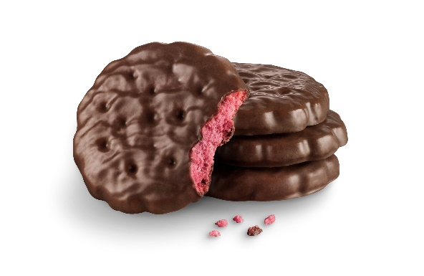
Raspberry Rally
In collaboration with GSUSA, a brand new online shipped only cookie is available for the 2023 cookie season
1
1
2
2
3
Simplicity
Less physical handling
Shipped directly to consumers
Learning for Girls
Enables girls to build selling skills, pitching to her customers in person, and online, where shoppers are buying across channels for convenience
Building Consumer Excitement & Growth
Product concept and development grounded in consumer research, with strong scores for Girl Scout Cookie consumers and overall cookie buyers nationwide

Slide 12
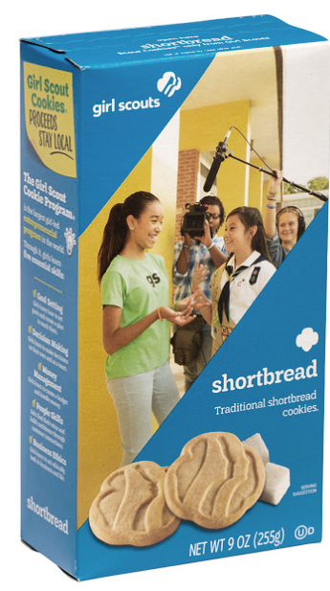
Unified Trefoils name in 2023
Minor package and graphic changes to align with Girl Scout brand standards
Trefoils will be the Troop Sample Cookie for 2023, shipped to SU’s via standard process
Notes:
Current GSUSA-owned names (IP)
Thin Mints, Trefoils, Toast Yay! (ABC’s French Toast-inspired cookie launched in 2021), Adventurefuls, Raspberry Rally

Slide 13
Packaging updates to Caramel deLites and Peanut Butter Patties
Simplifies supply chain
Increases baking flexibility (other ovens)
Saves ~70,000 trees per season
Reduces the carbon footprint from production of the cartons
Optimizes truck loads with better pallet utilization
Notes:
After using this packaging format last season, we are confident that consumer purchases will continue to grow and the highest levels of cookie quality will be maintained. This packaging format is used by 80% of all retail cookies, including every leading brand. The cookie size, weight, and package count will remain the same. The pallet count will increase from 162 to 180 cases, thereby improving shipping efficiency. This package change will happen mid-season for 2023 and ABC will communicate with your Council on anticipated timing for your cookie program.

Slide 14
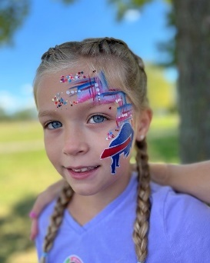
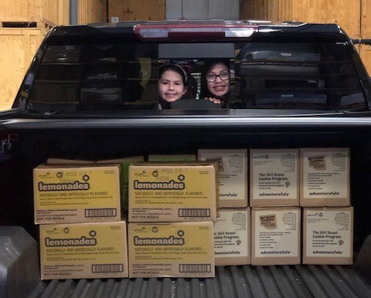
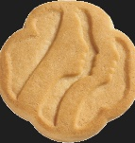
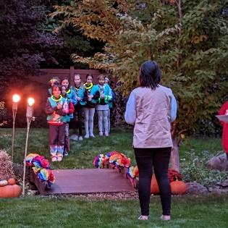
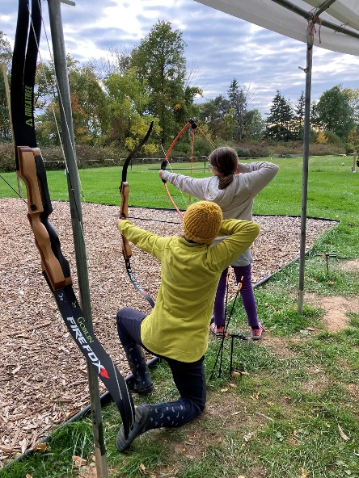
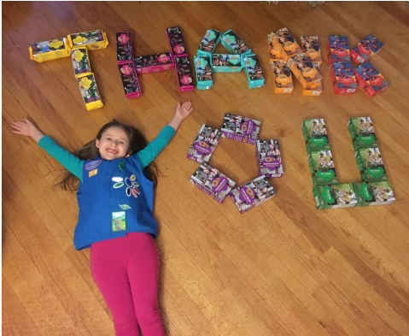
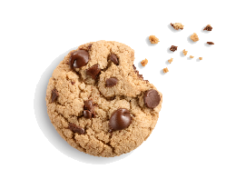
Invest in Girls
2023 Girl Scout Cookies = $6.00/pkg
Girl Scout Troop Proceeds = 20% increase
Notes:
Alison:.
To maintain and expand our high-quality programming and services for girls and adults, the price for cookies has been increased from $5 to $6. The price GSWNY pays to our baker per package has increased and distribution and storage expenses also have increased tied to supply chain issues such as costs of labor and fuel.
The price increase is necessary to keep pace with ricing costs due to inflation, and ensure GSWNY can continue to fulfill our mission to serve girls and volunteers in all areas of our council, including ensuring proper volunteer training, screening and support.
Cookies help pay for member services and infrastructure which include camp and program property maintenance, forest management, staff, insurance, rent, utilities, information technology, volunteer screening, training and support, website, marketing, and investments in equity, including financial aid.
Girl Scout cookies are an Investment in girls
Total: $ 6.00
We are announcing this tonight to you, and we will share later in tonight’s call how we will be communicating to our members and the general public.
Our goal is to get ahead of this so when our girls are ready to sell-our consumer is aware of the price increase to $6.00

Slide 15
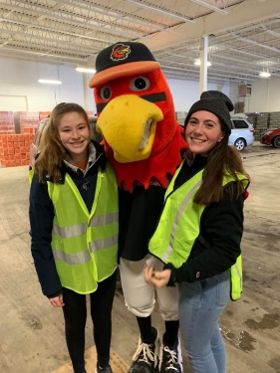
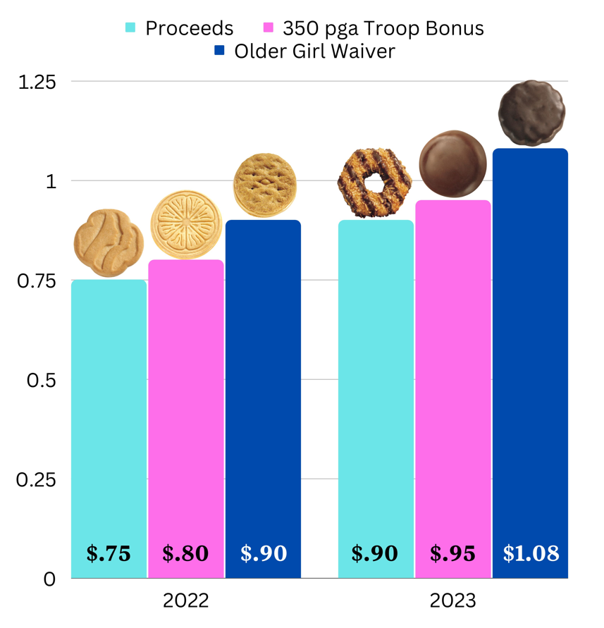
Supporting Troops
Notes:
Alison-.
The rise in inflation will also have an impact on our troops. We realize this and see the need to raise troop proceeds. This will help support our girls and troop activities.
The cookie price will be increasing by 20% and accordingly Troop proceeds will increase 20% from prior year.
The proceeds are on a sliding scale where troops have ability to earn .$90 to $1.08
Base: $.90
Troop who average over a PGA of 350 packages will earn an additional $.05
When all girls in older troops (Cadette, Senior, and Ambassador ) agree-troops can waiver the main reward and earn additional $.13

Slide 16
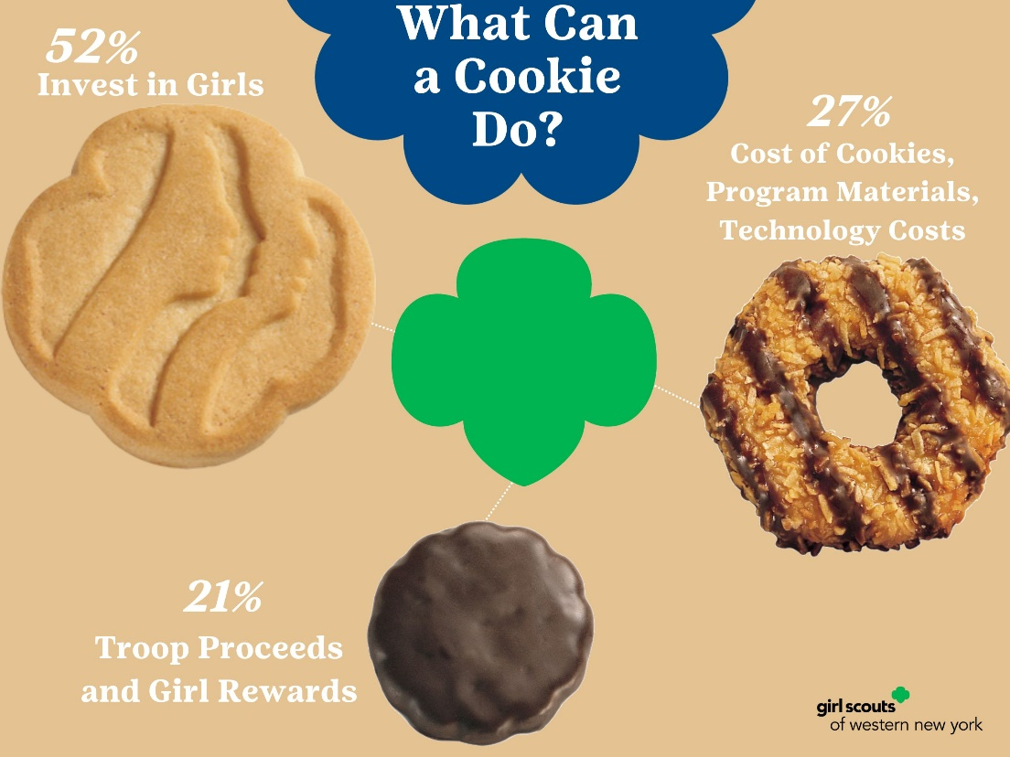
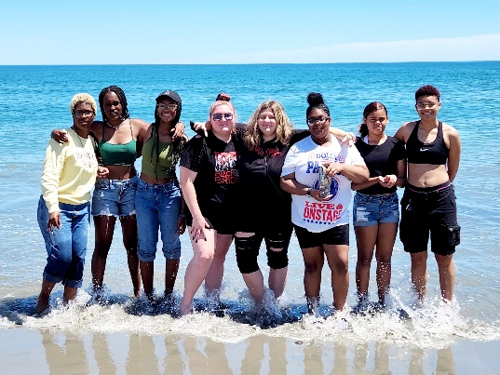
Invest in Girls
Girl Scout Cookies
$6.00/pkg
Notes:
This retail price increase is a good thing, and it should be shared in a positive manner. Statistics show that the price of cookies is not a negative factor in terms of revenue generated through the program; however, how the price increase is communicated will affect sales. Plus, there are so many positives like the fact that the girls and troops will see an increase in the funds they receive that will further aid them in their Girl Scout journey. Our goals are to continue elevating the many positive benefits of the Girl Scout Cookie Program and increasing girl participation in 2023. With your support, we are confident that we can positively address the retail price increase and achieve these goals!

Slide 17
Our net weight and cookie count have not changed in nearly a decade!
Nutritional information can be found at abcsmartCookies.com or abcbakers.com
Cookie Variety | Net Weight | Number of Cookies | Packaging
Thin Mints | 9 oz | 32 | 2 foil sleeves, carton
Caramel deLites | 7 oz | 15 | Foil wrapped tray, carton
Peanut Butter Patties | 6.5 oz | 15 | Foil wrapped tray, carton
Trefoil | 9 oz | 20 | 2 clear sleeves, carton
Lemonades | 8.5 oz | 16 | Single tray, overwrap
Peanut Butter Sandwich | 8 oz | 20 | 2 cello sleeves, carton
Toast-yay! | 8.5 oz | 16 | Foil wrapped tray, overwrap
Adventurefuls | 6.5 oz | 15 | Foil wrapped tray, carton
Notes:
RR will have 32 cookies per package, net weight is 9oz.
First, let’s dive into a package of ABC cookies. I would like to start by noting that the net weight per package and cookie count per package have not changed in almost a decade.
These fun facts are an added value statement when actively selling the cookies in market and can be fun trivia questions for Girl Scouts.
I wonder how many of you on the call today could have confirmed that there were 15 Adventurefuls per package?
Nutritional information can be viewed on the ABC Flickr site, which can be found via a link at the top of the Smart Cookies homepage.
Be sure to visit the “2022 Cookies & Packaging” folder for full details.

Slide 18
2023 Changes to Direct Ship Program
Standard shipping flat rate will increase from $12.50 to $14.99 for every 12 packages
Subsidy minimum package requirements will increase from 6 packages to 9 packages.
Subsidy shipping rate will be $7.49 starting at a 9 package minimum (50% of the standard shipping flat rate of $14.99). A reminder that your Council pays half of the subsidized shipping cost.
An updated gift box design with GSUSA graphics will be available during the 2023 cookie season. ABC will ship the new gift box design once existing gift box inventory runs out.
2023 Direct Ship Shipping Fee Schedule
Notes:
Subsidy minimum package requirements will increase from 6 packages to 9 packages and aligns with GSUSA’s suggested package minimum for Digital Cookie.
Refer to shipping grid on following slide for examples of consumer shipping expenses by package count

Slide 19
Changes to Cookie Cupboards & Planned Order Timeline
Due to new order guidelines set by ABC Bakers, troops must order cookies from a cupboard two weeks prior to pickup. It is recommended troops order their booth cookies with troops initial order
Only troop volunteers may pick up cookies at cupboards
Planned Order By | Cookies Not Guaranteed Until
March 5th | March 9th
March 12th | March 22nd
March 19th | March 29th
Notes:
The Product Program team is working diligently to ensure council cupboard inventory is able to support troop’s cookie needs during the month of March. To ensure council cupboards have enough inventory to fulfill planned orders, this may mean more lead time is needed from a troops placing a planned order to a troop picking it up at a cupboard. Troops can help council by:
Being proactive when scheduling their troop’s cookie booths during the month of March
Keep accurate records of how many cookies were sold at a specific booth location/date and time for future cookie booth needs
Pre-plan. To ensure your troop has enough inventory for upcoming scheduled booths, place a planned in advance so troop’s have enough inventory on hand

Slide 20
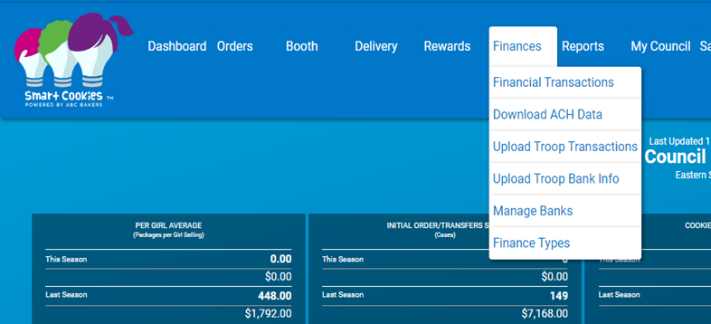
Adding a Girl Financial Transaction
Troops should add all girl payments into Smart Cookies
Notes:
Log into Smart Cookies and select Finances
This screen shows the Girl Transactions tab.
To enter a Girl Transaction, click on Add Girl Transaction
The Add Transaction box will appear as shown in center of screen. Fill in all information needed. Click Save
The bottom screen shows where the transaction was added
Click on the Girl Balance Summary Report link to view the financial report of that Girl

Slide 21
Key Points
Online Exclusive Raspberry Rally
Shortbread is now Trefoil
Cookie price $6 for all varieties
Troop Proceeds increase 20%, base $.90
Planned orders 10 day lead time
GSWNY offers subsidized shipping on 9+ pkgs
IRGs sellers managed by unrelated approved and BGC adult in Smart Cookies

Slide 22
2023 Cookie Program

Slide 23
Important Program Dates
December
January
February
March/ April
December 10:
Online Cookie Program Opens
January 7:
In-person Order Taking begins
January 14:
Council Sponsored Booth Lottery opens
February 4:
Council Sponsored Booth Lottery winners notified
February 5:
Initial Order Taking ends
FCFS booths open
February 6:
Unlimited Booths per troop open
Initial Order and Recognition orders due in Smart Cookies by 11:59pm
Keep Goaling begins
February 7:
SUPPM reviews and confirms troops initial cookie and reward orders
March 1-4:
Delivery
March 5 – April 2:
Direct Sales
March 5, 12,19:
Planned Orders Due
March 22:
Initial Payment Due
April 2:
Program Ends
April 4:
Troop Final Rewards Selections Due
April 6:
Troop Final Payment Due

Slide 24
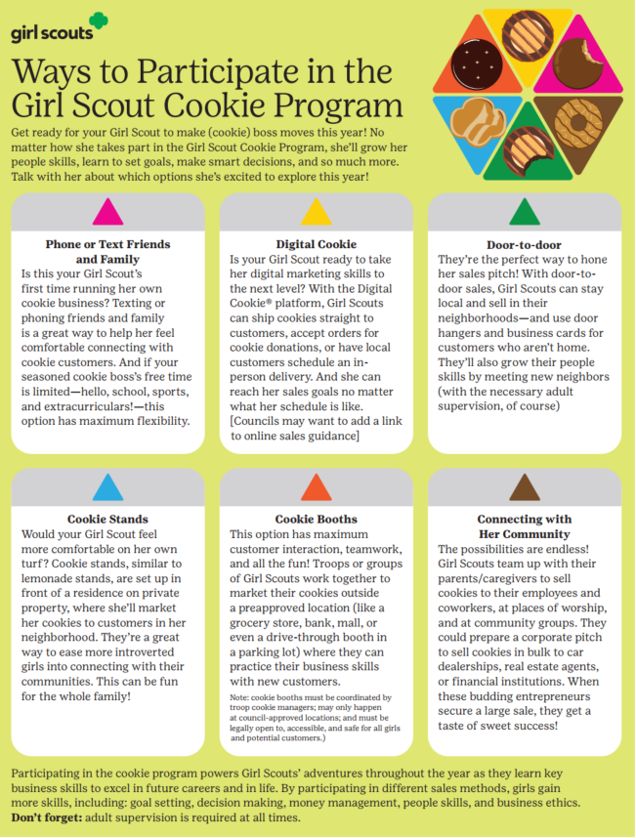
Girl-Led
Girl Scouts take the lead in their budget, plans and marketing techniques
Cooperative Learning
Girl Scouts work together to set their goals, decide how to use their troop funds as a team and overcome hurdles along the way
Learning-by-doing
Girl Scouts get to iterate on their cookie business each year gaining real life, hands on experiences that translate to their future careers
Notes:
Lauren
Provide link in chat to document
Highlight Girl Led, Cooperative Learning and Learning by doing.

Slide 25
5 Skills…The Girl Scout Cookie Program is more than selling cookies…
Notes:
The Five Essential Skills
The Cookie Sale supports learning in a fun environment. Girls learn by doing. The Girl Leadership Experience invites girls to make decisions around the Cookie Sale! Troops and girls set goals – both sales and learning goals. They practice business ethics by following the sale guidelines and selling dates. Money management takes the lead when girls make change or budget their cookie money to support troop activities. And we all know that girls practice and develop people skills as they interact with each other and their customers!
Let’s Review the 5 Skills
Goal Setting: At the start of the sale, girls will set a goal. And it’s not just about how many boxes of cookies she sells. Her goals should also be based on things she’ll learn, experiences she’ll have, and what she’ll be able to accomplish once she reaches her sales target.
Business Ethics: Throughout the sale, she’ll be making decisions, both with the group and as an individual. What will they do with the funds they generate? Where would be the best place for a booth sale? You’re here to help her sharpen her skills for making good choices.
Money Management: For many girls, this is the first time they’re responsible for handling money. Through the sale, they’ll learn all about accountability and the importance of accuracy and safety.
People Skills: The Cookie Sale is a great way to encourage positive interaction with people. You’ll be amazed at how much confidence can be built along the way.
Decision Making: Girls will learn that strong values should lead any business — including theirs. Good thing they have you as a role model.

Slide 26
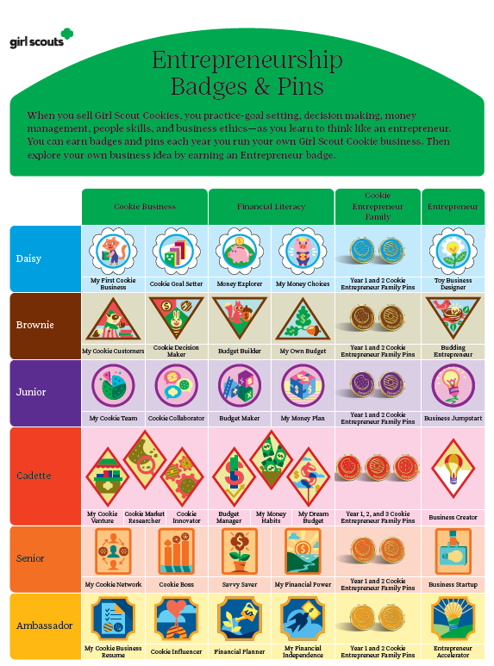
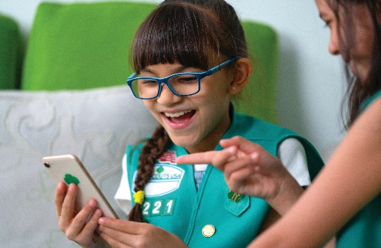
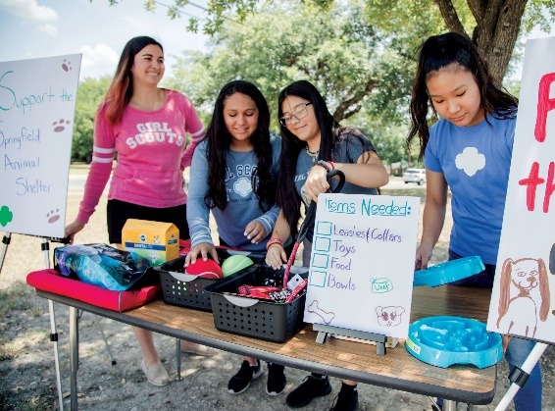
Notes:
New version of this available? Old trefoil servicemark

Slide 27
Cookie Program Engagement
Buy 5+
Goal Chart
Secret Shopper
Keep Goaling
The 2023 Goal Chart is located at www.abcsmartcookies.com/resources
Notes:
What programs are we doing?

Slide 28
Cookie Share
Gives consumers an option to support Girl Scouts without taking possession of cookies
Helps girls think creatively in order to give back to their communities
Helps girls reach goals
Council handles the distribution of virtual Share orders
Available through online sales
Share cookies are donated to local military, hometown heroes and other organizations.
Share cookies purchased during Keep Goaling and Direct Sales should be donated directly by the troop to an organization of their choice
Share patch available at GSWNY shops

Slide 29
Key Points
Important dates:
Online program begins December 10th
In-person order taking begins January 7th
Initial order due February 5th
Delivery March 1-4th
Direct Sales begin March 5th
Resources to engage girls and help them reach their goals
Multiple ways to participate allows girls to customize their entrepreneurship experience
Cookie Share is a great way to give back to your community

Slide 30
Smart Cookies

Slide 31
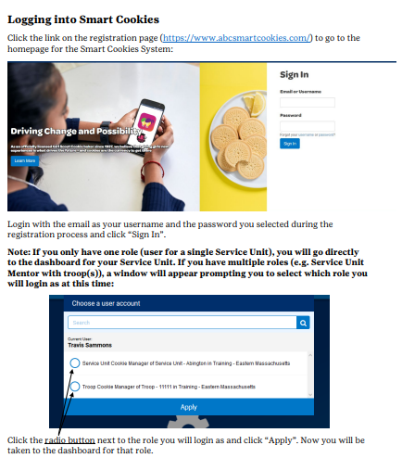
Notes:
Anne

Slide 32
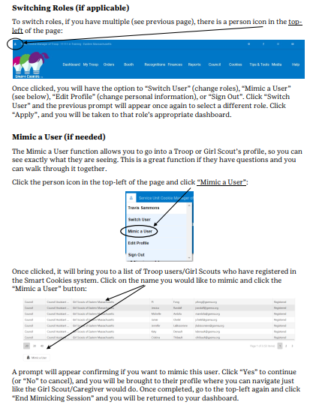
Notes:
Anne

Slide 34
Notes:
2nd link

Slide 36
Notes:
New slide from power hour
This supports orders outside of local delivery area. Customer pays shipping.

Slide 37
Notes:
There are two links, the first is the Troop Ship link.

Slide 39
Adding a Girl Financial Transaction
Troops should add all girl payments into Smart Cookies
Notes:
Log into Smart Cookies and select Finances
This screen shows the Girl Transactions tab.
To enter a Girl Transaction, click on Add Girl Transaction
The Add Transaction box will appear as shown in center of screen. Fill in all information needed. Click Save
The bottom screen shows where the transaction was added
Click on the Girl Balance Summary Report link to view the financial report of that Girl

Slide 40
Cookie Share Sales in Smart Cookies Managed by Troop User
Girls Sell Cookie Share
Girls Report Sales to Troop Volunteer
Orders are Created by Troop Volunteer
What are Troops’ Responsibilities?
If a girl sells “Cookie Share” to a customer – it is considered a “variety” in the Smart Cookies System and must be accounted for – even if pre-paid.
Troop enters on the initial order
If a girl sells cookie share door-to-door during direct sales she collects the money, reports the sale to the troop volunteer – the volunteer then enters the order using Orders>Virtual Cookie Share.
If a troop sells Cookie Share at a booth, it is entered in the booth divider and is divided at the time the sales are allocated to girls.
23%
+200%
+139%
Notes:
Anne
This seemed to be a confusing issue for many troops last year with the addition of the pre-payment of cookie share last year. The best way to look at this is to remember that in Smart Cookies, cookie share is viewed as a “variety” or “product”. So it is handled the same way as any of the other varieties. It must be ordered for the girl to get credit – whether it is pre-paid or not for girl delivery and at booth sales. If a girl sells cookie share – she needs to report that sale to her troop volunteer so the sale can be recorded in Smart Cookies. The troop volunteer can also see it on the girl manage order report if they mimic a girl or on the mobile and e-card summary report if they girl used an e-card, took the order via a mobile device or social media. Creating a cookie share order for a girl assigns financial responsibility to the girl. It does not create double responsibility. For instance, if Jane’s grandmother orders 6 boxes of cookie share from an e-card that Jane sent her and pays by credit card, Jane will have a $30 credit on her account as a payment. The troop has not transferred any cookies to Jane at the start of the sale. The troop transfers 50 packages of cookies to Jane and she sells them to her customers and turns in $150 in cash and checks and has $100 in credit card payments credited to her account. At the end of the sale, she has a $30 credit still on her account. The troop realizes they never created a cookie share order for the 6 boxes of cookies for Jane. If they had not created the order, Jane would have only had credit for incentives for 50 boxes of cookies instead of 56 and would have missed the next incentive level and would have an overpayment.
If the troop sells a cookie share “package” at a booth sale, they should record that sale in the Smart Booth divider and the order will be created at the time they create the girl transfers. This is the ONLY time a cookie share order is created other than direct ship. But remember, the order is created only because the troop reported the sale as part of the Booth Divider. If they do not report the sale on the Booth divider – creating a virtual cookie share order would assign financial responsibility to a girl.

Slide 41
Booth Sales in Smart Cookies Managed by Troop User
Approve any orders from Troop Cookie Link
Secure Needed Inventory
Allocate Cookies Sold at Booth Sale to Girls via Booth Divider
What are Troops’ Responsibilities?
Booth Sale Orders from Troop Cookie Link must be approved by Troop volunteer
Troop Volunteer secures Inventory from cupboard as needed to fill orders or supply traditional booth
Troop Volunteer allocates cookies sold from troop cookie link to participating girls via Booth Divider. (Only option)
Troop Volunteer should use Booth Divider to allocate cookies to girls for booth sales but can choose to use transfer process.
23%
+200%
+139%
Notes:
Anne
Sales generated from the Troop Cookie Link will be tracked in SC but troop must approve the order, secure the inventory, and allocate the cookies to the girls. For traditional booths, troops must track the sales and enter them into the Smart Booth Divider and allocate them to girls.
Alternatively, the troop can use the transfer function to transfer booth cookies to girl in order to keep troop inventory accurate and give girls credit for sales while keeping financial responsibility for booth cookies at the troop level.

Slide 42
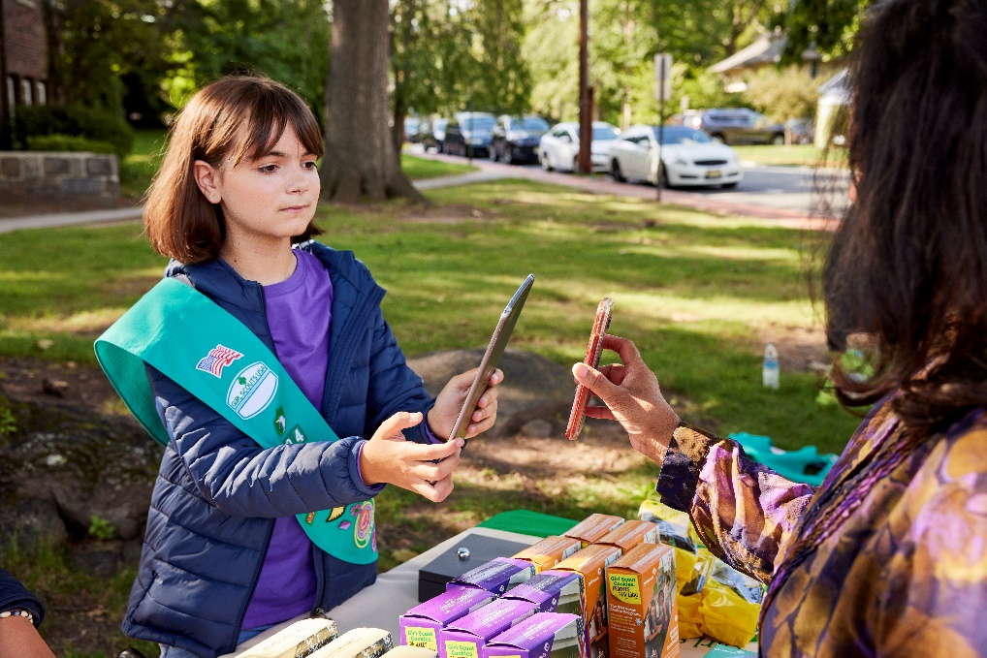
Smart Cookies for Girls
Our Smart Cookies site is a business center so girls can be their own cookie boss!
Girls will receive an email to create their profile and can:
Set cookie goals and monitor their progress
Girls can use their smart phones or tablets to take
Direct Ship orders
Door to Door orders
Track customer orders
View their recognitions earned and personal achievements
Upload and share video ask
Access their own unique social media URL and QR codes

Slide 43
Smart Cookies Registration Email for Girls
Dec. 8: Smart Cookie email sent via Smart Cookies
Dec. 8: Girls gain access to Smart Cookie and can begin adding email addresses
December 10: Online Program opens and girls may send emails
from noreply@abcsmartcookies.com
From noreply@abcsmartcookies.com
Notes:
Follow the links to register and set up your dashboard. (Check your spam folder for link.)
Download the app.
If girls do not get their email, their Troop Leader/SUPPM can resend
Sisters will get individual links, but can use the same email address for registration. Will be able to toggle between two girls dashboards.
Girls will receive their registration email

Slide 45
Parent approval email
Action needed by parent:
Reach out to your TL/TCM weekly to let them know of additional cookies needed to fill your orders
Update Girl Delivery orders through the Manage My Orders tab
Notes:
Anne
Girl Scout Cookie Delivery approval email – Girl Delivery link sale
Parents/caregivers must click the blue URL link in their parent approval email to confirm if they approve the order for delivery.

Slide 46
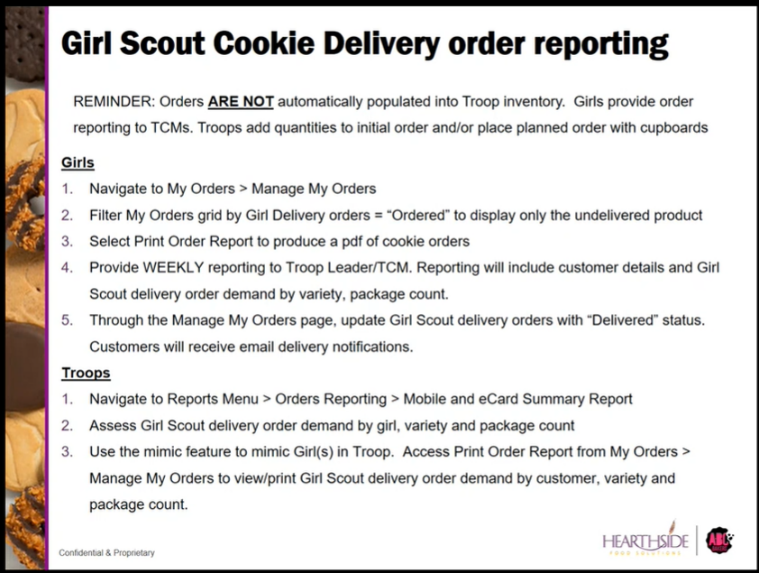

Slide 47
Girl Manage Orders: Cancelation of Girl Delivery Social Media Link Order
Notes:
Anne
From Girl Delivered social media link:
The girl’s manage orders page will update to show the order in “ordered” status, paid “yes” and payment method “credit card”.
Paid status has to be updated to “no” to be able to cancel an order

Slide 48
Key Points
December 8th Smart Cookies launch email goes out to families
Troops and girls can use their smart phones or tablets to take booth orders and accept credit card payments
Parents must approve Girl Delivery social orders, within five days, by clicking the link in the order notification email
Troops can schedule a virtual booth to collect orders for pickup at their physical booth location
All girl payments should be entered in Smart Cookies as a financial transaction for accurate bookkeeping

Slide 49
Direct Sale

Slide 50
Direct/Booth Sales
Two registered adults must be present at all times
Girls must be present to sell cookies
Booth locations should be held at locations girls and families can patronize
Cookies cannot be placed in stores for resale
Cookies should be stored off the ground, out of direct sunlight and other weather elements
We represent Girl Scouts when we are at booths, always leave the space better than we arrived. Take all cardboard and trash with you
Should multiple troops be at the same location or area for a booth, troops should model Girl Scout appropriate behavior as girls watch and model how adults react in conflict situations
If council is contacted by any community partner due to bad booth behavior the troop will lose booth privileges for the remainder of the program
We are guest of these businesses, this means we behave properly and kindly. We are Girl Scouts as such we have a pledge and law we follow. Before your troop attends a booth revisit the law and promise with your girls.
Notes:
Laura
https://www.gswny.org/en/our-council/covid-19-updates.html

Slide 51
Community Partners and Booth Lottery Dates
GSUSA has secured partnerships with Walmart
GSWNY will continue to add booth locations in Smart Cookies, troops should check often to see what is available
Booth Lottery Dates:
Opens Jan. 14th
Lottery winners notified Feb. 4th
FCFS for 1 additional booth per troop Feb. 5th
Unlimited FCFS – Feb 6th
Important reminder: Troops who reserve a booth spot and are unable to attend must cancel the reservation in smart cookies 24 hours prior to the date of the booth
Promising Practice: Troops can secure their own booth locations beyond those secured by GSWNY. Making the ask is a great skill builder for girls.
Notes:
Laura
These are just a few of the businesses that work with gswny to allow cookie booths. Troops should check Smart Cookies often as we enter new booths frequently.
Important reminder: Troops who reserve a booth spot and are unable to attend must cancel the spot in smart cookies to allow another troop to fill it and to remove it from the cookie finder (Is this accurate)

Slide 52
Key Points
Direct Sales are more than traditional cookie booths. Get creative!
Girls must be present with two registered adults to maintain booth safety and all etiquette guidelines followed
Booth Lottery Dates:
Opens Jan. 14
Lottery winners notified Feb 4
FCFS for 1 additional booth per troop Feb 5
Unlimited FCFS – Feb 6
Troops release booths 24 hours in advance if they are unable to attend.

Slide 53
What’s Next?

Slide 54
Build your cookie team!
Troop Leaders
Cookie Manager
Delivery
Reward & Cookie Distribution
Direct Sales
Notes:
Laura
SU and Troops should build a team of volunteers to assist them with cookie program operations. Ask friends or relatives who want to volunteer and who demonstrate strengths in these areas to help you.

Slide 55
Next Steps…
Collect signed permission forms for each girl before distributing cookie materials
Plan the Cookie Program with your Cookie Team
Set troop goals
Schedule family cookie training
Distribute Materials
Review girls in Smart Cookies
Review Safety Check Points
Notes:
Laura

Slide 56
Helpful Resources for Troops and Families
Parent/ Guardian Permission
Troop Volunteer Agreement
Older Girl Reward Waiver
Online Safety Pledge
Online Activity Check Points
Notes:
These forms can be found on the GSWNY website under the Cookies+ tab along with other valuable resources for you and for families.
Parent Guardian Permission form is electronic again this year. Parents will receive a completed copy of the form to their email and should forward to their troop leader. This year we have included a place for the troop leaders email address on the family flyer so that families have the information at their finger tips.
Troop volunteer agreement is also electronic and you should forward a copy to your SUPM when you receive your email copy.
Older girl troops may waive rewards for additional proceeds, each girl should sign the waiver and the troop leader should keep it for their records.
Online Safety pledge and Online Activity check points should be reviewed and signed by every girl who participates online.

Slide 57
Volunteer Program Resources Continued
Resource Location | What Can I Find There?
ABC Bakers Facebook page Lemonades Facebook page | Baker and Lemonade Facebook pages
www.abcsmartcookies.com/cookies | Cookie variety details, nutritional information
https://www.youtube.com/user/ABCCouncils | ABC Smart Cookies technology Training videos for Volunteers, Girls and Caregivers and safe selling tips
https://abcsmartcookies.com/resources/ | Rally Guide, Allergen Flyer, Troop Goal Poster, Cookie Calculator, standard forms

Slide 58
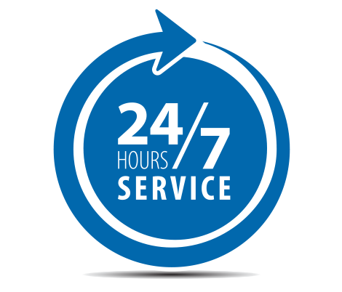
Cookie Program Online Resources
From our art gallery of images to ABC’s YouTube channel with helpful videos designed to navigate Smart Cookies, there are resources available for everyone
 | FLICKR ART GALLERY FOR VOLUNTEEERS Create your own flyers with seasonal clip art https://www.flickr.com/photos/abcbakersvolunteergallery/albums
 | SMART COOKIES TECH SUPPORT IS ALWAYS OPEN Call: 1-800-853-3730 NOTE NEW EMAIL ADDRESS: Email: ABCSmartCookieTech@hearthsidefoods.com
 | ABC SMART COOKIES YOUTUBE CHANNEL Just In Time videos for all user levels of Smart Cookies, designed to help you navigate through every phase of the cookie program https://www.youtube.com/user/ABCCouncils
Notes:
24/7 support for SC related questions for volunteers – 800-853-3730 or abctech@westonfoods.com
Direct ship questions are handled via email and the information is on the receipt to the customer –abcsmartcookiesdirect@westonfoods.com
Cookie product questions – 800-221-1002, the number is on each package of cookies along with the ABC website

Slide 59
2023 Flickr art gallery
https://www.flickr.com/photos/abcbakersvolunteergallery/albums
All theme-related artwork is available in our Flickr gallery with access through Smart Cookies (far right corner of every page ) or by clicking the above link
Borders
Corners
Patterns
Notes:
To access flicker, click the flicker icon in the top left corner to access the volunteer flicker page to be able to download all these fun images

Slide 60
Who Do I Call With Questions?
Your SU Cookie Manager
Need help using the Smart Cookies platform?
Call us at 1-800-853-3730 or email us at ABCSmartCookieTech@hearthsidefoods.com
Questions about our cookies?
Check out our Cookie FAQ's or email us your questions or concerns at ABCSmartCookieBakers@hearthsidefoods.com or 1-800-221-1002
GSWNY Customer Care, 1-888-837-6410 – customercare@gswny.org
Notes:
Laura & Megan
Have questions and not sure who to call?
ABC has a support staff for all your questions regarding products, tech support and direct ship.
If you have questions about dates, cookie booths or anything related to the cookie program, you can contact our Customer Care team at customercare@gswny.org
POLL QUESTION

Slide 61
Thank You!
We make a living by what we get, but we make a life by what we give.”
— Winston Churchill

