Slide 1



2025 FALL PRODUCT PROGRAM FAMILY TRAINING
Notes:
”Welcome to Fall Product Program training for Troops.

Slide 2








Thank you!!
Thank you for empowering the next generation of women entrepreneurs by supporting your Girl Scout and her troop in the product programs!
If you have not completed the Product Program section of your 2025-26 Annual Information Form, please take a moment to complete it now and submit it to your service unit volunteer.
Notes:
PP Team
Thank you for supporting your Girl Scout and her troop! By participating in the Fall Product Program, your Girl Scout will be learning skills they will use throughout their lives. The product programs teach Girl Scouts 5 main skill sets represented by these icons: Business Ethics, Decision Making, Goal Setting, Money Management, and People Skills. As you go through this training, keep an eye out for these symbols indicating how each part of the program aligns with these goals.
If you haven’t‘ already, please take a moment to complete the Product Program section of your annual information permission form.

Slide 3

2025 Fall Program

Slide 4



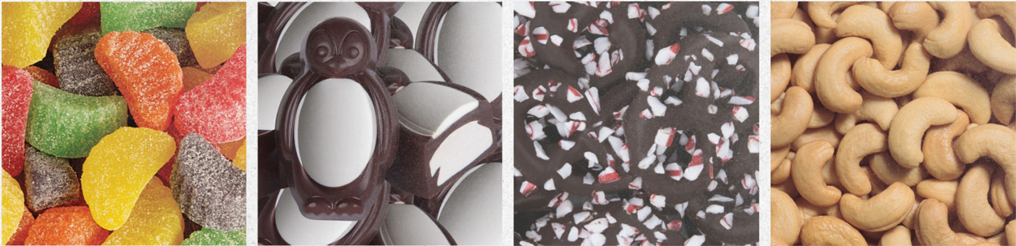



Meet our Vendors
Founded in 1921, Ashdon Farms has been working with Girl Scout Councils since 1996
Ashdon Farms produces nuts and candy for our council as well as many national retailers.
Founded in 2004, M2 has been working with Girl Scout Councils since 2013
M2 offers top magazine subscriptions, easy renewals for your favorite magazines, Tervis mugs and the vendor software for all participating GS councils.
Notes:
Joe/Todd

Slide 5
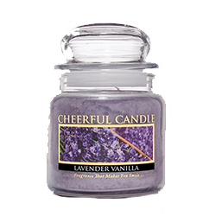

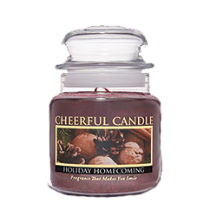
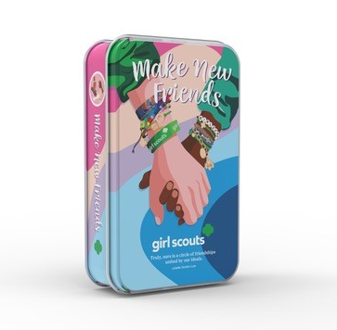
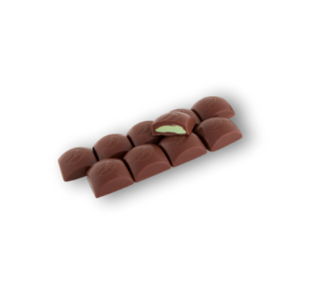
Product Updates
new!
new!
Cherry Almond Clusters
Candles
Balsam Fir
Banana Nut Bread
Cranberry Orange
Gourmet Sugar Cookie
Holiday Homecoming
Juicy Apple
Lavender Vanilla
Orange Cinnamon Clove
new!
2025 Mint Treasure Tin
Notes:
Joe/Todd
Cherry Almond Clusters
Cherries and almonds covered in caramel and milk chocolate.
Packaged in a gift box.
Available on nut order card, online girl delivery, and online for direct shipped ordering.
Girl Scout Make New Friends Tin
(Available on nut order card, online girl delivery, and online for direct shipped ordering)
Milk Chocolate Mint Treasures
Notes:
- Online only Nut & Caramel Trail Mix
- 23 of 30 items are gluten free

Slide 6
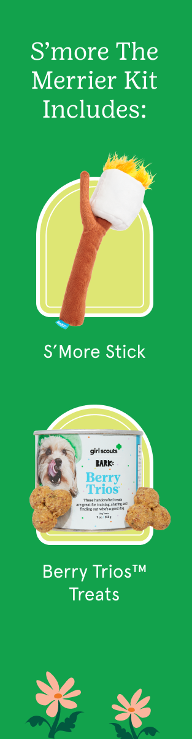
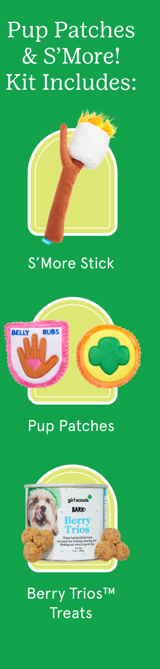

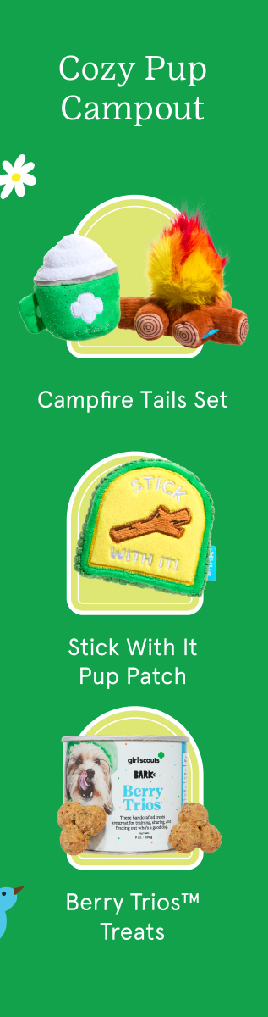

BARK BOXES
new!
new!
new!
Notes:
Joe/Todd

Slide 7







2025
Fall Program Highlights
Notes:
Joe/Todd
This year’s theme is BRAVE. FIERCE. FUN. We’re excited to inspire Girl Scouts to get out there and show the world what they’ve got, and of course have loads of fun while doing it!
For the Fall Program, Girl Scouts have voted in the Grizzly Bear!
Grizzlies are native to forests, river valleys, and mountains in North America and can grow to be 6-8 feet long. They LOVE to play! Cubs often wrestle with each other to build strength and learn important survival skills. And they’re strong swimmers, capable of swimming across large rivers!
You’ll find a fun fact sheet about Grizzlies that troops can share with their Girl Scouts on our Fall Program Resources page on gswny.org. We encourage you to find out more about these amazing animals.

Slide 8
Timeline
Before the Fall Program
PROGRAM PREP
Make sure your Girl Scout has a 2025-26 GSWNY Membership
Complete the Product Program portion of your annual Troop Information Form
Sept 26
PROGRAM START
Launch email sent to Girl Scouts to register. Girl Scouts begin to take orders. SUPPM’s should enter in delivery sit information for products & rewards.
Oct 27
PROGRAM END
Parents enter product/reward orders into M2 and make payment to troop leader.
Nov 15
PRODUCT IS DELIVERYED TO THE SERVICE UNIT PRODUCT PROGRAM MANAGER
Your Troop Volunteer will pick up your product from them and let you know when it is ready for you to pick up.
Business Ethics
Notes:
PP Team
This year’s program will run from September 26th through October 27th. Please take note that any order card orders need to be entered into M2 and any reward options selected no later than October 27th.
Your troop leader will have the next day, the 28th to make any needed changes and finalize the troop’s payment to the council.
Your service unit volunteers will receive delivery of your Girl Delivery Product on November 15th. Troop leaders will pick the product up from them and notify you when it’s ready for pick up and delivery.

Slide 9
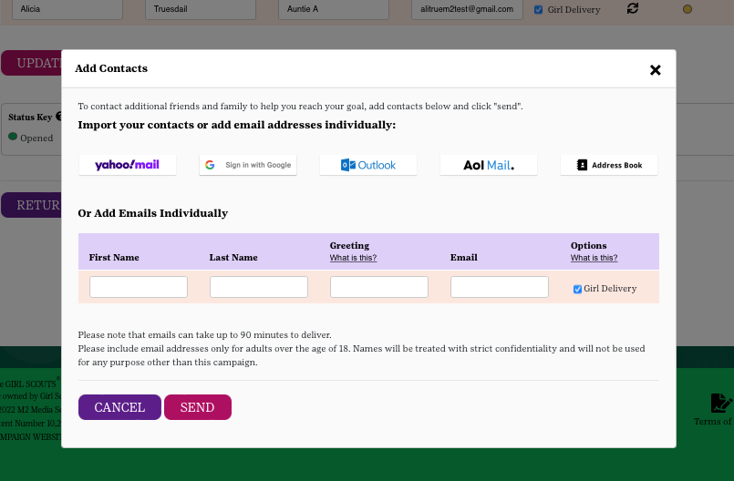
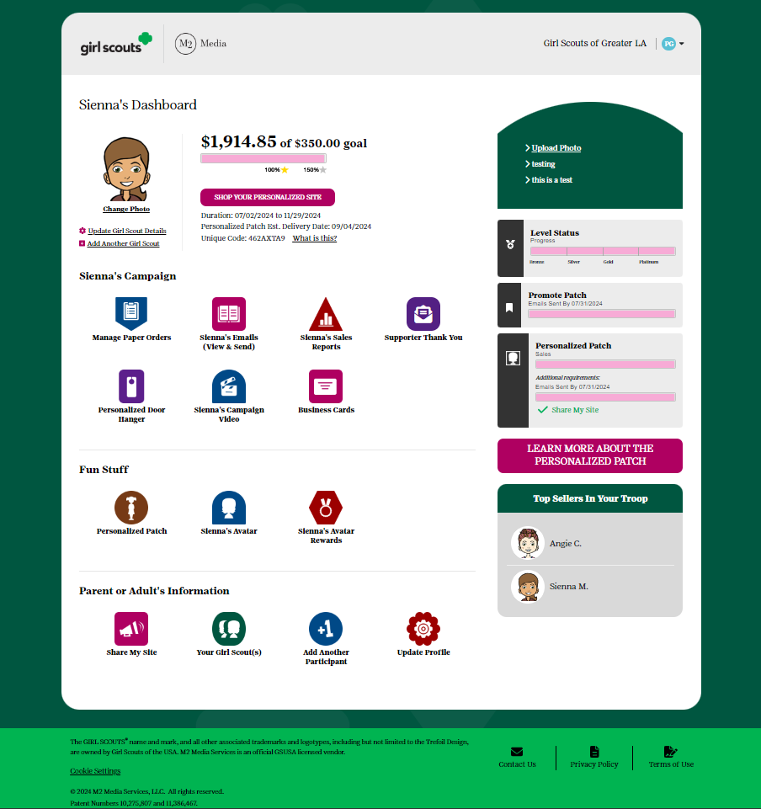

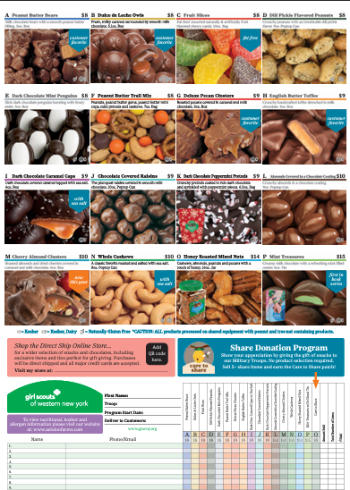
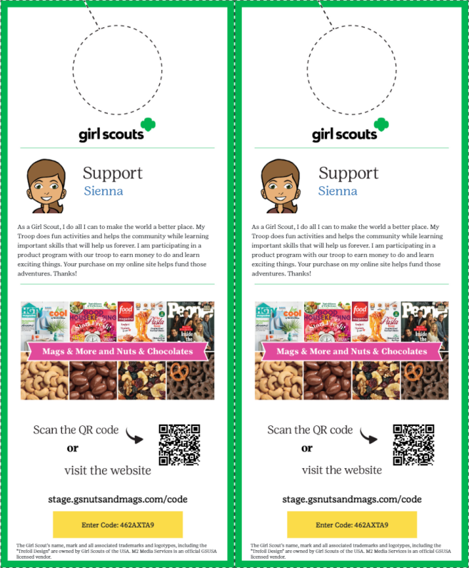
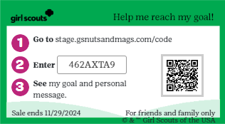
Participation
Online Personalized Site
Create an Avatar & track goals
Send emails
Share your link
Print business cards & door hangers
Take Girl Delivery (varieties on nut card only) or Direct Shipped orders
Nut & Candy Card
Collect payment upfront
Place order via M2 site & pay troop
SUPPM’s distribute product to Troop Leader
Decision Making
Notes:
PP Team
Girl Scouts have the choice to take orders online or in person within the Fall Program. The nut and candy card will include all varieties available for Girl Delivery. Be sure to ask your Troop Fall Program Manager if your troop will be participating in Girl Delivery before offering this option to your customers.
The M2 platform allows Girl Scouts to create an online personalized selling site. From this site they can take Girl Delivery orders for those same nuts & candies, but customers can also order a variety of direct shipped items such as bark boxes, magazines, candles, and more!

Slide 10
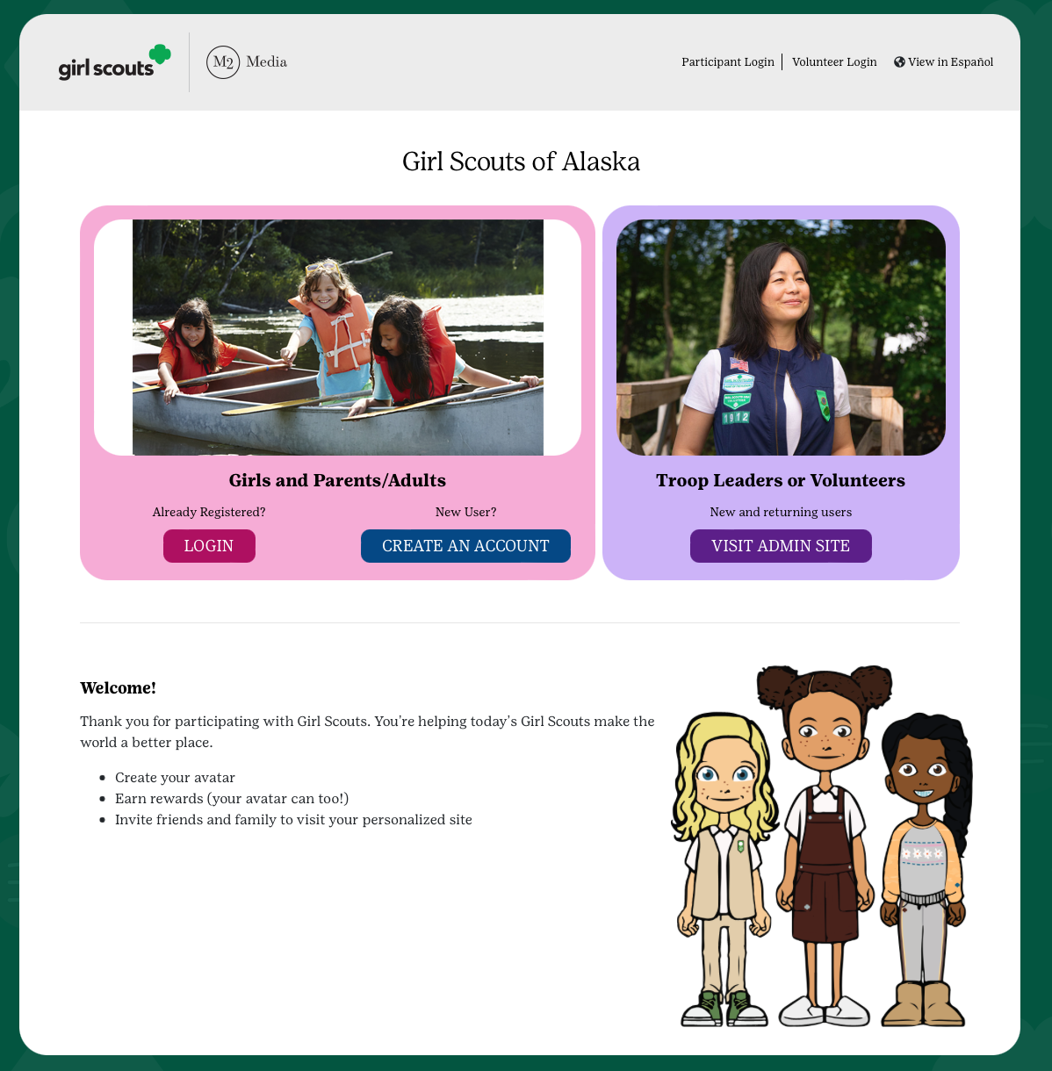
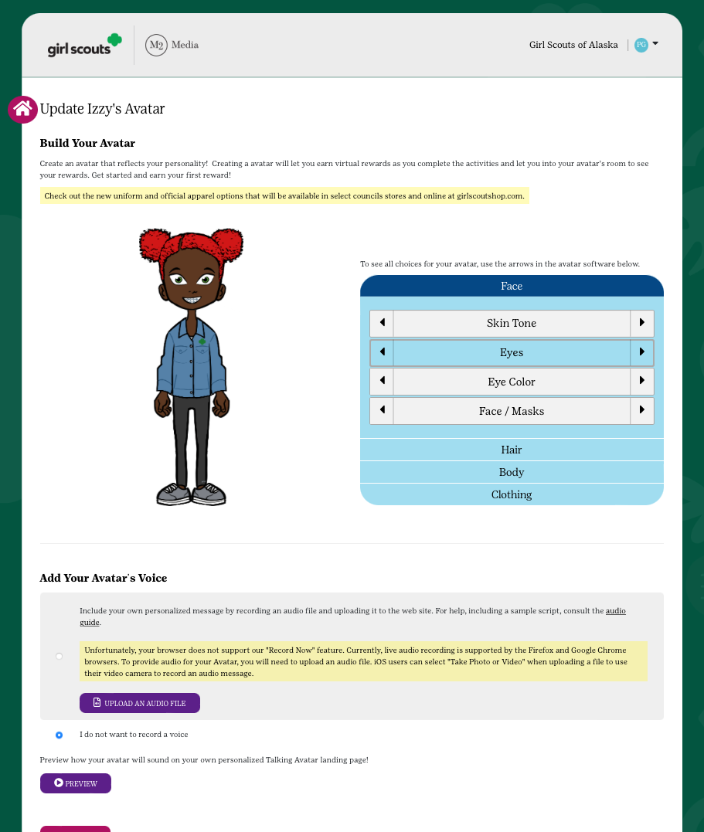
GIRL SCOUT’S PLATFORM SET-UP
Login
Set Your Goals
Build an Avatar
Upload a Video or Picture (optional)
Send Emails
Share your site!
Notes:
You’ll receive a launch email within the first few days of the program’s start date letting you know it’s time to get started.
You can also go directly to the M2 site on the first day of the program and login to your Girl Scout’s account.
Of course, be sure that you have completed the product program participation portion of your information form and connected with your troop leader to let them know your Girl Scout would like to participate.
When you log in, be sure to have your Girl Scout’s troop number available. If you see their troop number or name, complete the setup process and council will verify after complete.
Returning participants can use the same email address and password but need to confirm and complete the setup process.
The parent/adult and Girl Scout validate their council with their zip code next, confirm participant’s troop number, and then answer questions about their Girl Scout goals and what Girl Scouting means to them. Along the way, participants build their virtual avatar likeness with the patented Girl Scout platform. Girl Scouts sharing their goals for the Product Program through an individual or troop video has shown to significantly increase results too.
You will also be prompted to send your first email blast out to customers. You must send at least 1 email to complete setup.

Slide 11
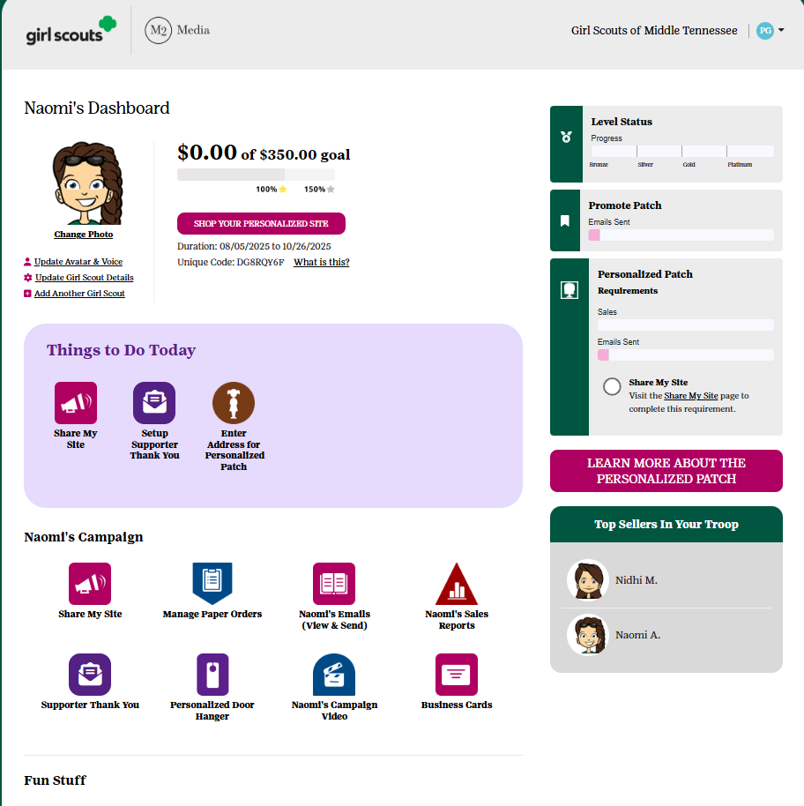
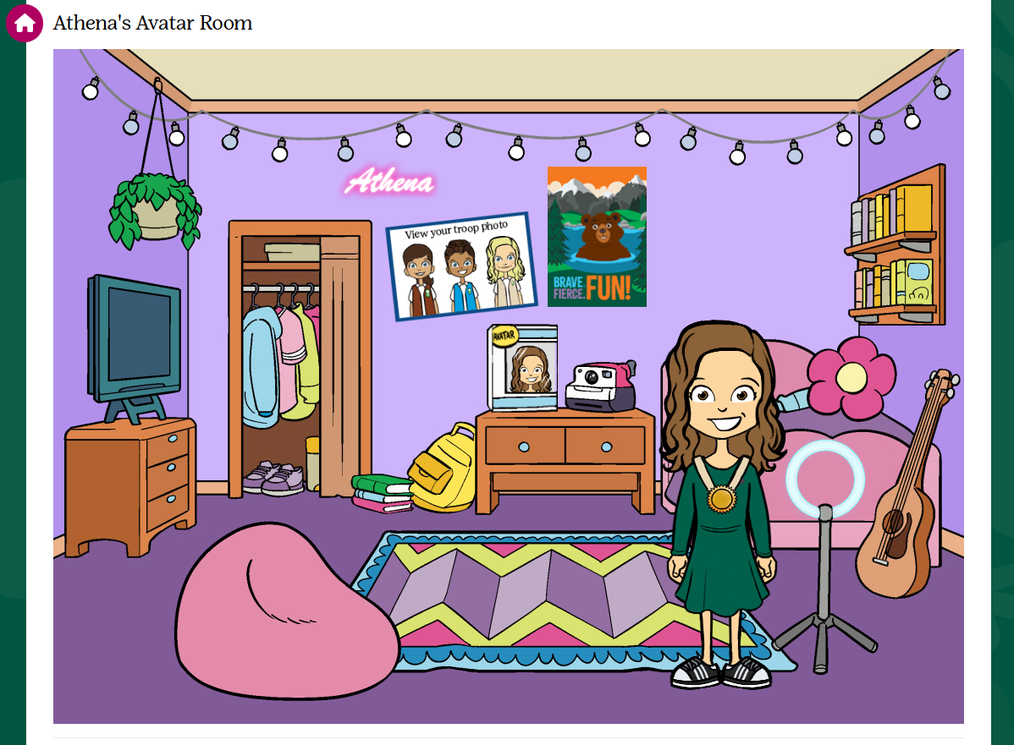
PARTICIPANT’S DASHBOARD
Track your Goal Progress on dashboard and in Avatar room
Send Supporters a Thank You Email
Enter your nut card order
Select rewards
View sales reports
Notes:
“Here is the participant’s online toolkit for managing both online sales and in person participation. Girl Scouts can send additional emails, social media and texts from the participant’s Dashboard. There is also an opportunity to send supporter thank you emails.
Girl Scouts visit their Avatars room 4 times on average during the program to see virtual rewards earned by completing actions and also the troop photo.
The Avatar room & rewards have gotten an upgrade this year. New rewards to unlock in this virtual experience. When clicking on the closet, you will be redirected to update your avatar’s outfit and looks
Parent/Adults and Girl Scouts enter in the totals of each item using the nut order card into the system prior to the end of the program if this is an option offered by council. Nut order card totals will be tabulated and added to all online sales totals in reports. Rewards earned are automatically selected and participants can make selections at levels where there are choices after rewards are earned. There are reports showing sales by category and specific reports highlighting girl delivered items sold online by supporter with contact information for in person nut and chocolate delivery.”

Slide 12
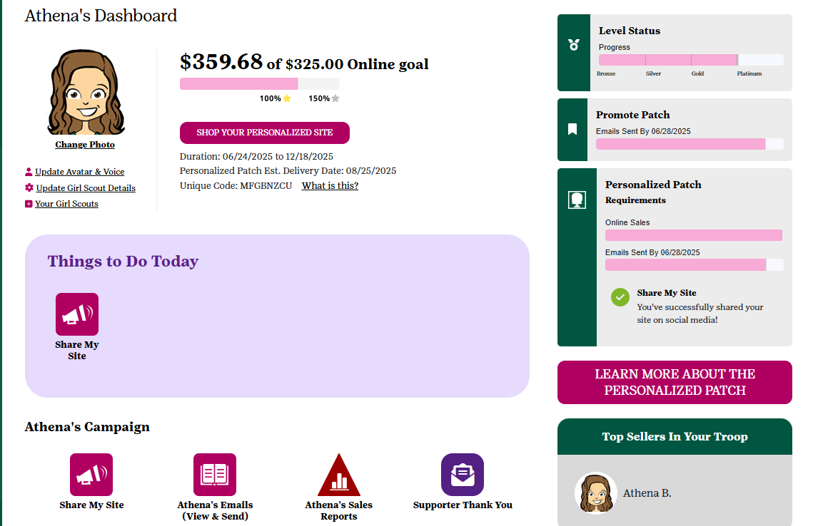
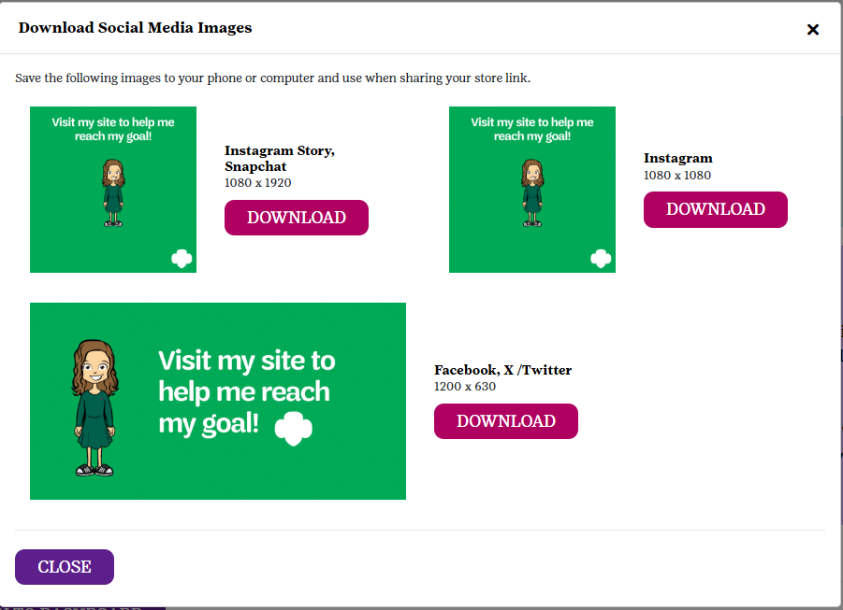
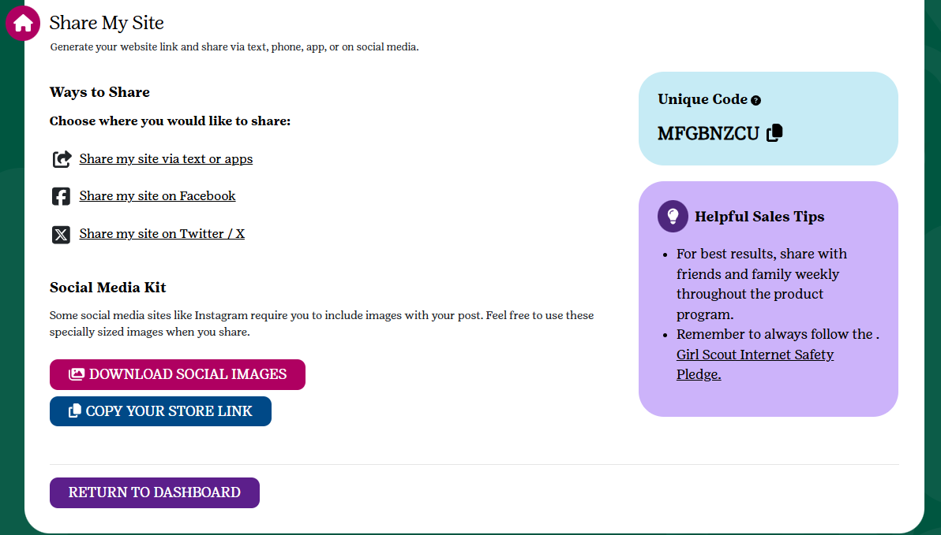
SHARE MY SITE TOOL KIT
Many ways to Share
Download images for additional online marketing
Copy the storefront link to send
Share on Social Media
Text friends & family
new!
Notes:
Recording:” This year, a Share My Site tool kit has been added to help utilize the Share My Site function. Participants can now share their site with ease by copying the storefront link and using a downloadable image to share to their caregiver’s social media. Everything is in one place for easier access to share their site. “

Slide 13


Be safe online!
Review with your Girl Scouts:
Internet Safety Pledge
Safety Activity Checkpoints
Notes:
PP TEAM

Slide 14
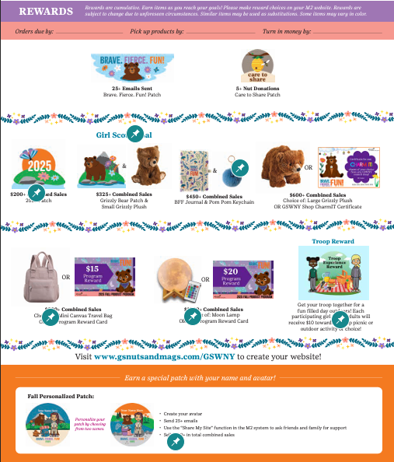

Girl Scout Recognitions
Earn a 26/27 GSUSA Membership
with a Fall and cookie program combined reward!
To earn:
Sell $550 in combined Fall sales AND
300 packages of cookies in the 2026 Girl Scout Cookie Program.
Both goals must be met to qualify.
Goal Setting
Notes:
PP Team
We’ve got some FUN recognitions for the girls this year! Having these physical recognitions helps the Girl Scouts have something tangible to work towards when they are setting their goals.
Recognitions are cumulative, so the more the Girl Scout sells the more she earns!
Girl Scouts who sell $550 or more will also have the opportunity to earn their 2026-27 GSUSA Membership! This reward is a combined reward, meaning participation and reaching the assigned goal in both programs is required to qualify for the membership.

Slide 15








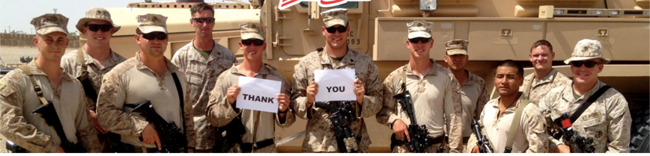
Girl Scout Patches
$200+ Combined Sales
GIRL SCOUT GOAL!
$325+ Combined Sales
CARE TO SHARE
Girl Scouts ask their customers to purchase “Care to Share” packages to support Operation Gratitude!
Orders can be placed via their order card, online girl delivered or direct ship channels. Products are distributed by council and are not delivered to troops/girls.
Troops earn proceeds and girls who sell 5+
Care to Share items earn a special patch
and credit towards other rewards
25+
Emails Sent
Fall Personalized Patch
5+ Care to Share Packages Sold
Create your Avatar
Send 25+ emails
Use the “Share My Site” function from your M2 dashboard to ask friends & family for support
Sell $400+ in total combined sales
People Skills
Notes:
PP Team
Within the recognition flyer you’ll find this year’s themed patches. Back again is a Girl Scout favorite, the Fall Personalized Patch. This patch can be earned by a girl scout: creating their Avatar in M2, sending 25+ emails, Sharing their site, and selling $400+ in combined sales. The patch features their avatar and name!
We also have our Care to Share program, which offers customers the opportunity to give back to the community. Customers purchase a Care to Share package of nuts and candies at $8. The Girl Scout gets credit for the sale and our council donates the package to local military personnel. This is a great way for Girl Scouts to connect with their community and practice their communication skills with customers.
Girl Scouts who sell 5+ care to share get the patch!

Slide 16

Troop Reward & Proceeds
Troop Proceed Plans
$1.15 for every nut and candy item
$3.25 for every magazine, Bark Box,
  personalized gifts, candles,
  and Tervis Tumblers
Older Level Reward Waiver
C/S/A level only
$1.40 for nut and candy items
$3.75 for magazine, Bark Box,
personalized gifts, candles,
and Tervis Tumblers
Money Management & Budgeting
Notes:
PP Team
Troops who participate in the Fall Program are also eligible for troop proceeds and can earn a Troop Reward!
Consider setting a troop goal with your Girl Scouts. This is a great time to talk budgeting and what they want to do within the MY26 year.
Older level troops may waive their recognitions in exchange for more proceeds. They must complete a waiver form which includes signatures from all members of the troop to do so. The troop leader can then adjust their recognition plan in M2.
There is also a great reward lined up for troops who hit a $400 per girl selling average by October 27th. Troops who reach this goal will earn $10 per participating girl plus up to 2 adults. They can use these funds for an outdoor adventure of their choice!

Slide 17
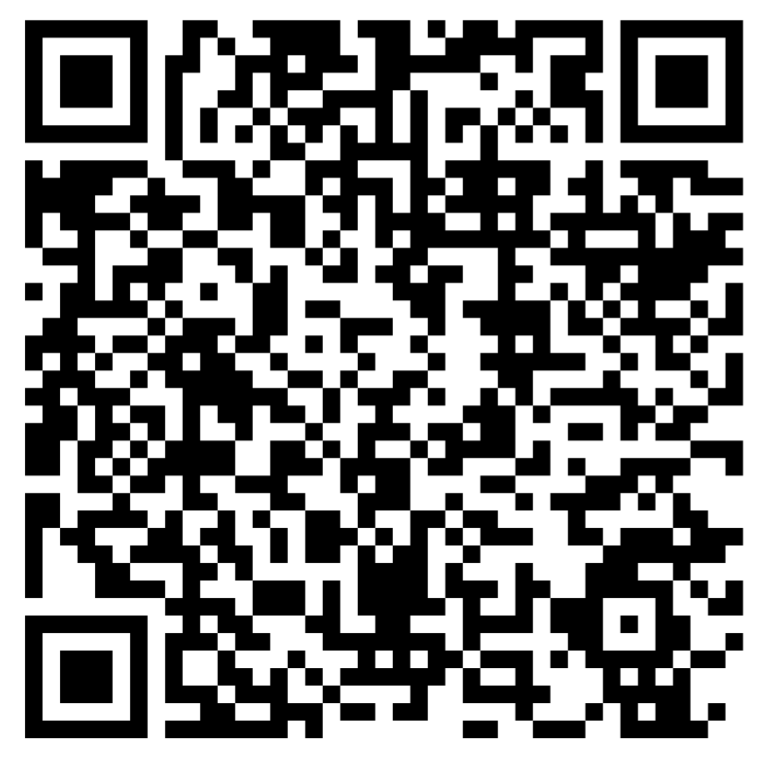
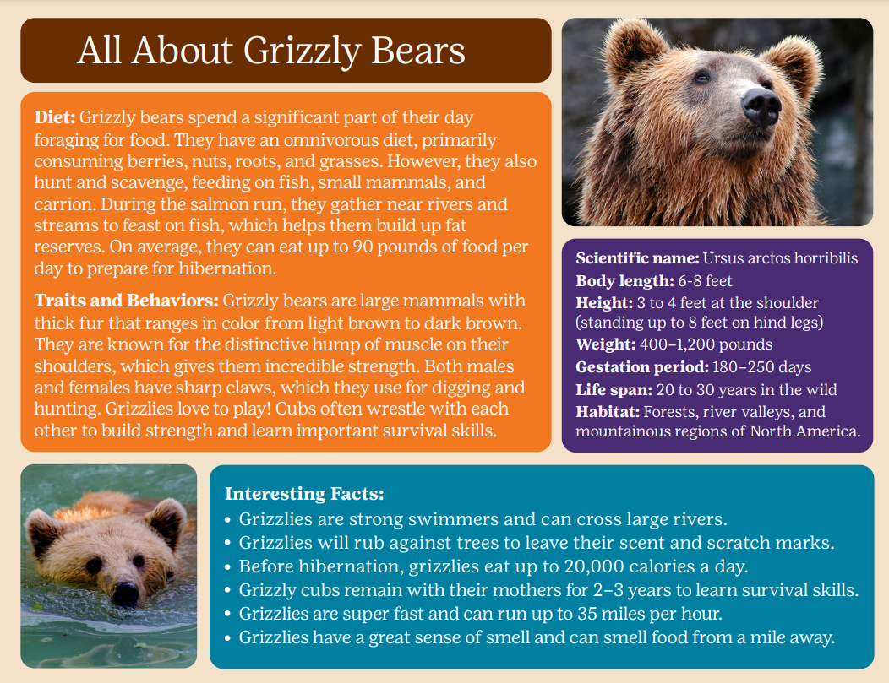
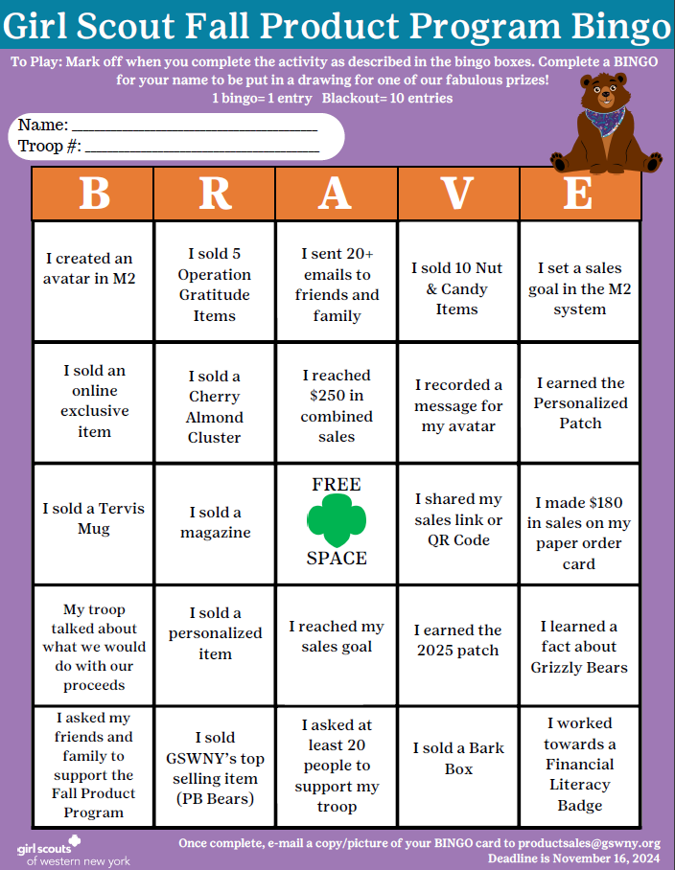
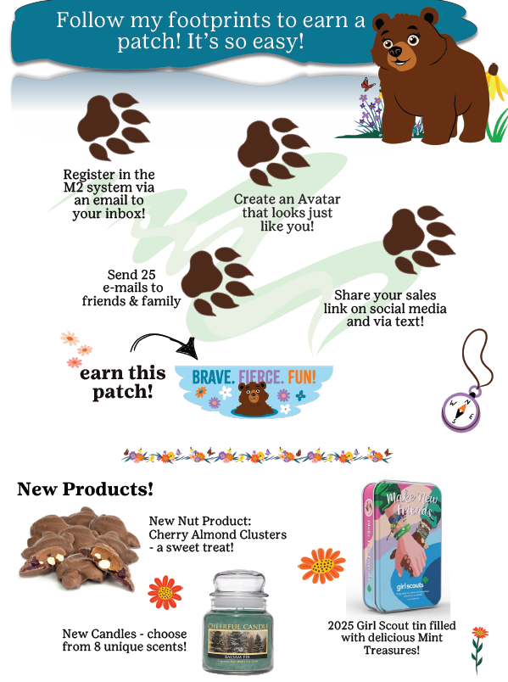

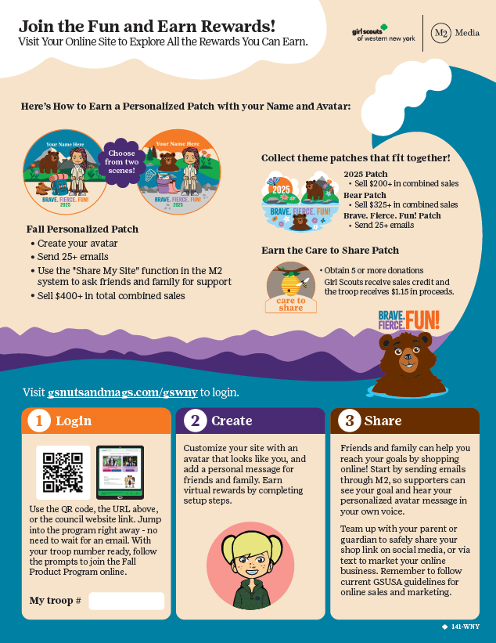

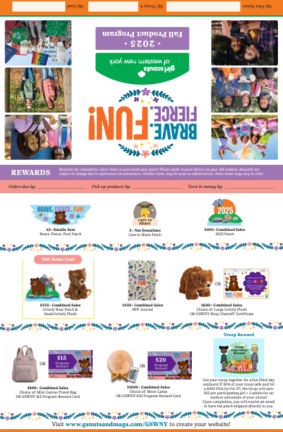
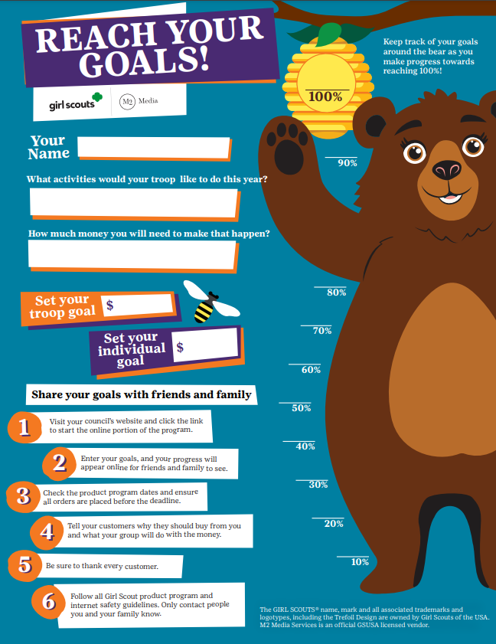

Scan here to view Online Resources as well as digital versions of your printed materials on GSWNY.org
Resources
Online
Printed Materials
Family Guide
M2 Getting Started Flyer
Order Card & Recognition Flyer
Notes:
Joe or Todd
After this training, take a moment and visit the Fall Resources page on gswny.org. You’ll find a TON of digital resources for this program. There are activities, flyers on getting started and council promos such as the BINGO board, any form you will need, and MOST OF ALL links to the M2 video tutorials.
M2 has videos that guide you through pretty much anything you need to do on the site. And they have another set just for caregivers.
Make sure your families know about this resource page!
And if you can’t find what you’re looking for on the page, reach out to your SUPPM for support.

Slide 18

Make sure you are opted-IN to receive emails from GSWNY!
Check your inbox every Saturday for our Fall Product Program Newsletter.
Here we include important program updates, promotions, and instructions for things like order placing and final payments.
If you need assistance, contact customercare@gswny.org

Slide 19


Slide 20

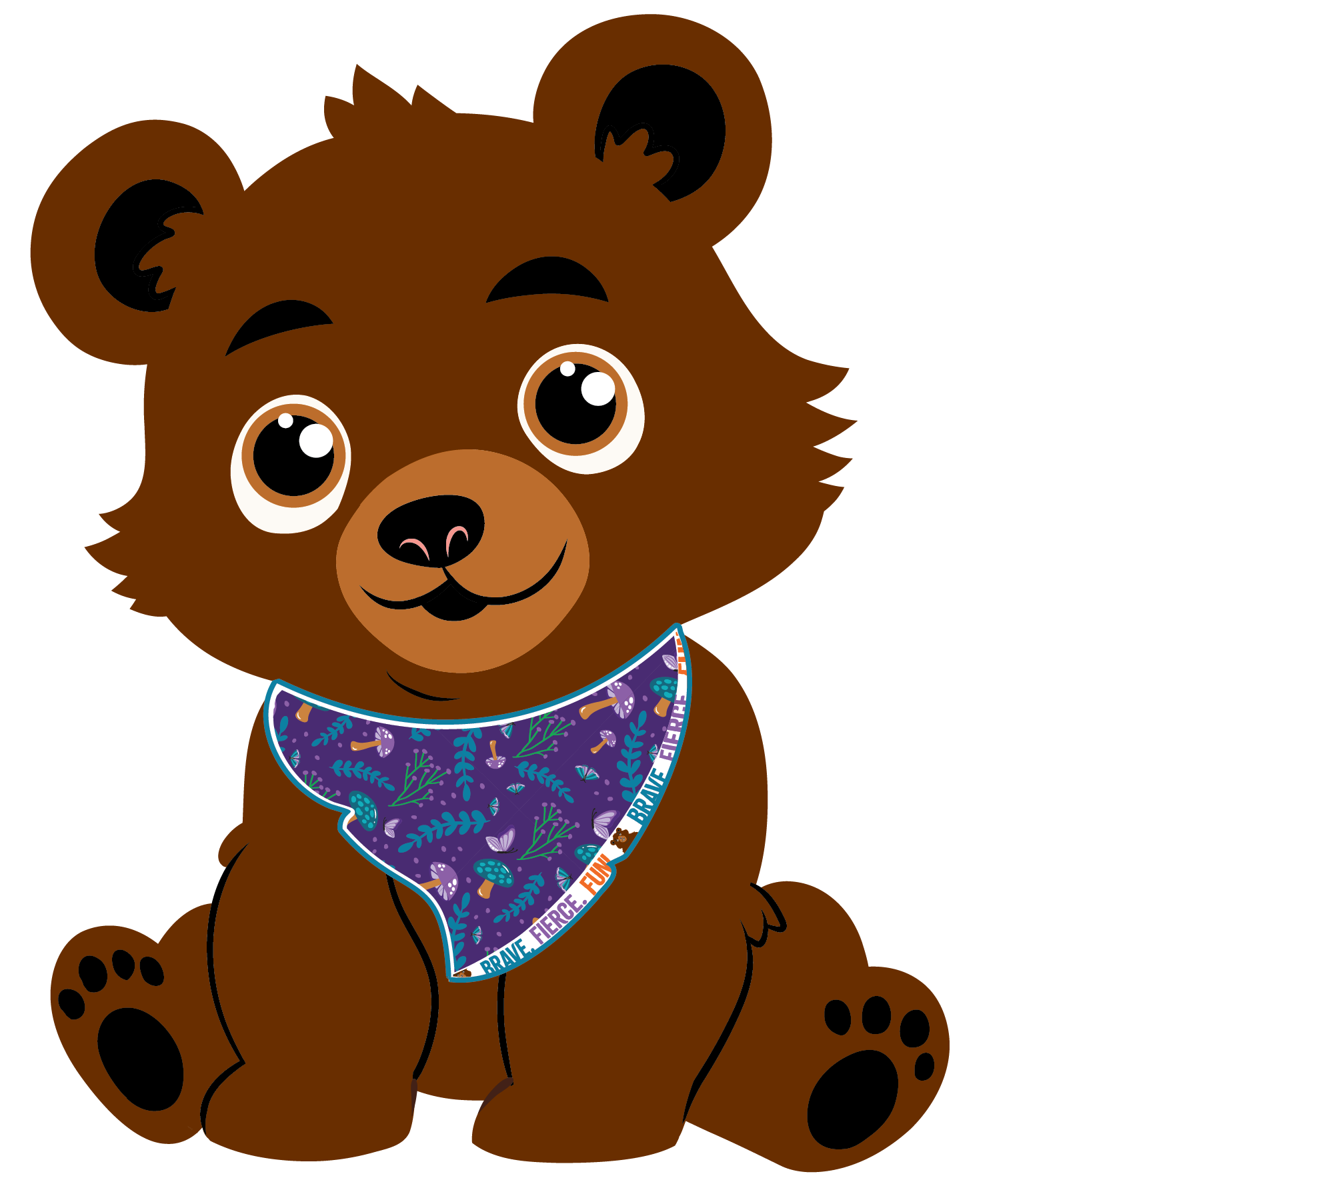
End of Program

Slide 21
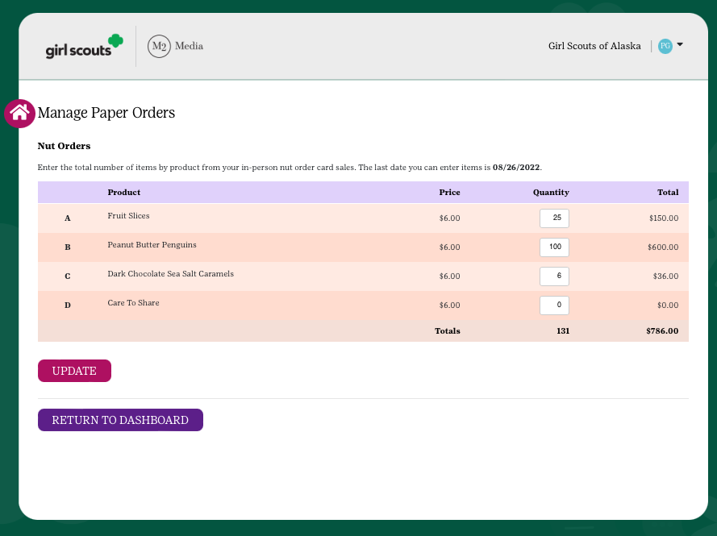
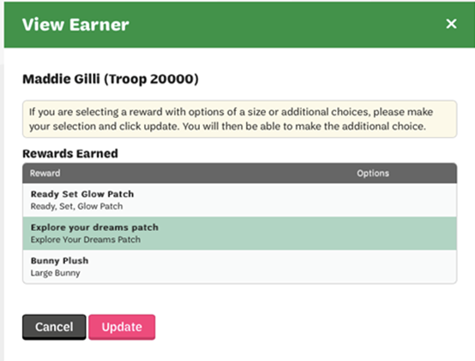
ENTERING ORDER CARD AND REWARD ITEMS
Parents/guardians enter the total of each item from their nut order card into the M2OS system.
These nut card totals will be added to the girls online sales. Online orders and payments are automatically credited in M2OS (including Girl Delivered)
Make reward selections where needed
$
Notes:
When the program concludes on October 29th, you’ll want to make sure that you enter your order card items into M2 so they can be included in your troop’s product order.
Anything ordered online does not need to entered into M2, this is where items on the order card only are entered.
You’ll also want to confirm that no recognition choices need to be made.

Slide 22
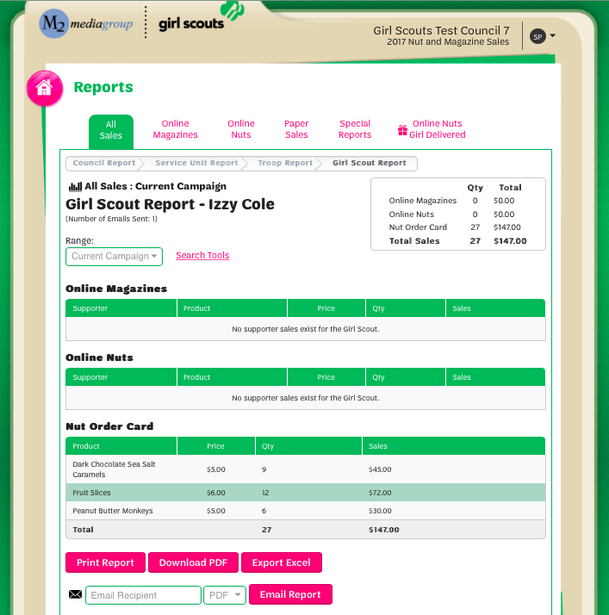
REPORTS
Reports broken out by sales categories
View all Girl Delivered items sold online by customer to see which products to deliver
Notes:
Reports are also available to make it easy to see the online Girl Delivery orders taken during the program.

Slide 23



Questions?
M2’S Customer Care team is cross-trained to handle tech support, volunteer/participant and customer inquiries
100% customer satisfaction guarantee
Council
Product Program Manager
S
U
P
P
M
Service Unit Product Program Manager
Troop Fall Program Manager
Girl Scouts &
their Caregivers
GSWNY Customer Care :
CustomerCare@gswny.org
1-888-837-6410
Notes:
Recording: “M2’s Customer Care team is cross-trained to handle support for volunteer/participant and customer inquiries, so direct folks there as needed. Thank you for your time and effort with the Product Program.”

Slide 24
FAQs
How do I reset my password?
From the login page, click the Forgot Your Password link. Remember that if you are also a parent, you must log into the participant section to manage your Girl Scout’s account. If you are also the troop/SU manager, you will need to login to the admin site. You can set up each site to use the same login and password for both!
When can a supporter expect a direct ship nut order placed online?
The supporter will receive a confirmation email of the order and then another email when the order ships with tracking details.
When will a participant receive their Personalized Patch?
The personalized patch will arrive about 8 to 10 weeks after being sent to the patch company for production. On the participant dashboard, you will see an ETA date so you can anticipate when your patch should arrive.
What if a participant didn’t find their name as they log into the platform?
That’s not a problem! Any Girl Scout who doesn’t know their troop number or see their name, can add themselves to the system. After a participant sets up an account, there will be a brief delay while the council confirms their GSUSA membership. Once that task is completed, council will release the participant from the holding tank and their customers will then have access to make purchases.
When can I expect my online girl delivery items?
Because timelines may vary, please have customers inquiring about their online girl delivered items reach out directly to the Girl Scout from whom they purchased for more details.”
Notes:
FAQs for resource only. Do not need to go over in training

Slide 25
Thank you!

