Slide 1



2025 FALL PRODUCT PROGRAM TROOP MANAGER
TRAINING
Notes:
”Welcome to Fall Product Program training for Troops.

Slide 2








Thank you!!
Thank you for empowering the next generation of women entrepreneurs by supporting your troop in the product programs!
If you have not completed the Troop Fall Program Manager Agreement, please take a moment to complete it now and submit it to your service unit volunteer.
Notes:
PP Team
Thank you for supporting your troop! Because of you Girl Scouts in your troop are learning skills they will use throughout their lives. The product programs teach Girl Scouts 5 main skill sets represented by these icons: Business Ethics, Decision Making, Goal Setting, Money Management, and People Skills. As you go through this training, keep an eye out for these symbols indicating how each part of the program aligns with these goals.
If you haven’t‘ already, please take a moment to look over the Troop Fall Program Manager agreement. This agreement should be signed and returned to your Service Unit Product Program Manager prior to your troop beginning the Fall Program.

Slide 3

2024 Fall Program Recap
Overview
Top Selling Items
Units Sold by Category
58,731 Nut and Candy Items
3,776 Magazines
303 Personalized Products
585 Tumblers
928 Bark Box
Troops Selling -44
2,250 Girls Selling -170
$95,671 Troop Proceeds -7%
$758,439 Total Sales -.4%
$306,803 Net Revenue +3.8%
Peanut Butter Bears
Deluxe Pecan Clusters
English Butter Toffee
Dulce de Leche Owls
Dark Chocolate Caramel Caps
$337.08 Council Per girl average

Slide 4

2025 Fall Program

Slide 5



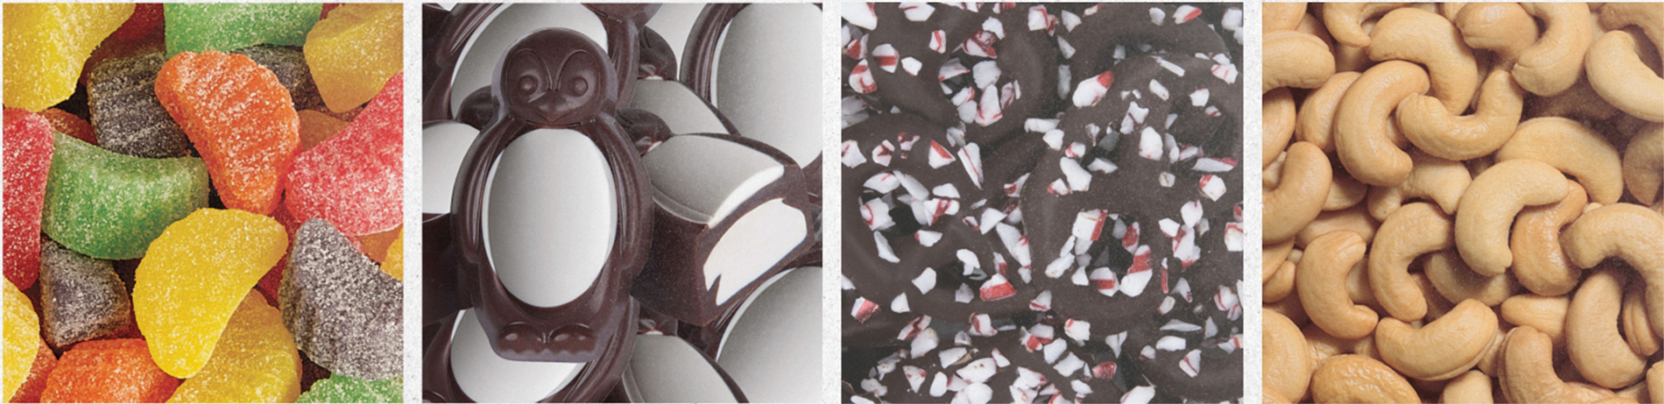



Meet our Vendors
Founded in 1921, Ashdon Farms has been working with Girl Scout Councils since 1996
Ashdon Farms produces nuts and candy for our council as well as many national retailers.
Founded in 2004, M2 has been working with Girl Scout Councils since 2013
M2 offers top magazine subscriptions, easy renewals for your favorite magazines, Tervis mugs and the vendor software for all participating GS councils.
Notes:
Joe/Todd

Slide 6
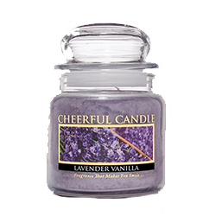

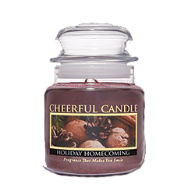
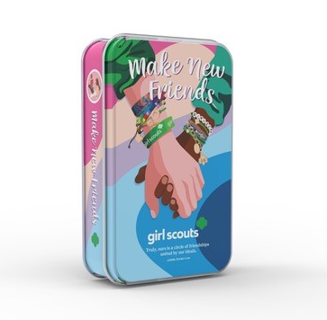
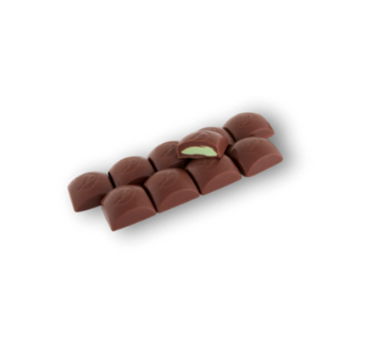
Product Updates
new!
new!
Cherry Almond Clusters
Candles
Balsam Fir
Banana Nut Bread
Cranberry Orange
Gourmet Sugar Cookie
Holiday Homecoming
Juicy Apple
Lavender Vanilla
Orange Cinnamon Clove
new!
2025 Mint Treasure Tin
Notes:
Joe/Todd
Cherry Almond Clusters
Cherries and almonds covered in caramel and milk chocolate.
Packaged in a gift box.
Available on nut order card, online girl delivery, and online for direct shipped ordering.
Girl Scout Make New Friends Tin
(Available on nut order card, online girl delivery, and online for direct shipped ordering)
Milk Chocolate Mint Treasures
Notes:
- Online only Nut & Caramel Trail Mix
- 23 of 30 items are gluten free

Slide 7
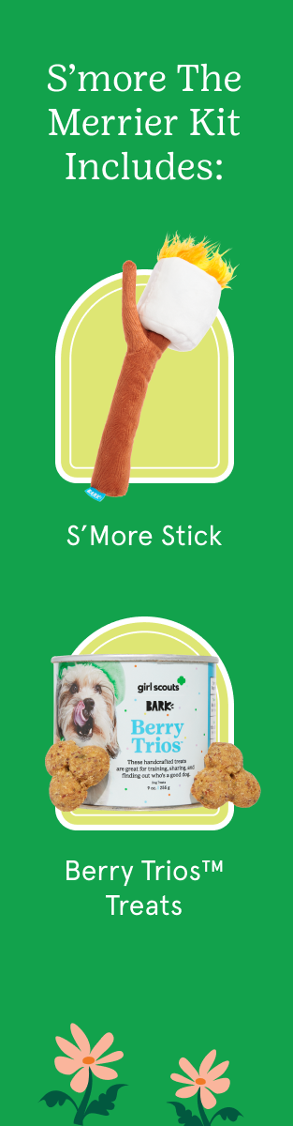
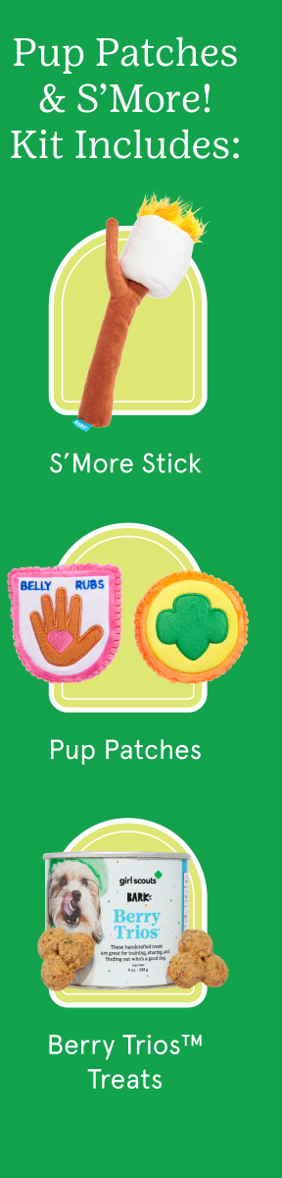

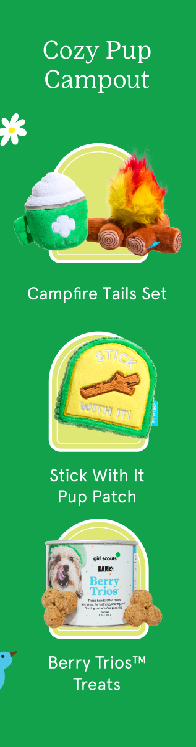

BARK BOXES
new!
new!
new!
Notes:
Joe/Todd

Slide 8







2025
Fall Program Highlights
Notes:
Joe/Todd
This year’s theme is BRAVE. FIERCE. FUN. We’re excited to inspire Girl Scouts to get out there and show the world what they’ve got, and of course have loads of fun while doing it!
For the Fall Program, Girl Scouts have voted in the Grizzly Bear!
Grizzlies are native to forests, river valleys, and mountains in North America and can grow to be 6-8 feet long. They LOVE to play! Cubs often wrestle with each other to build strength and learn important survival skills. And they’re strong swimmers, capable of swimming across large rivers!
You’ll find a fun fact sheet about Grizzlies that troops can share with their Girl Scouts on our Fall Program Resources page on gswny.org. We encourage you to find out more about these amazing animals.

Slide 9
Timeline
Aug 13 – Sept 26
PROGRAM PREP
Training (Troop & Caregiver), Distribute Materials, Collect Troop Volunteer Agreements/ Permission Forms, and Check Rosters
Sept 17
VOLUNTEER ACCESS TO M2 SYSTEM
Sept 26
PROGRAM START
Launch email sent to Girl Scouts to register. Girl Scouts begin to take orders. SUPPM’s should enter in delivery site information for products & rewards.
Oct 27
PROGRAM END
Parents enter product/reward orders into M2 and make payment to troop leader.
Oct 28
TROOP LEADER REVIEW & TROOP PAYMENT DUE
Oct 29
SUPPM REVIEW OF ORDERS & PAYMENTS BY TROOPS
Nov 15
DELIVERY OF PRODUCT TO SERVICE UNITS
Business Ethics
Notes:
PP Team
This year’s program will run from September 26th through October 27th. Please take note of Troop Leader review, Troop Payment Due, and product delivery dates on this timeline.
Troop Volunteers should plan to finalize your troop’s Girl Delivery and Recognitions orders as well as make your final troop payment to council on October 28th.
Your SUPPM will receive delivery of your Girl Delivery Product on November 15th. Keep on eye out for communication from them so that you can coordinate pick up and distribution to your troop of this product. They will also notify you when recognitions are received and available for pick up.
And finally, please note that this program begins prior to the start of the My26 Girl Scout year. It’s important to check your rosters in M2 to ensure that only Girl Scouts registered for MY26 are in the system as Girl Scouts must be registered for MY26 to participate in this program.

Slide 10
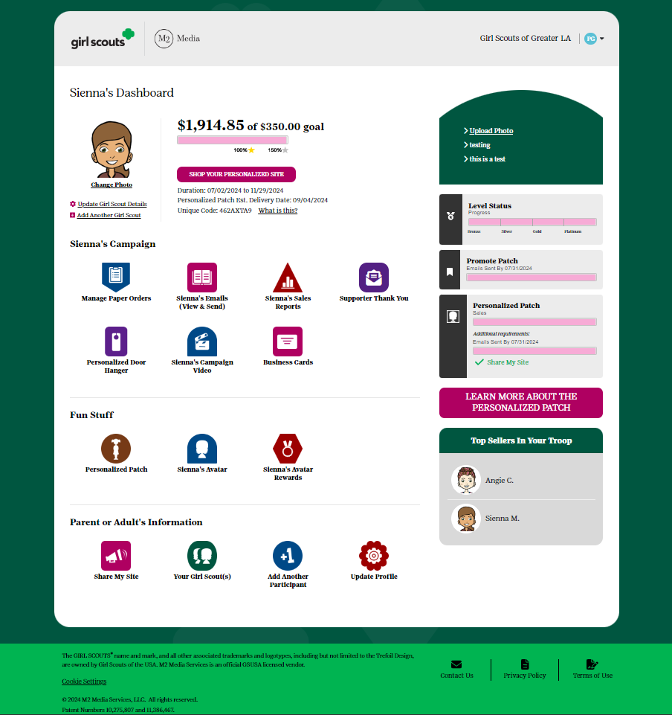

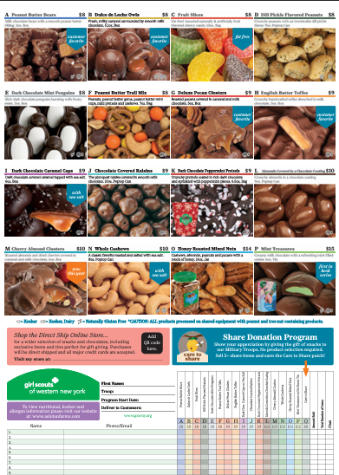
Participation
Online Personalized Site
Create an Avatar & track goals
Send emails
Share your link
Print business cards & door hangers
Take Girl Delivery (varieties on nut card only) or Direct Shipped orders
All participating Girl Scouts must be registered for the 2025/2026 Girl Scout year
Nut & Candy Card
Collect payment upfront
Place order via M2 site & pay troop
SUPPM’s distribute product to Troop Leader
Decision Making
Notes:
PP Team
Girl Scouts have the choice to take orders online or in person within the Fall Program. The nut and candy card will include all varieties available for Girl Delivery.
The M2 platform allows Girl Scouts to create an online personalized selling site. From this site they can take Girl Delivery orders for those same nuts & candies, but customers can also order a variety of direct shipped items such as bark boxes, magazines, candles, and more!
Troops can choose how they are going to participate. If a troop chooses, they can forgo Girl Delivery and instead participate online only, offering the Direct Shipped option to customers.
If you are thinking of doing a Direct Shipped only program, it’s very important to communicate to caregivers that they will need to UNSELECT the Girl Delivery option when they send emails to customers.

Slide 11
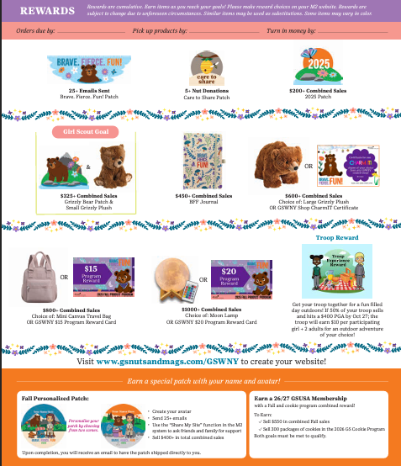

Girl Scout Recognitions
Earn a 26/27 GSUSA Membership
with a Fall and cookie program combined reward!
To earn:
Sell $550 in combined Fall sales AND
300 packages of cookies in the 2026 Girl Scout Cookie Program.
Both goals must be met to qualify.
Goal Setting
Notes:
PP Team
We’ve got some FUN recognitions for the girls this year! Having these physical recognitions helps the Girl Scouts have something tangible to work towards when they are setting their goals.
Recognitions are cumulative, so the more the Girl Scout sells the more she earns!
Girl Scouts who sell $550 or more will also have the opportunity to earn their 2026-27 GSUSA Membership! This reward is a combined reward, meaning participation and reaching the assigned goal in both programs is required to qualify for the membership.

Slide 12








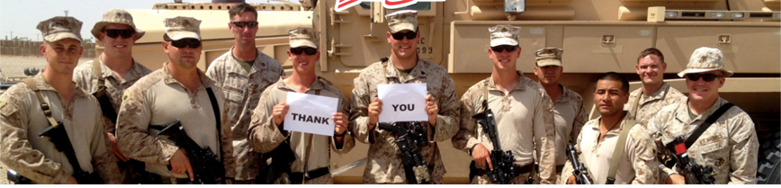
Girl Scout Patches
$200+ Combined Sales
GIRL SCOUT GOAL!
$325+ Combined Sales
CARE TO SHARE
Girl Scouts ask their customers to purchase “Care to Share” packages to support Operation Gratitude!
Orders can be placed via their order card, online girl delivered or direct ship channels. Products are distributed by council and are not delivered to troops/girls.
Troops earn proceeds and girls who sell 5+
Care to Share items earn a special patch
and credit towards other rewards
25+
Emails Sent
Fall Personalized Patch
5+ Care to Share Packages Sold
Create your Avatar
Send 25+ emails
Use the “Share My Site” function from your M2 dashboard to ask friends & family for support
Sell $400+ in total combined sales
People Skills
Notes:
PP Team
Within the recognition flyer you’ll find this year’s themed patches. Back again is a Girl Scout favorite, the Fall Personalized Patch. This patch can be earned by a girl scout: creating their Avatar in M2, sending 25+ emails, Sharing their site, and selling $400+ in combined sales. The patch features their avatar and name!
We also have our Care to Share program, which offers customers the opportunity to give back to the community. Customers purchase a Care to Share package of nuts and candies at $8. The Girl Scout gets credit for the sale and our council donates the package to local military personnel. This is a great way for Girl Scouts to connect with their community and practice their communication skills with customers.
Girl Scouts who sell 5+ care to share get the patch!

Slide 13


Troop Reward & Proceeds
Troop Proceed Plans
Older Level Reward Waiver
C/S/A level only
$1.15 for every nut and candy item
$3.25 for every magazine, Bark Box, personalized gifts, candles, and Tervis Tumblers
$1.40 for nut and candy items
$3.75 for magazine, Bark Box, personalized gifts, candles, and Tervis Tumblers
Earn your Leader Avatar Patch!
Create an avatar
Queue your email blast to Girl Scouts in your troop between 9/17 – 9/26
Reach $2000+ in Troop Sales
Money Management & Budgeting
Notes:
PP Team
Troops who participate in the Fall Program are also eligible for troop proceeds and can earn a Troop Reward!
Encourage your troops to set a troop goal for proceeds. This is a great time to talk budgeting and what they want to do within the MY26 year.
Older level troops may waive their recognitions in exchange for more proceeds. They must complete a waiver form which includes signatures from all members of the troop to do so. The troop leader can then adjust their recognition plan in M2.
We’ve also got a great reward lined up for troops who hit a $400 per girl selling average by October 27th. Troops who reach this goal will earn $10 per participating girl plus up to 2 adults. They can use these funds for an outdoor adventure of their choice!
Leaders can also earn a personalized Avatar patch!

Slide 14
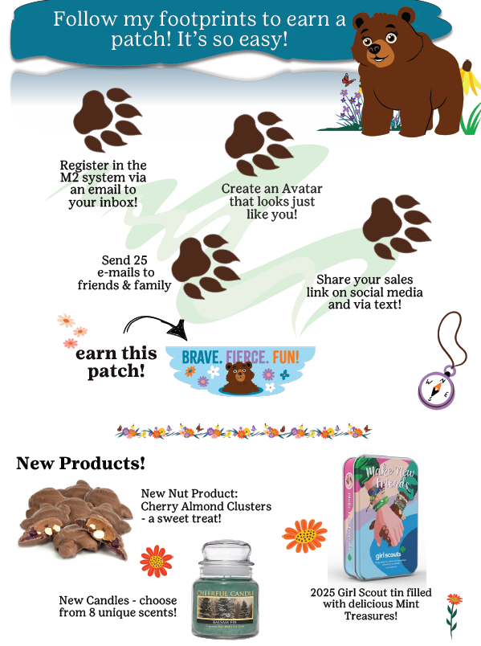

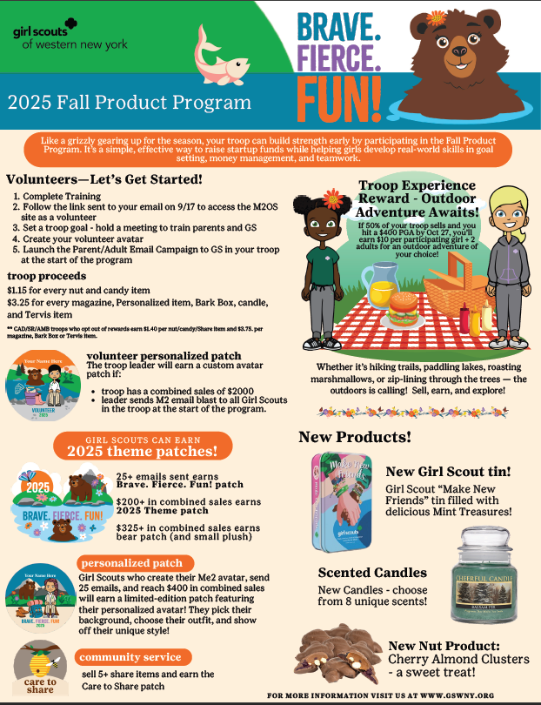
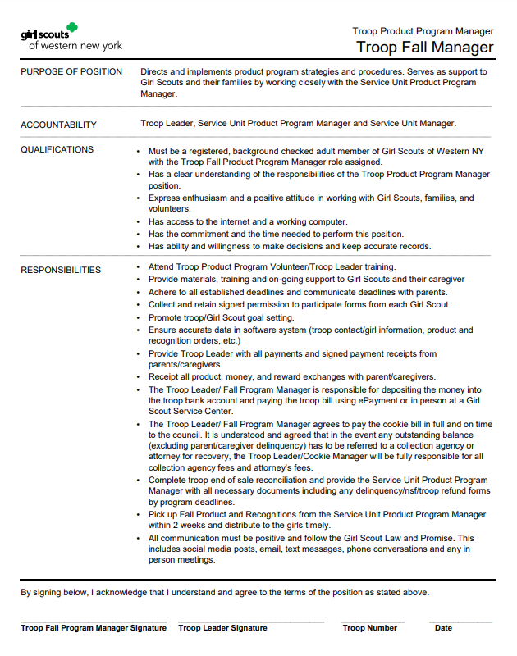
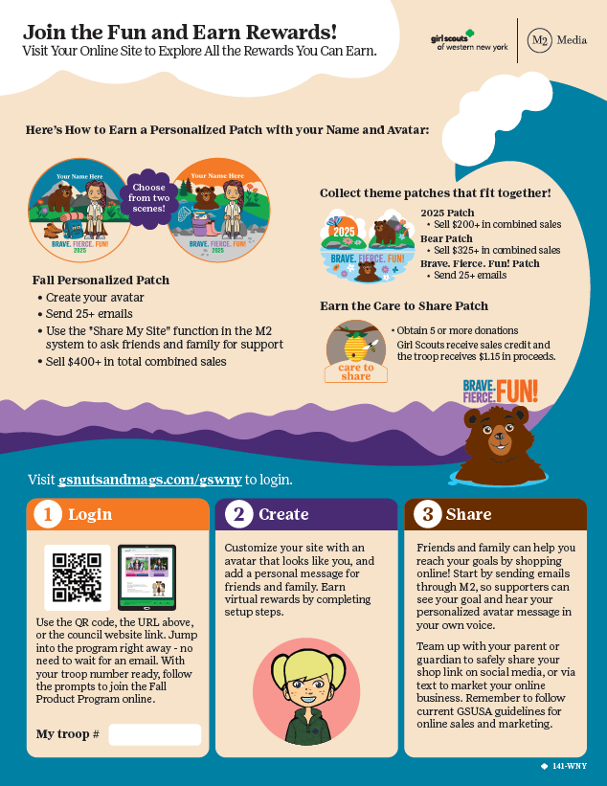
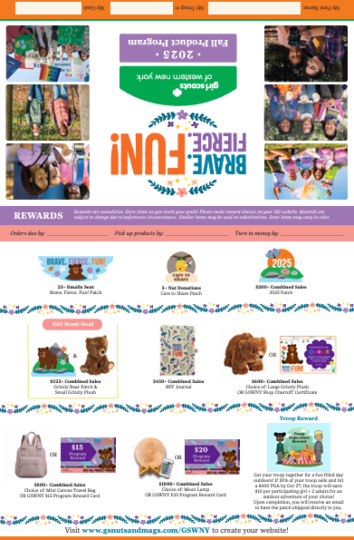
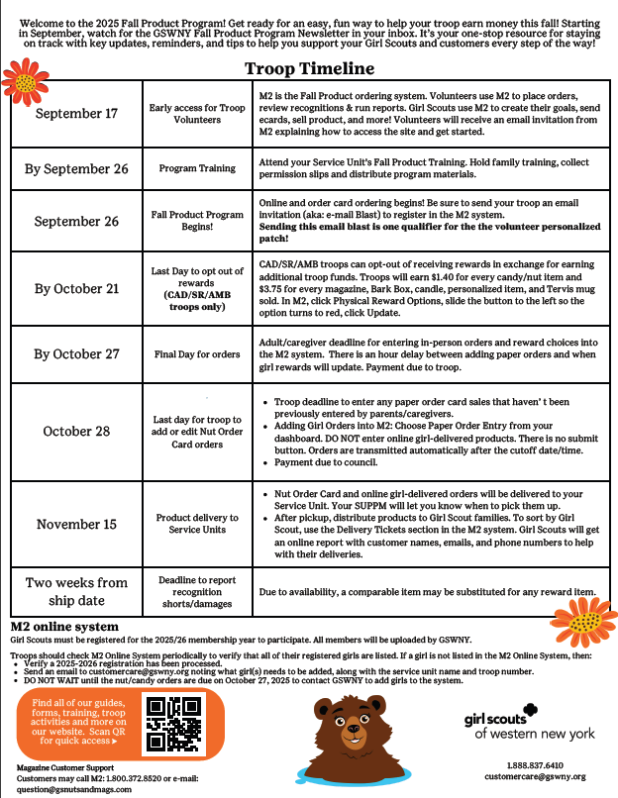
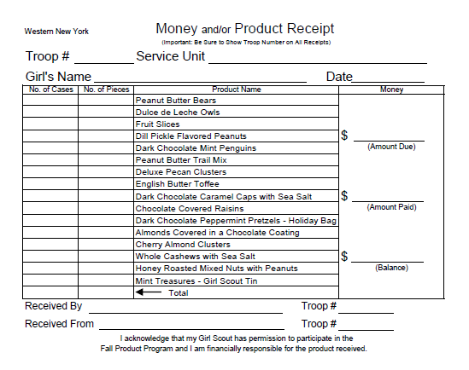
Paper Materials
Digital versions of all printed materials will be available online in fall resources
For Girl Scouts & Caregivers
For Troop Volunteers
Family Guide
M2 Getting Started Flyer
Troop Guide
with Timeline
Order Card & Recognition Flyer
Notes:
Joe or Todd
Your Service Unit Product Program manager has paper materials for you and your Girl Scouts. They will request a signed Troop Fall Program Manager agreement before releasing these materials to you.
When you conduct your family meeting, make sure that a Girl Scout’s permission form has been completed before you distribute her materials to the caregiver.
As a troop volunteer, you will receive a Troop Guide Envelope and a receipt book. Printed on the envelope is the program’s timeline as well as key information you will need as you go through the program.
If you do not see the information you need on your Troop Guide, reach out to your SUPPM for support.
Girl Scout families receive a Family Guide within their materials. This will contain the information they need to complete the program. Girl Scouts also get a flyer from M2 explaining how to access and get started for their online site, as well as a in person Order Card and Recognition Flyer so they can set their goals and start taking orders.

Slide 15
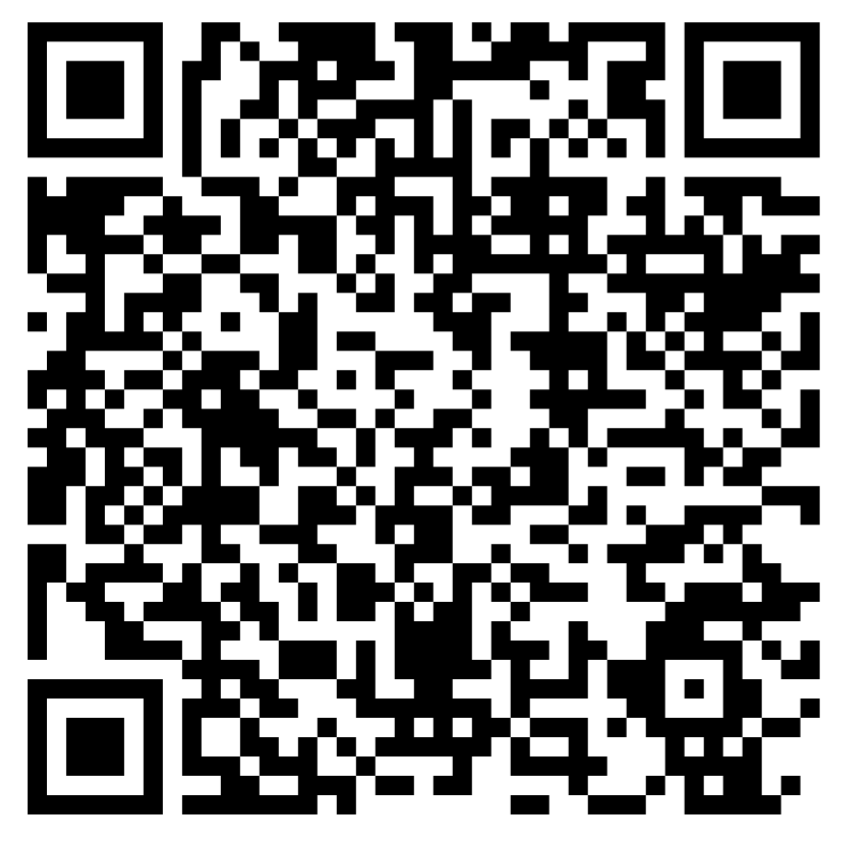
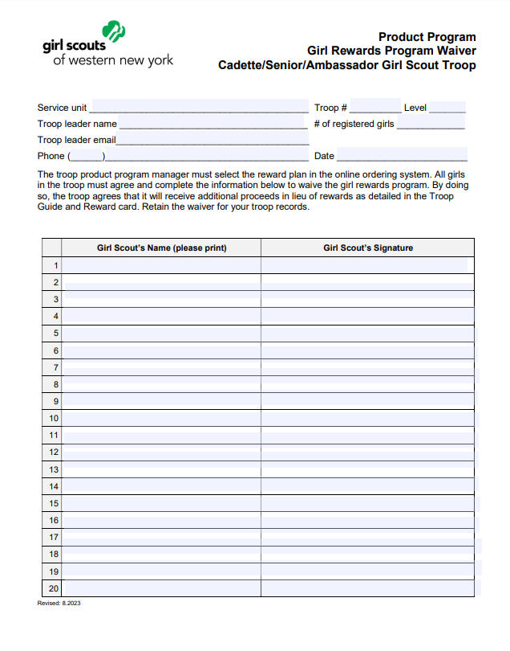
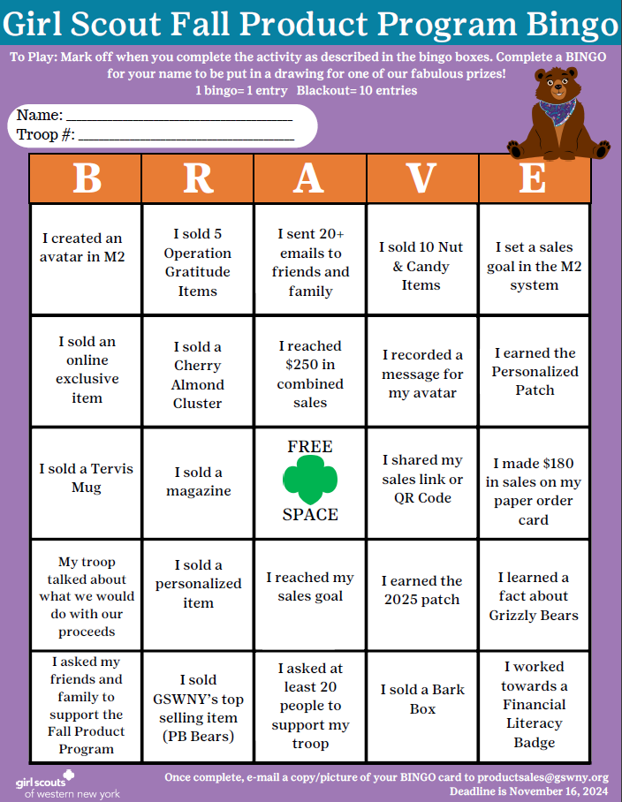
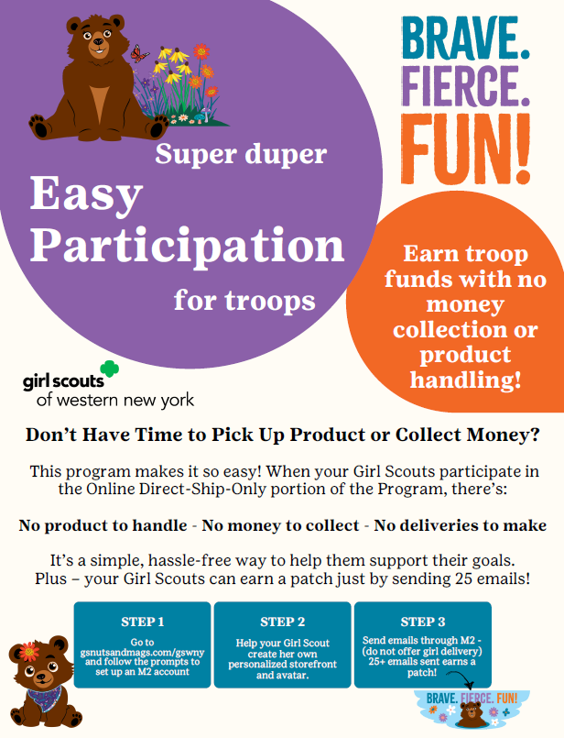
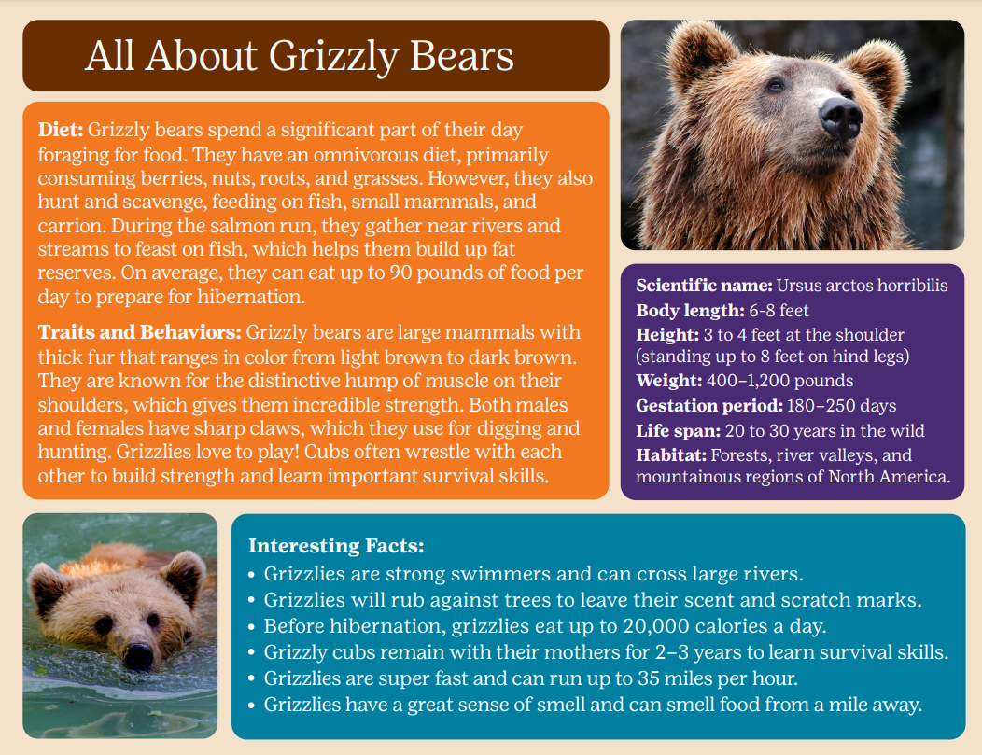

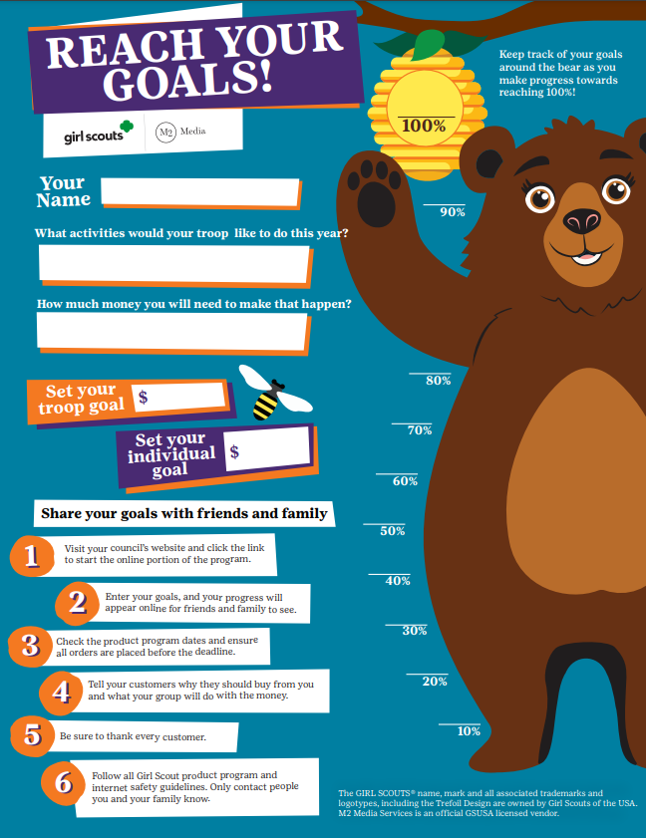


Scan here to view Fall Resources on GSWNY.org
Online Resources
For Girl Scouts & Caregivers
For Troop Volunteers
Notes:
Joe or Todd
After this training, take a moment and visit the Fall Resources page on gswny.org. You’ll find a TON of digital resources for this program. There are activities, flyers on getting started and council promos such as the BINGO board, any form you will need, and MOST OF ALL links to the M2 video tutorials.
M2 has videos that guide you through pretty much anything you need to do on the site. And they have another set just for caregivers.
Make sure your families know about this resource page!
And if you can’t find what you’re looking for on the page, reach out to your SUPPM for support.

Slide 16

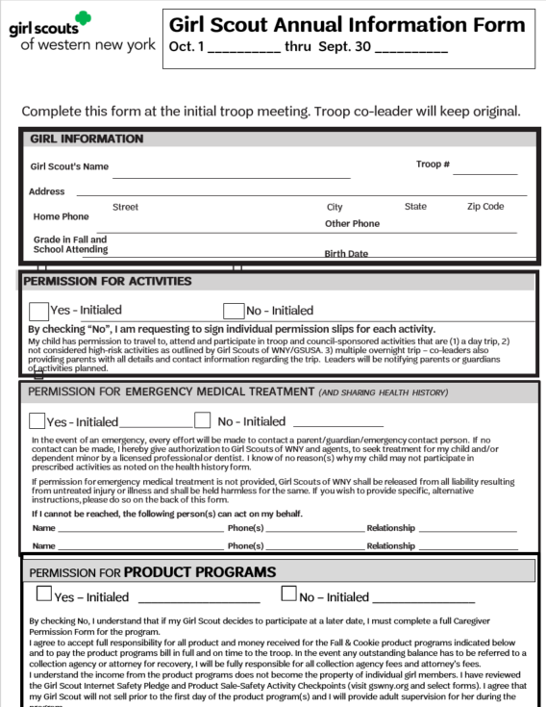
Caregivers can now give permission for their Girl Scouts to participate in BOTH Product Programs via the updated Girl Scout Annual Information Form!
EXCITING NEWS!
NOTE: This only relates to caregivers. All Troop volunteers must still complete the Troop Volunteer Agreement. A standard Caregiver Product Program Permission Forms will also be available online should the troop prefer to use them.
Notes:
PP Team
A regular PP permission form can be used at any time in leiu of this being selected.
Troop leaders retain this form same as they would a PP permission form as it will be requested in the event of delinquency.

Slide 17

Make sure you are opted-IN to receive emails from GSWNY!
Check your inbox every Saturday for our Fall Product Program Newsletter.
Here we include important program updates, promotions, and instructions for things like order placing and final payments.
If you need assistance, contact customercare@gswny.org

Slide 18


M2 Features for Girl Scouts

Slide 19
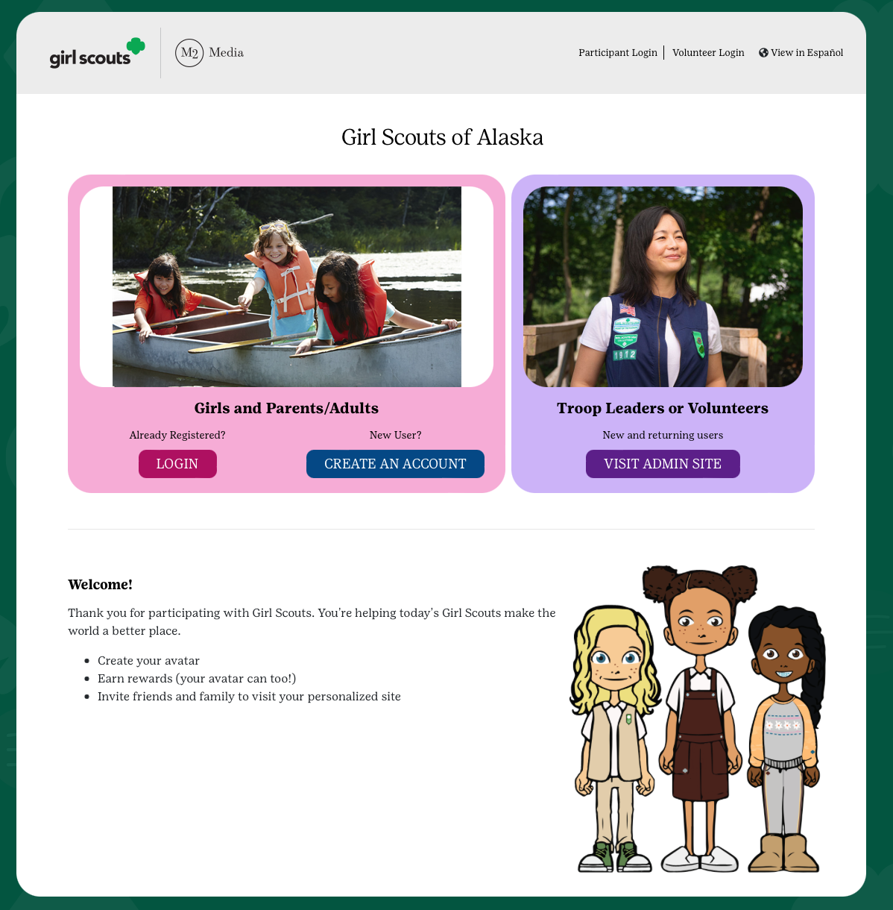
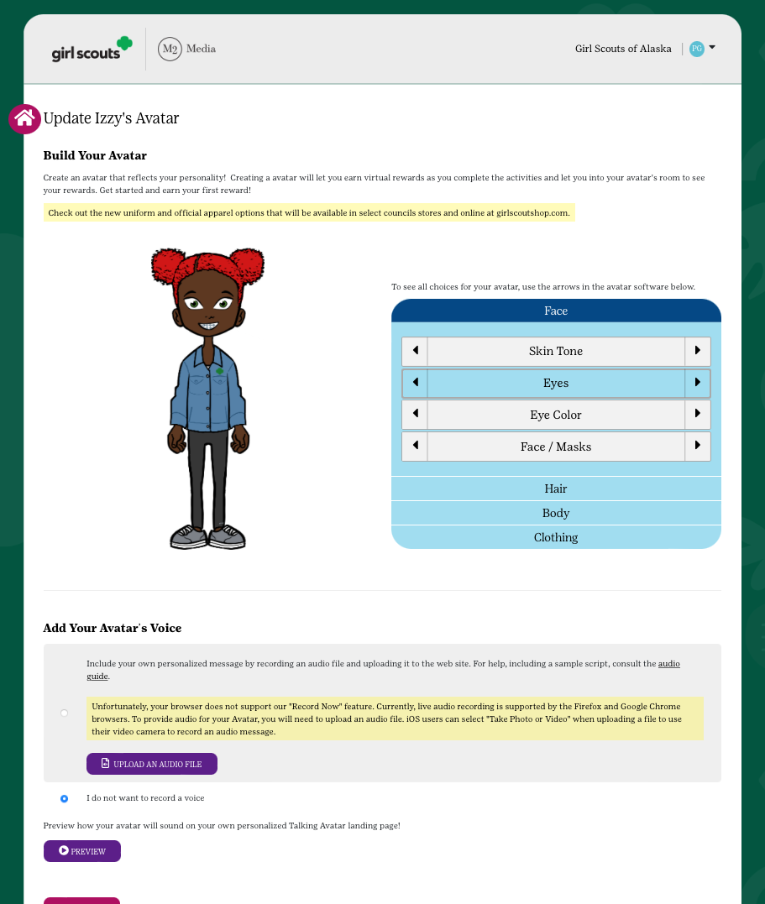
GIRL SCOUT’S PLATFORM SET-UP
Login
Set Your Goals
Build an Avatar
Upload a Video or Picture (optional)
Send Emails
Share your site!
Notes:
Todd/Joe
Recording: “The parent/adult and Girl Scout login for the first time after receiving the launch email or accessing the council-specific url on or after go day. Participants should have their troop number available. If a participant doesn’t see their troop number or name, complete the setup process and council will verify after complete. Returning participants can use the same email address and password but need to confirm and complete the setup process.
The parent/adult and Girl Scout validate their council with their zip code next, confirm participant’s troop number, and then answer questions about their Girl Scout goals and what Girl Scouting means to them. Along the way, participants build their virtual avatar likeness with the patented Girl Scout platform. Girl Scouts sharing their goals for the Product Program through an individual or troop video has shown to significantly increase results too.”
“Girl Scouts engage digitally with supporters by designing their own avatar. This can help make the digital experience more personalized like connecting with supporters in person, but in the digital space. Girl Scouts personalize their avatar, select the avatar’s background of the mountains or lake scene with the Grizzly Bear, and include their name, nickname or initials on the patch. Once the personalized patch is earned with the criteria highlighted, through in person and online efforts together, the patch is directly shipped to the mailing address provided after login.”

Slide 20
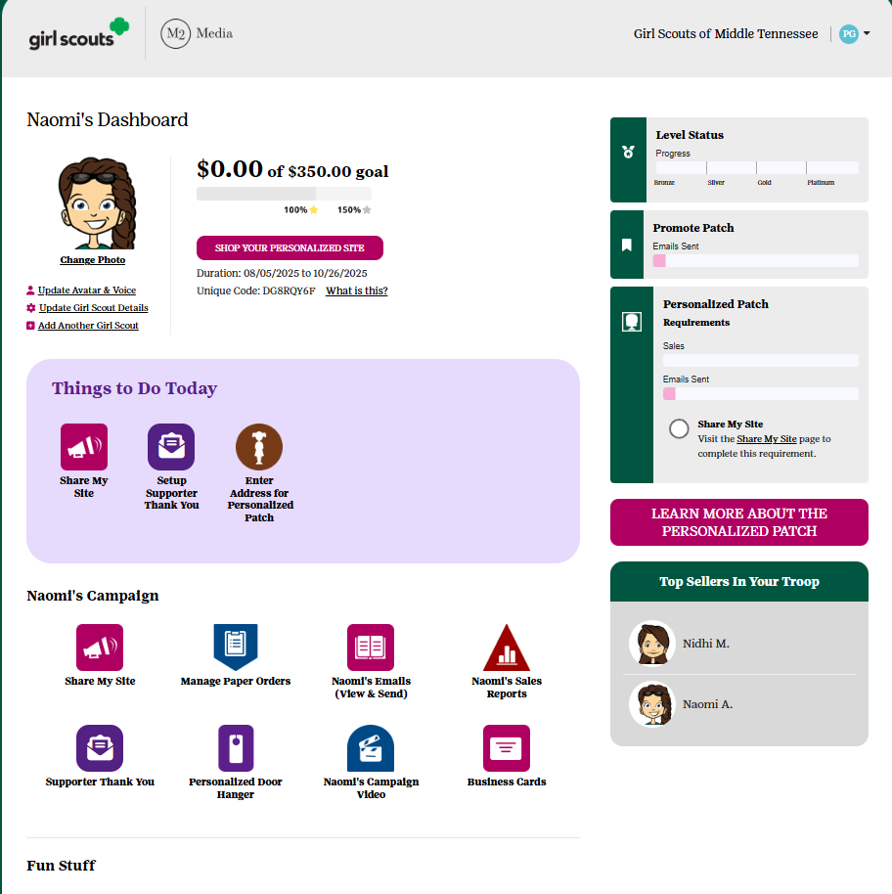
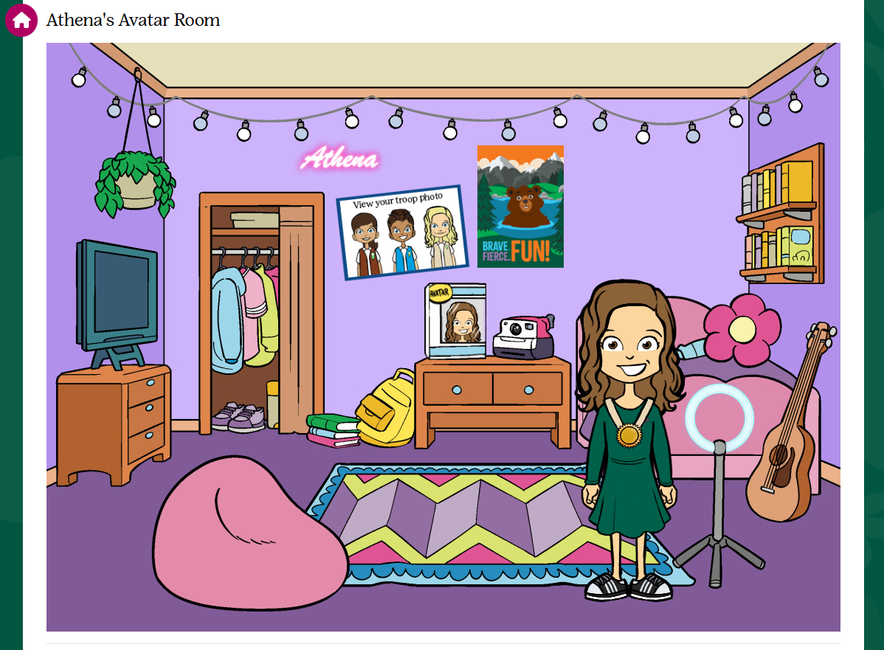
PARTICIPANT’S DASHBOARD
Track your Goal Progress on dashboard and in Avatar room
Send Supporters a Thank You Email
Enter your nut card order
Select rewards
View sales reports
Notes:
“Here is the participant’s online toolkit for managing both online sales and in person participation. Girl Scouts can send additional emails, social media and texts from the participant’s Dashboard. There is also an opportunity to send supporter thank you emails.
Girl Scouts visit their Avatars room 4 times on average during the program to see virtual rewards earned by completing actions and also the troop photo.
The Avatar room & rewards have gotten an upgrade this year. New rewards to unlock in this virtual experience. When clicking on the closet, you will be redirected to update your avatar’s outfit and looks
Parent/Adults and Girl Scouts enter in the totals of each item using the nut order card into the system prior to the end of the program if this is an option offered by council. Nut order card totals will be tabulated and added to all online sales totals in reports. Rewards earned are automatically selected and participants can make selections at levels where there are choices after rewards are earned. There are reports showing sales by category and specific reports highlighting girl delivered items sold online by supporter with contact information for in person nut and chocolate delivery.”

Slide 21
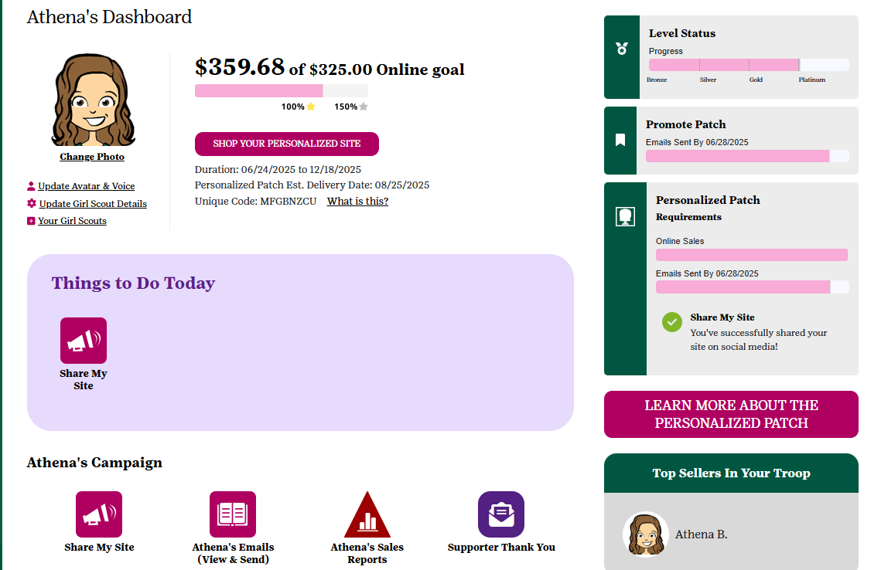
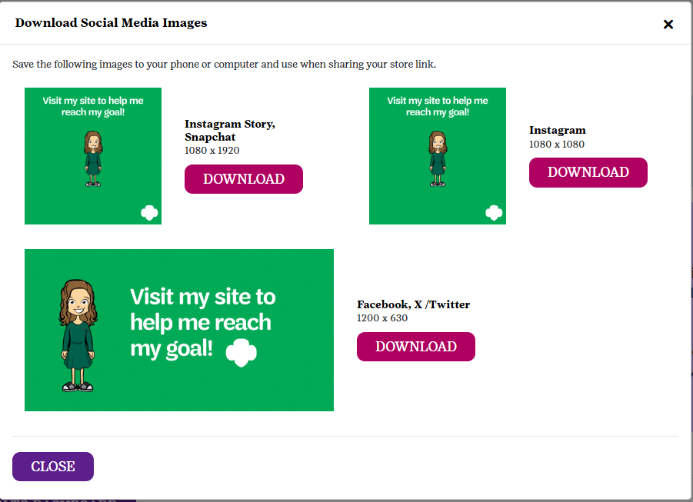
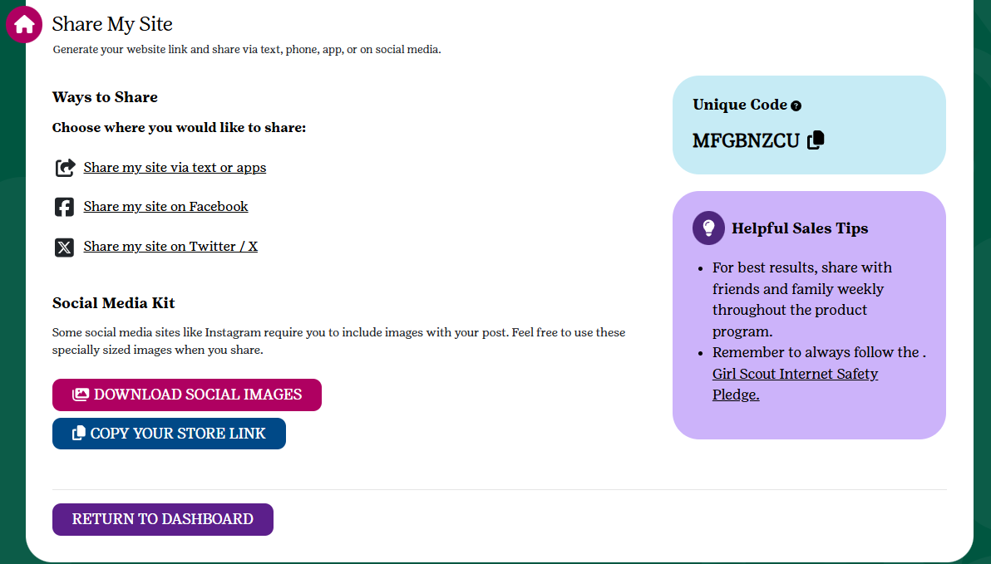
SHARE MY SITE TOOL KIT
Many ways to Share
Download images for additional online marketing
Copy the storefront link to send
Share on Social Media
Text friends & family
new!
Notes:
Recording:” This year, a Share My Site tool kit has been added to help utilize the Share My Site function. Participants can now share their site with ease by copying the storefront link and using a downloadable image to share to their caregiver’s social media. Everything is in one place for easier access to share their site. “

Slide 22
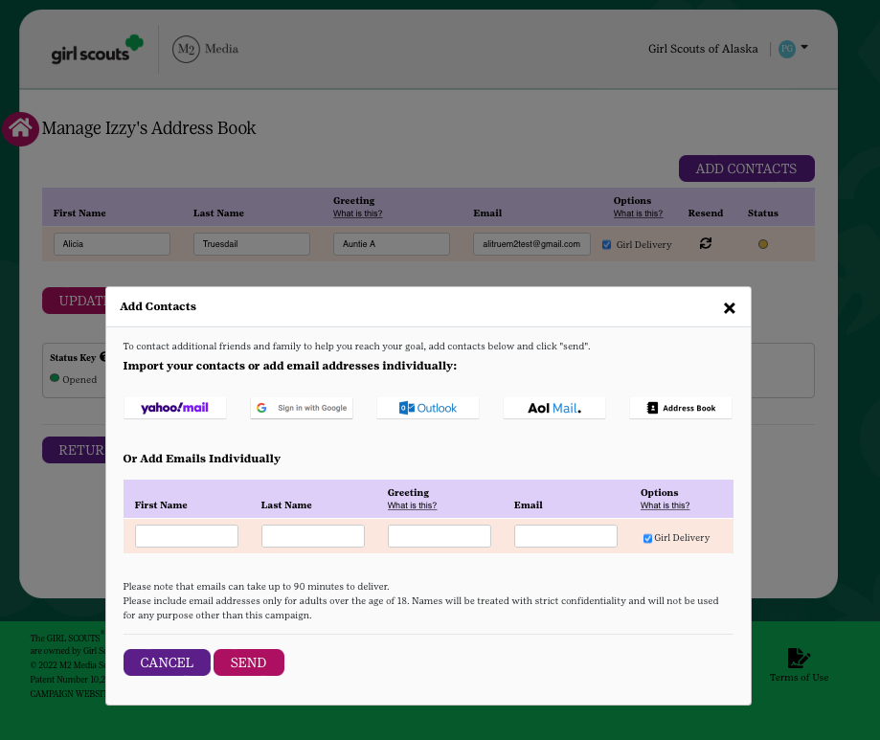
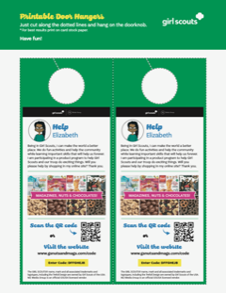
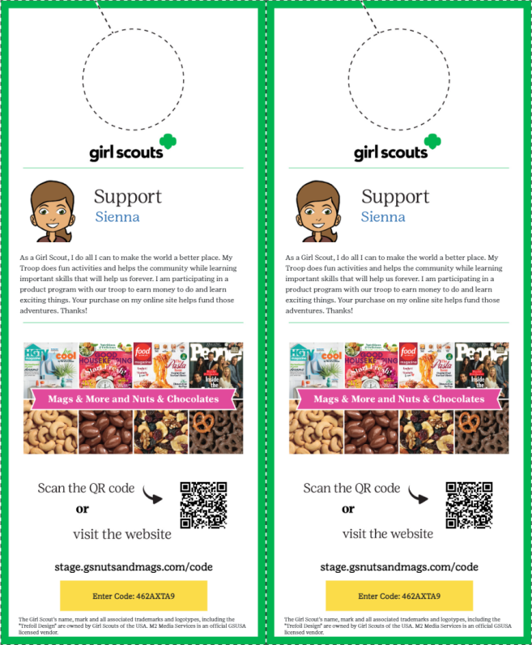
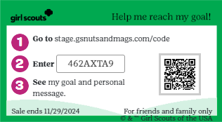
TOOLS TO RUN A BUSINESS
Send emails
(Select Girl Delivery Option before sending. Opt in is the default setting)
Share My Site with social media and texting - NEW toolkit this year!
Printable business cards
Door hangers with QR codes
Notes:
“Girl Scouts can personalize their request for support based on the supporter’s preferences for each contact. The most popular option is still sending emails with over 58% of sales coming from that channel. Next in line is social media. Texting shares the participant’s personalized site conveniently for those using a smartphone. The printable business cards and door hangers are effective printable tools as leave behinds after contact with supporters.”

Slide 23
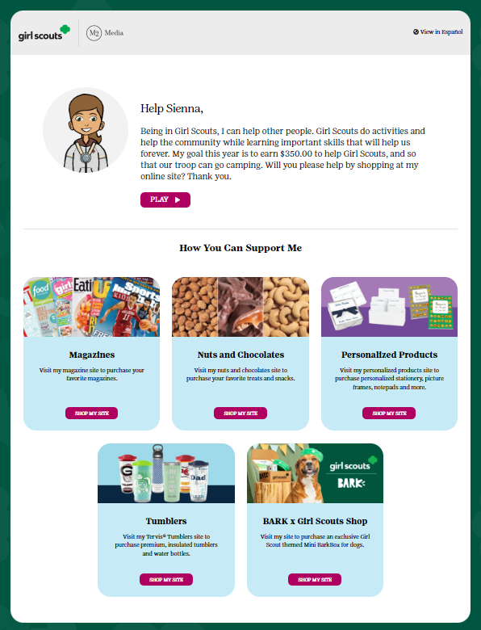
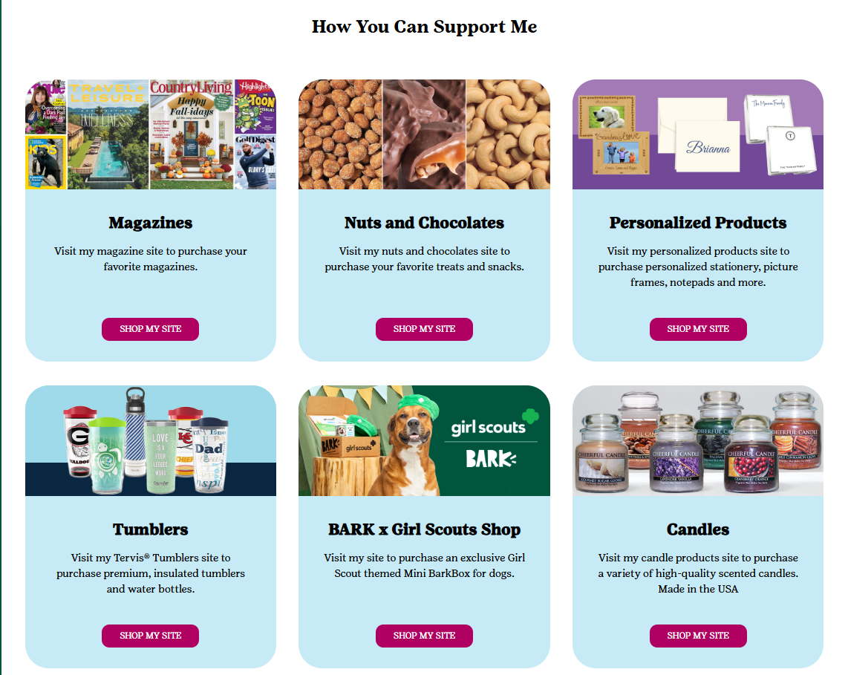
ONLINE SHOPPING SITES
Supporters select their desired product line
Magazines, Bark Boxes, Tumblers, Candles and Personalized Products
Nuts & Chocolates have two options:
Girl Delivered or
Direct Ship
Notes:
“For the online options, Girl Scouts and adults invite friends and family to make a purchase via email, social media, texting, business cards and door hangers. Supporters are directed to a personalized site that looks like this. Here they can select which items they wish to shop. Most items are only available for direct shipping. Direct ship items are sent directly to the customer preferred address after paying for shipping. Regardless of option chosen, supporters pay for all products online at the time of checkout.”

Slide 24
GS Online Nut Store
Direct Ship
Direct shipped – Products are shipped to customers.
Customers pay for shipping based on the online shipping chart.
Shipping cost only slightly higher this year.
Notes:
If the supporter selects nuts and chocolates, they will be taken to this screen where they’ll have the option to choose girl delivered or direct ship.
Girl Scouts and adults have the ability to turn off the Girl Delivery option for certain supporters.
Therefore, some supporters will have the option of girl delivery or direct ship and others may see direct ship only. Girl delivered nuts/chocolates are those items available at council and ultimately delivered by the Girl Scout.

Slide 25
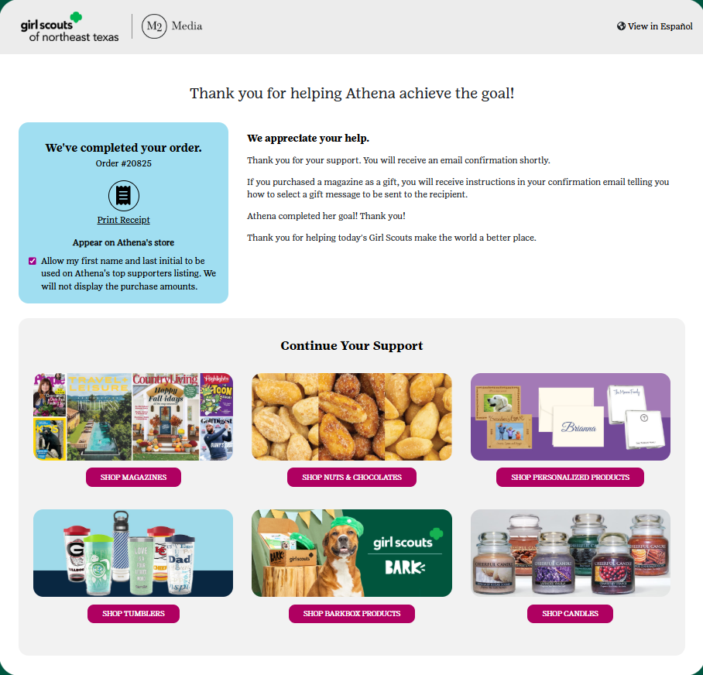
WAYS TO VISIT STOREFRONTS
Supporters can visit other storefronts after checking out online
Notes:
Recording: “After making a purchase from one storefront, supporters can also visit other storefronts to purchase additional items of interest.”

Slide 26
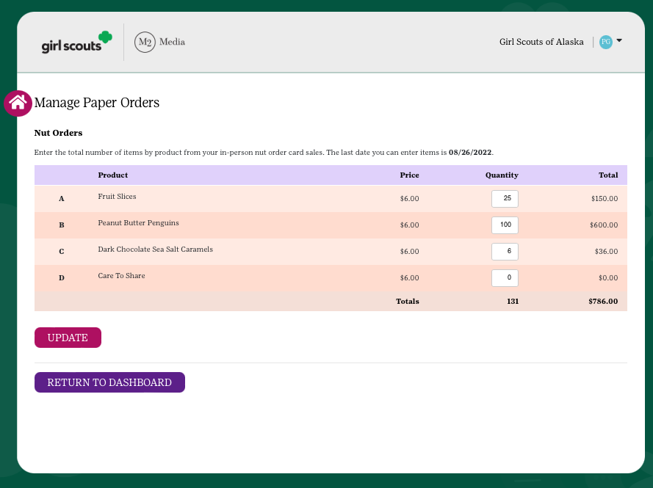
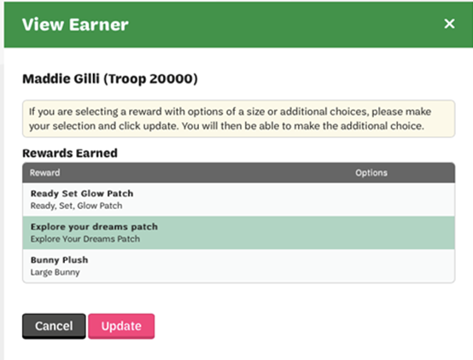
ENTERING ORDER CARD AND REWARD ITEMS
Parents/guardians enter the total of each item from their nut order card into the M2OS system.
These nut card totals will be added to the girls online sales. Online orders and payments are automatically credited in M2OS (including Girl Delivered)
Make reward selections where needed
$
Notes:
Joe/Todd
anything ordered online does not need to entered into M2, this is where items on the order card only are entered
**Drop updated screenshot

Slide 27
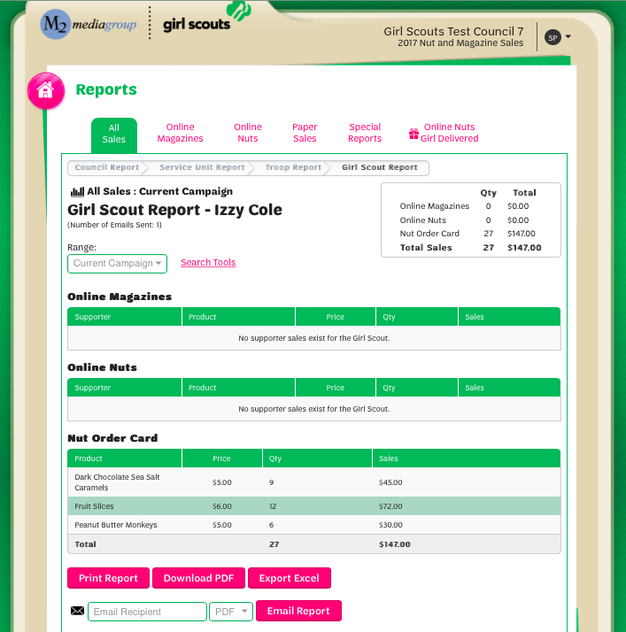
REPORTS
Reports broken out by sales categories
View all Girl Delivered items sold online by customer to see which products to deliver
Notes:
Joe/Todd

Slide 28

Troop Volunteers
Helping their troop & Girl Scouts Do Great Things!

Slide 29
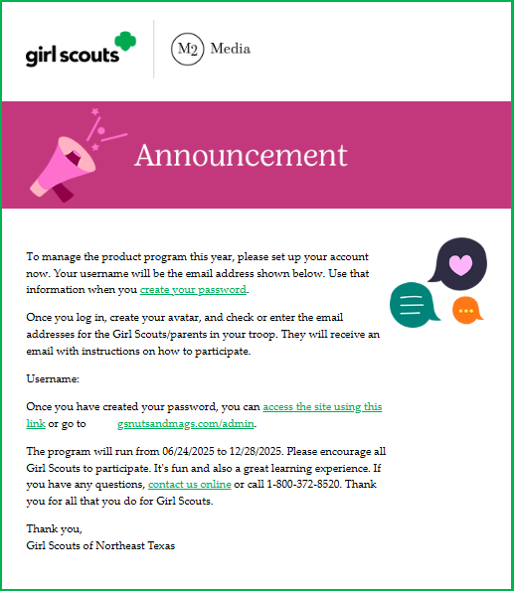

TROOP VOLUNTEER ACCESS
Email invitation to login 9/17
Watch Troop training video
Queue Parent/Adult Email Campaign
Create Volunteer avatar
Notes:
“M2OS is a management toolkit that provides troops with tools to enable participants to do great things. About a week before the start of the Program or when council gives you access, troops will receive an invitation to login to the toolkit. Troops will watch a short training video about the details of the M2OS platform. Training now and then training in the platform. This gives troop volunteers a great overview of the Product Program today and a troop training video later that will take them through the details of the platform when they are in M2OS. Troops login and get started with the next step in troop training. Then queue up the Parent/Adult Email Campaign announcing the troop’s participation in the Program and providing parents/adults with a link and instructions on how to participate with their Girl Scouts. Along the way, be sure to encourage troops to create their troop volunteer avatar as well.”

Slide 30
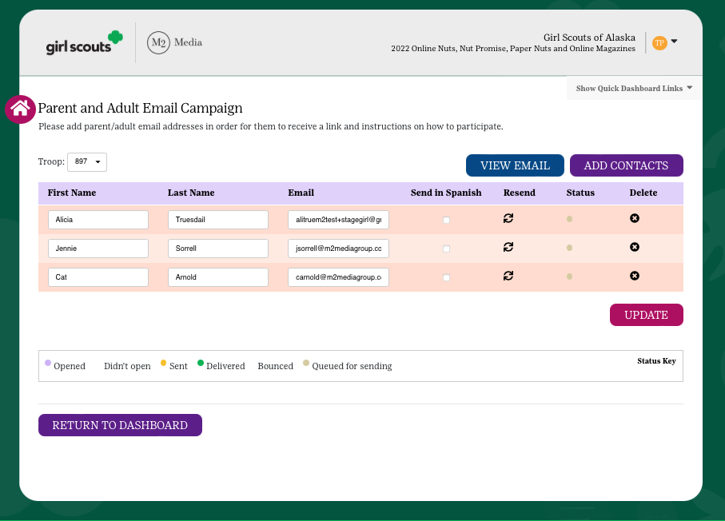
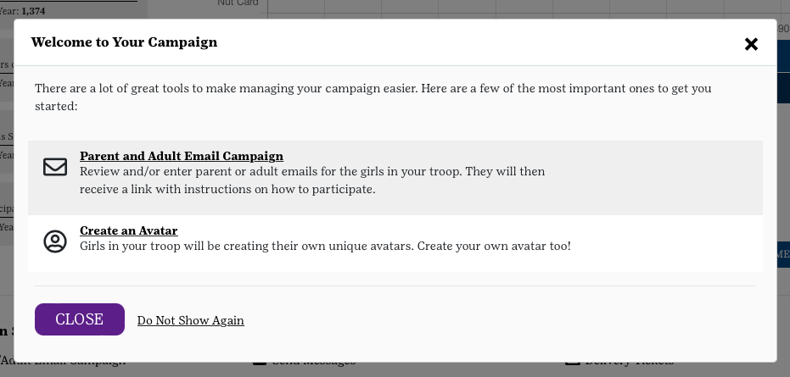
PARENT/ADULT EMAIL CAMPAIGN
Email addresses uploaded by council
Edit or enter missing parent/adult emails
Email will include instructions on how to participate
Resend at any time within the program
Queue for sending before 9/26 to fulfill requirement towards Troop Leader Avatar patch!
Notes:
Recording: “After troops watch the troop training video they will be prompted to send the Parent/Adult Email Campaign. In order to continue setting up their profile, they must send the PAEC out first. Parent/adult email addresses will be uploaded by council, so troops just need to confirm the email addresses are the ones used by parent/adults in the troop and confirm all the Girl Scouts in their troop are listed so they get the email blast at the start of the Program.”
If you do not set this campaign up your Girl Scouts will STILL RECEIVE A PARTICIPATION EMAIL the day after the program begins.

Slide 31
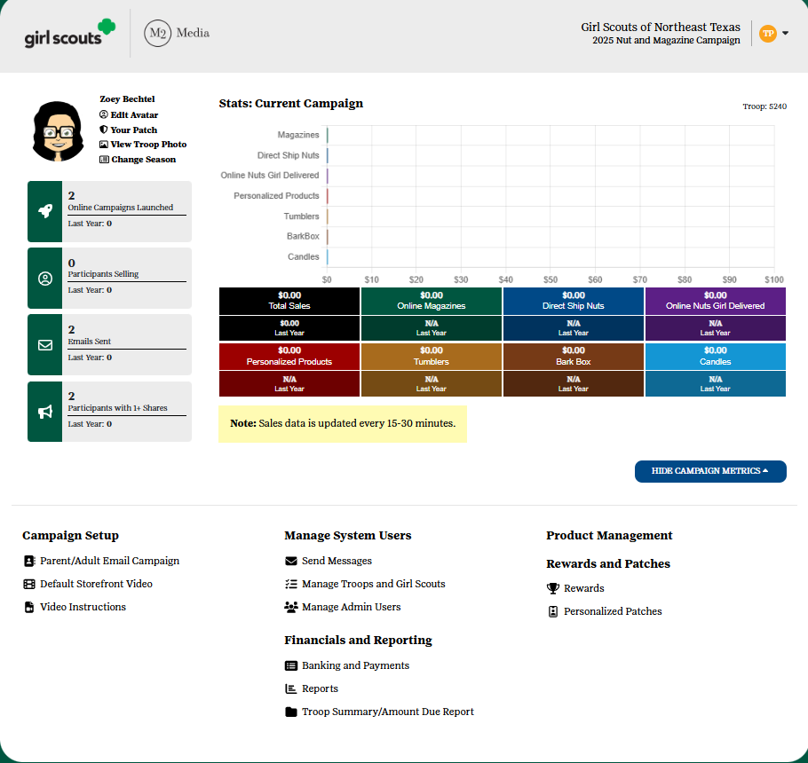
TROOP DASHBOARD
Message Caregivers
Manage nut card order entry
Select rewards
View Sales reports
Enter Girl Scout payments to the troop
Notes:
Recording: “Troop leaders and product program managers can view overall troop stats on the landing page of the volunteer admin site, as well as manage the program. Troops have the ability to send messages to participants within the troop to encourage participation, share Program updates, and thank them at the conclusion of the Program. Troops also have the ability to edit or enter participant order card items if your council participates with the nut order card. Rewards and personalized patches that Girl Scouts have earned will appear in the site. Troops should check to make sure they are correct, make any missing selections of items so rewards can be submitted, and enter addresses where necessary for patches to be fulfilled. Troop level reports are available showing total sales and a break down by channel and product. The Troop Summary Report is a great overview of the key troop financials including troop proceeds and balance due to council. Banking and Payments provides troops with a view into bank transactions and council payments and gives troops an optional tool to track participant payments if entered by the troop.
When troops login, a troop training video will take them through these tools. Even after the program is over, troop volunteers can login to see reports and banking information throughout the duration of the Girl Scout year.”

Slide 32
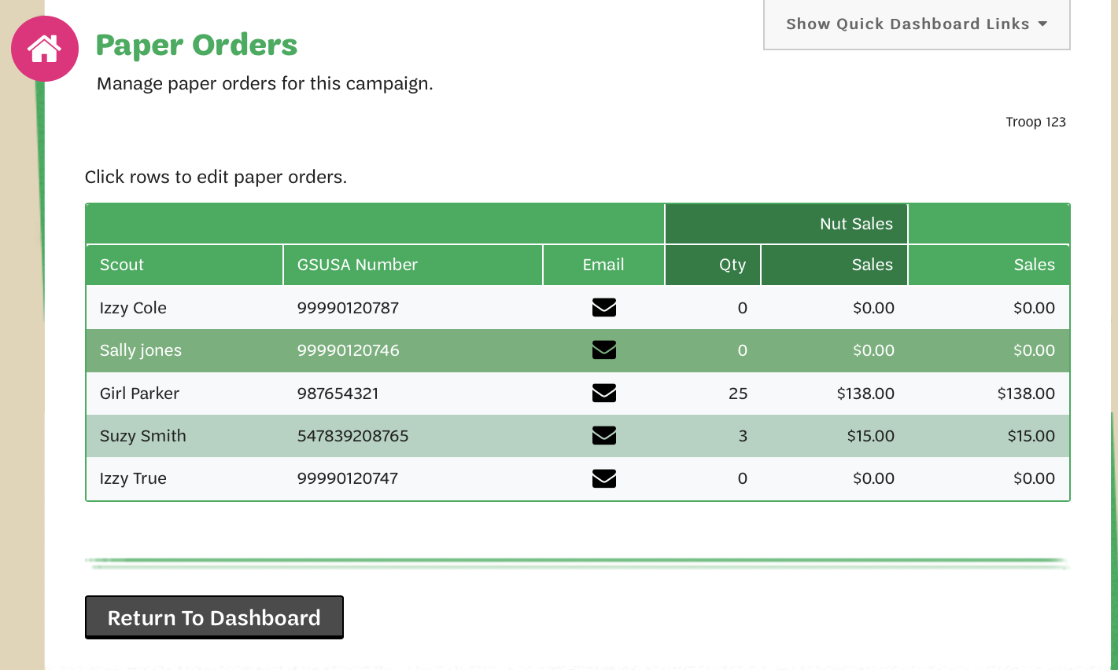
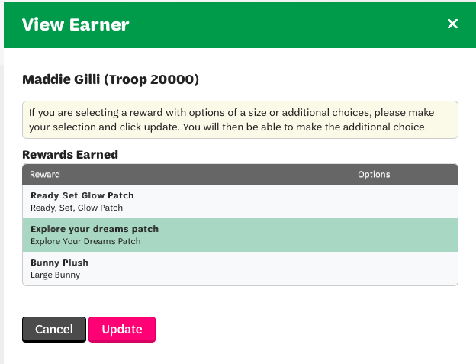
How to enter/edit Nut Card Orders
Select the Girl Scout’s name to edit orders
Only enter orders listed on order card if the caregiver did not enter them.
Online orders are automatically calculated in totals.
Message girls directly with questions about items entered
How to enter/ edit Girl Reward Choices
Rewards are automatically calculated for girls
To view rewards, choose the Rewards link from the Troop Dashboard
If girls didn’t make choices, troop volunteers can make reward selections for them
Detailed reports of earned rewards available under Reports link or through the Delivery Tickets link
Notes:
Joe/Todd
Troops are not able to edit girl orders until parents are locked out

Slide 33
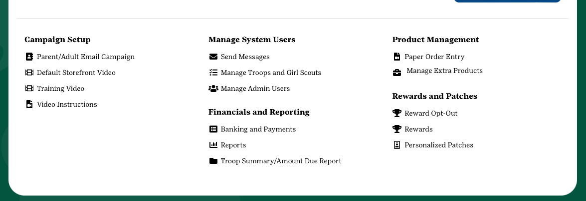

Ordering Additional Product
From the troop dashboard select Manage Extra Product under Product Management
Enter the number of additional items the troop wishes to order
Click SAVE
Product will be added to the troop order for pickup with the girl orders
Troop is financially responsible for all additional product ordered.
Additional product orders are added to the balance due and payment is due with the Troop Final Payment
**Be sure to only order what you are certain girls can sell as the troop is responsible financially for all product ordered
Notes:
New this year, troops can order additional product along with the girl’s orders. Simply click Manage Extra Product under Product Management, enter the items you wish to order and click Save.
Payment for additional product is due with the Troop’s Final Payment.

Slide 34


How to enter a girl payment
Notes:
Joe/Todd
Entering payments is easy,
From the troop dashboard select Banking and Payments
Select the + sign next to the girl you are entering the payment for or select Add Girl Scouts Payment and select the girl from the drop down menu
Enter the information and hit save.
Make sure you are creating a receipt for everything you are doing with your parents, should also have troop and parent signatures
-financial transactions
-products (can use receipt book)

Slide 35


REPORTS
Click the reports link from the troop dashboard to view total sales or sales by product category
Click a girl name to view the specific details of individual girls
Quick Link on dashboard to run the troop summary/amount due report
Notes:
Joe/Todd

Slide 36

Delivery Tickets
Product Delivery
SUPPM’s receive delivery of nuts and candy on Nov. 15th
Troops should count carefully at pick up and sign their troop delivery ticket
Store nuts & candy in a cool, dry location
Print delivery tickets to pre-sort for caregiver pick up as soon as possible
Notify your SUPPM immediately of any damages
Print delivery tickets by girl
Available for products and rewards for easier sorting and pick up
Option to include financials
Makes creating receipts easy!
Delivery tickets are available after the order is submitted by council
Notes:
Recording: “Detailed reports are available under the Reports link in M2OS or through the Delivery Tickets link. This link will become visible to volunteers AFTER the council has submitted the nut/chocolate order to the nut company. Once you can see the link, print delivery tickets for your Service Unit or troops from the platform to make for easier picking and packing but note that the delivery tickets do not include any late/extra product orders. There is an option to include financials by troop. If your council is still conducting online sales after the in-person order taking phase of your program is over, the financial information will not update to represent those online sales. For the most up-to-date troop financial information, please refer to the banking and payment section or the report section of the M2 system.”

Slide 37


Be safe online!
Troops should review with their girls:
Internet Safety Pledge
Safety Activity Checkpoints
Notes:
PP TEAM

Slide 38


Slide 39


Submit Signed Troop Fall Manager Agreement to SUPPM
Troop
TO DO
Hold Caregiver Meeting
Collect Permission/Information Forms
Distribute Materials to Families
Scan here to view Fall Program resources and training video as well as slide decks & recordings to train your families!
Review Girl Rosters in M2 System & Schedule Email
Encourage & Support Girl Scout Participation
Notes:
PP Team
So what’s next?
Make sure you have a signed troop agreement handed into your suppm
Start planning a caregiver meeting for Fall Product. This is a great time to have them complete the Annual Information form with Product Programs permission and to distribute materials.
Visit gswny.org’s Fall Resources page to find a recording and slide deck of training for caregivers.
Once into M2, be sure to review your rosters and ensure all MY26 registered Girl Scouts are in there. Schedule your email to caregivers. This email will go out on the first day of the program.
Encourage Girl Scout participation through troop entrepreneurship badge work and updating the girls on where your troop is in reaching their Fall goals.

Slide 40



Questions?
M2’S Customer Care team is cross-trained to handle tech support, volunteer/participant and customer inquiries
100% customer satisfaction guarantee
Council
Product Program Manager
S
U
P
P
M
Service Unit Product Program Manager
Troop Fall Program Manager
Girl Scouts &
their Caregivers
GSWNY Customer Care :
CustomerCare@gswny.org
1-888-837-6410
Notes:
Recording: “M2’s Customer Care team is cross-trained to handle support for volunteer/participant and customer inquiries, so direct folks there as needed. Thank you for your time and effort with the Product Program.”

Slide 41
FAQs
How do I reset my password?
From the login page, click the Forgot Your Password link. Remember that if you are also a parent, you must log into the participant section to manage your Girl Scout’s account. If you are also the troop/SU manager, you will need to login to the admin site. You can set up each site to use the same login and password for both!
When can a supporter expect a direct ship nut order placed online?
The supporter will receive a confirmation email of the order and then another email when the order ships with tracking details.
When will a participant receive their Personalized Patch?
The personalized patch will arrive about 8 to 10 weeks after being sent to the patch company for production. On the participant dashboard, you will see an ETA date so you can anticipate when your patch should arrive.
What if a participant didn’t find their name as they log into the platform?
That’s not a problem! Any Girl Scout who doesn’t know their troop number or see their name, can add themselves to the system. After a participant sets up an account, there will be a brief delay while the council confirms their GSUSA membership. Once that task is completed, council will release the participant from the holding tank and their customers will then have access to make purchases.
When can I expect my online girl delivery items?
Because timelines may vary, please have customers inquiring about their online girl delivered items reach out directly to the Girl Scout from whom they purchased for more details.”
Notes:
FAQs for resource only. Do not need to go over in training

Slide 42
Thank you!

