Slide 1




2026 Fall Program
SUPPM Training
Notes:
Welcome to the 2026 Fall Product Program SUPPM Training!
Before we get started, we have a few housekeeping items to go over.

Slide 2

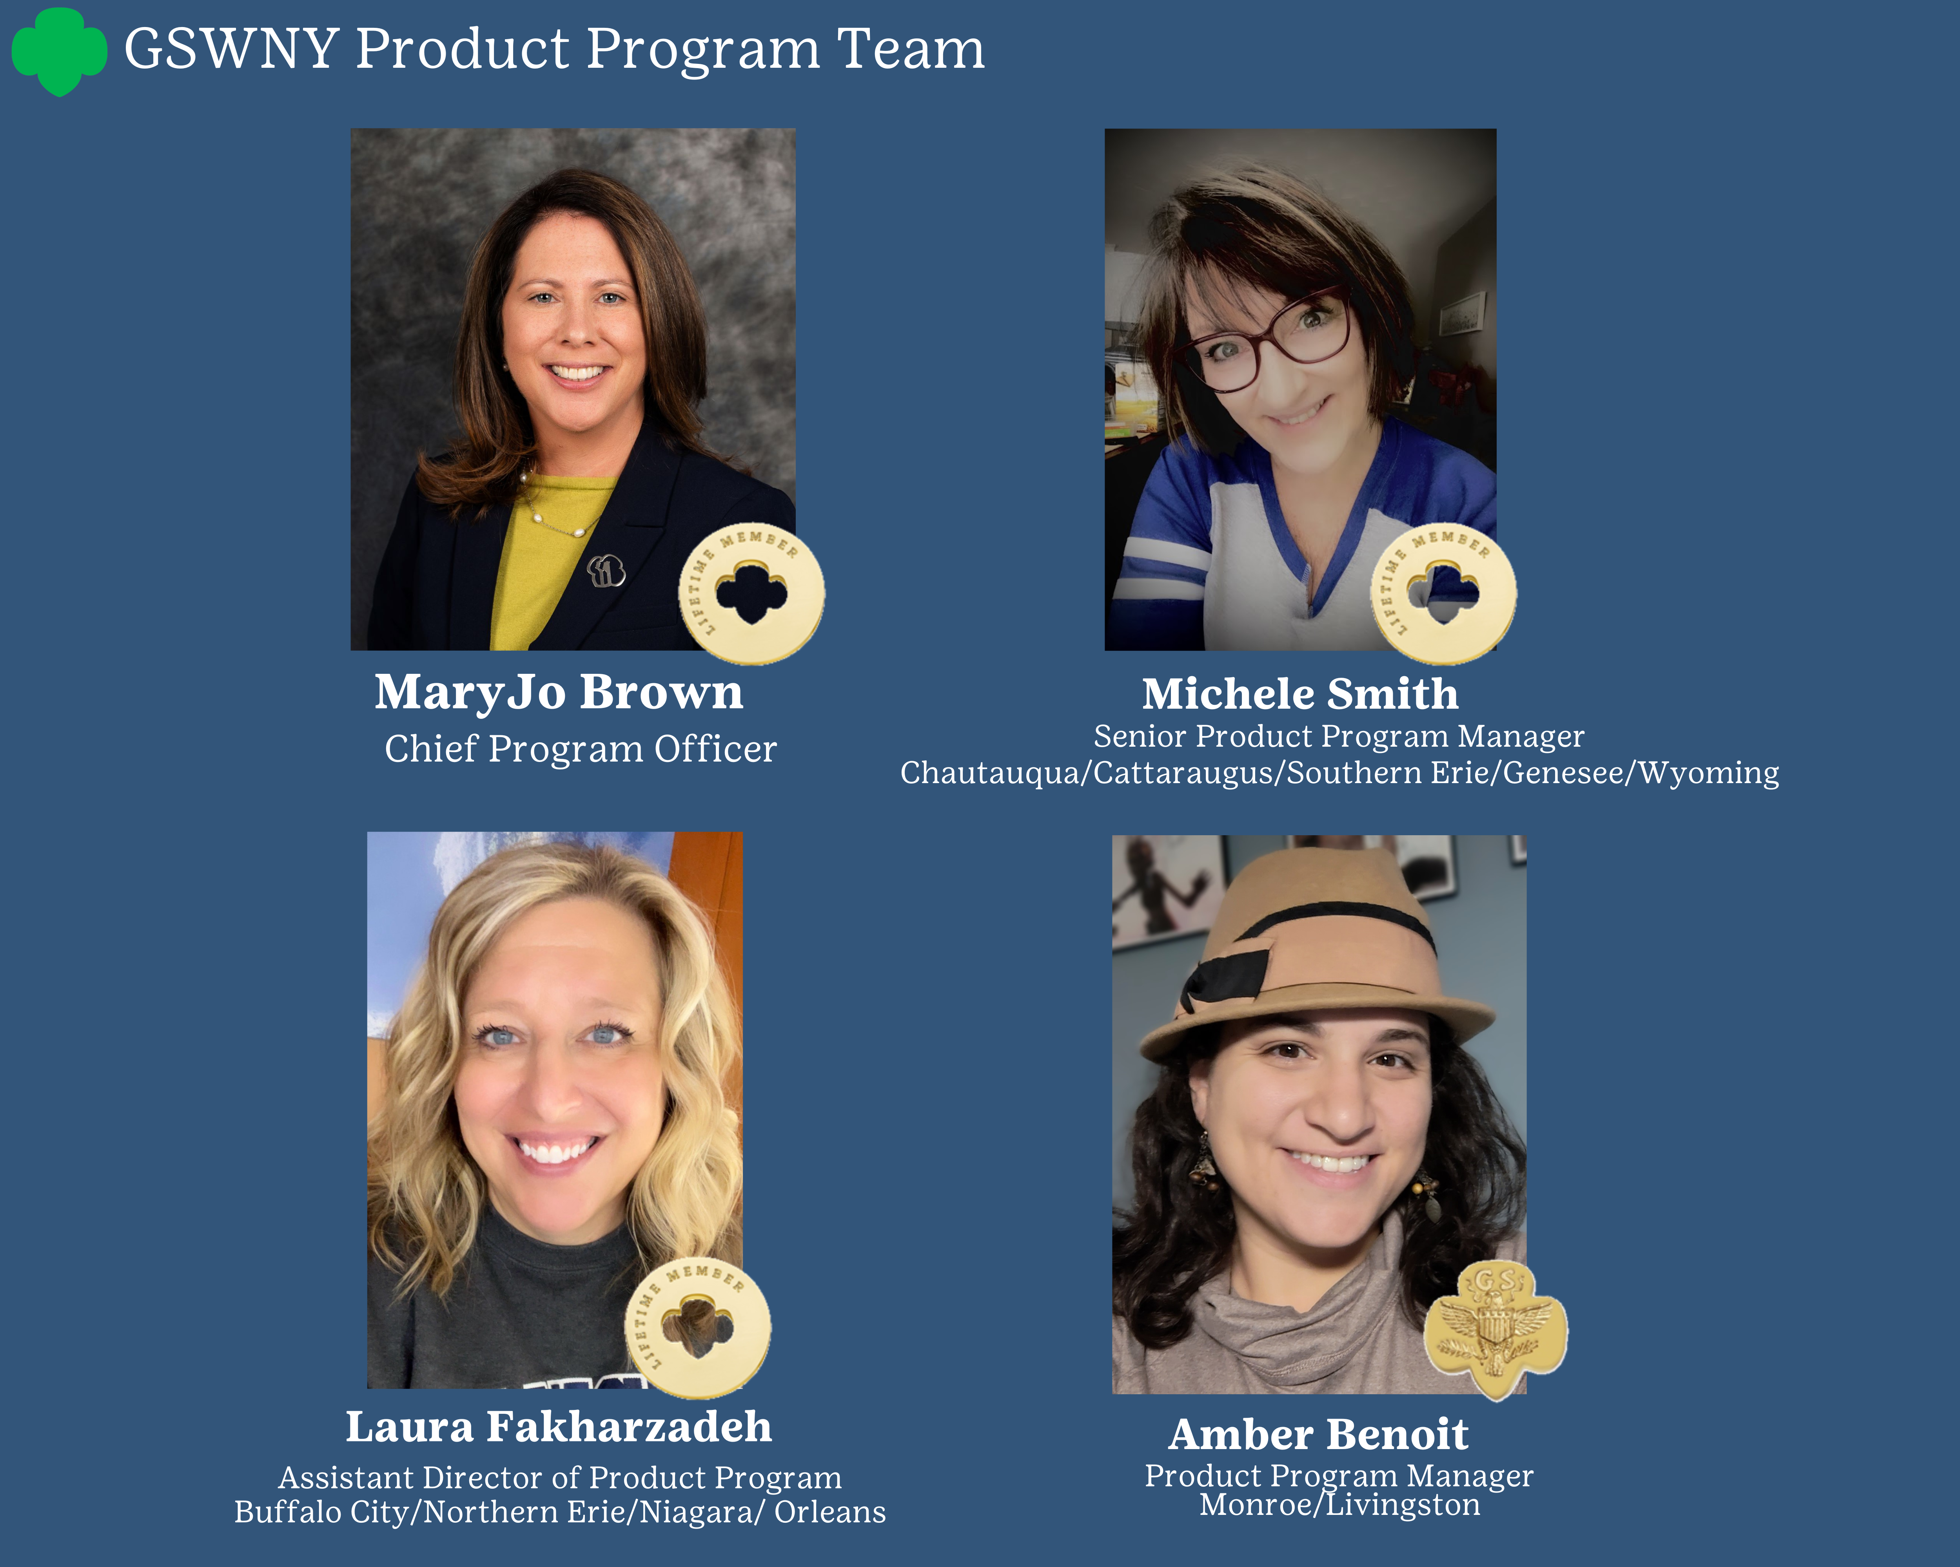

Here to support you!
Notes:
Your GSWNY Product Program team is here to support you in your role! You likely know at least one of these faces but we’ve got… (read slide)

Slide 3





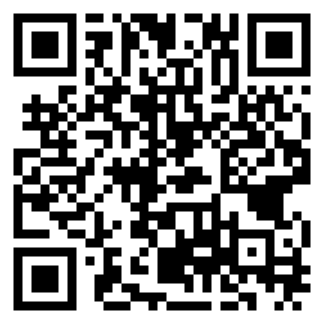

THANK YOU!
Thank you for empowering the next generation of women entrepreneurs by supporting your troops in the product programs.
JOIN US LIVE
Wednesday, September 2 from 7-8pm
For the 2026 Virtual Fall Vendor Showcase
Meet the Vendors
Recap 2025
See what’s new!
Complete your SUPPM Agreement & RSVP Here:
SUPPM are invited to stay after the presentation for a quick Q&A with the Product Program Team and Fall Vendors
Notes:
And from our entire team we want to say THANK YOU! We know it takes a special kind of volunteer to fill the role of SUPPM. THANK YOU for your dedication, creativity and organization! Everything you do helps not only increase financial literacy among our Girl Scouts, but also empowers the next generation of women entrepreneurs here in Western NY.
As we mentioned in our email to you, this year’s SUPPM training will take place in 2 parts:
Part 1 is the training you are watching today. It will provide a snapshot of this year’s Fall Program along with Service Unit Product Program Manager specific tasks. Keep this video link so you can reference it as needed throughout the program.
Part 2 is a LIVE Virtual Fall Vendor Showcase! We’ve invited our vendor reps to join us on Wednesday September 2nd from 7-8pm. At this showcase you’ll learn what’s new in the 2026 program, get to meet our vendors, and ask the team any questions you may have.
And finally, you will be able to complete your SUPPM Agreement virtually this year and it is available now. Scan the QR code on the screen to complete that. Included in the form is a space to register for the Fall Vendor Showcase.
Without further ado, your 2026 theme and mascot for the Fall PP are…

Slide 4














Notes:
Ready to Explore with Australia’s favorite bouncy mammal- the Kangaroo!
We’ll introduce this bouncy mammal a little more at our Vendor Showcase, but for now here’s a fun fact! A group of kangaroos can be called a herd, a mob, or a TROOP!

Slide 5







Every Product Program Builds Something Bigger!
Girls grow into confident leaders by practicing:
Money Management
People Skills
Goal Setting
Business Ethics
Decision Making
They form meaningful connections:
They become confident digital citizens:
Create positive peer relationships
Connect with customers and their community
Strengthen confidence alongside friends
Practice communicating with adults
Safely connect with customers online
Learn responsible digital communication
Build digital literacy and critical thinking
Set goals and celebrate reaching them
The result? Skills, confidence, and relationships that continue long after the Fall Product Program ends.
* Data above found in the 2026 State of the Girl report from GSUSA.
Notes:
The Fall Product Program is about so much more than selling products—it's about helping Girl Scouts discover what they're capable of.
Every Girl Scout starts somewhere. For one, success might be saying "thank you" to a customer. For another, it's setting a goal, managing their own orders, or deciding how to market their business. Year after year, those small moments grow into confidence, leadership, and independence.
Friendships grow along the way, lasting connections are made, and real world skills are developed like communication, money management, decision making and how to safely use digital tools to connect with customers.
As volunteers, you help create these opportunities. Every conversation you encourage, every goal you celebrate, and every challenge you help a Girl Scout overcome is preparing them for life.

Slide 6

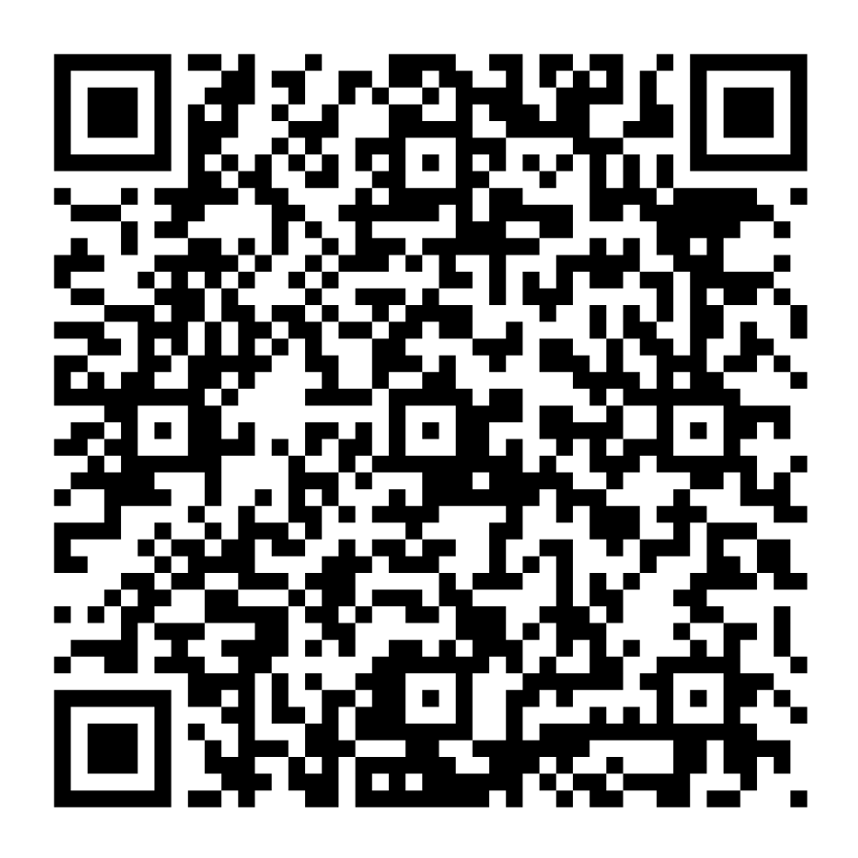
To read the full report and learn more about today’s girls, scan the QR code about.
Notes:
To read the full report and learn more about today’s girls, scan the QR code about.

Slide 7

Program Timeline
Sept 2– Sept 22
PROGRAM PREP
Host Troop Training (with enough time for troops to have a parent meeting) Distribute Materials, Collect Troop Volunteer Agreements/ Permission Forms, and Check Rosters in M2
Sept 16
VOLUNTEER ACCESS TO M2 SYSTEM
Sept 23
PROGRAM START
Launch email sent to Girl Scouts to register. Girl Scouts begin to take orders. SUPPM’s should enter in delivery site information for products & rewards.
Find this timeline in the Troop Guide!
Oct 24
PROGRAM END
Parents enter product/reward orders into M2 and make payment to troop leader.
Oct 25
TROOP LEADER REVIEWS & SUBMITS ORDERS
Oct 26
SUPPM REVIEW OF ORDERS & ONLINE STORES CLOSE
Oct 28
TROOP PAYMENT DUE & SUPPM RECONCILES PAYMENTS
Nov 14
DELIVERY OF PRODUCT TO SERVICE UNITS
Notes:
Now that the “kangaroo is out of the bag,” let’s dive into some details.
This year’s Fall Product Program will launch on Wednesday September 23rd and wrap up on Saturday, October 24th.
Our goal is to get as many troops ready to start prior to the September 23rd start date. To do this, we ask you schedule your trainings & material pick ups in a way that allows troops time to distribute materials before the program starts.
You’ll also notice that the program will begin prior to the start of the My27 Girl Scout year which begins on Oct 1st. We’ll go over in a little bit what that means for participating troops.
Troop Volunteers will be able to finalize all orders on October 25th, the day after parents are locked out of making changes in M2.
You’ll then have the 26th to review everything prior to submission. Keep in mind that this is also the last day all online stores will be open for direct shipped orders.
Troops need to pay their balance in full on or before October 28th.
And all Girl Delivery product is scheduled to be delivered to you on November 14th. Please note this day in your calendar to ensure you are available to receive the delivery.

Slide 8
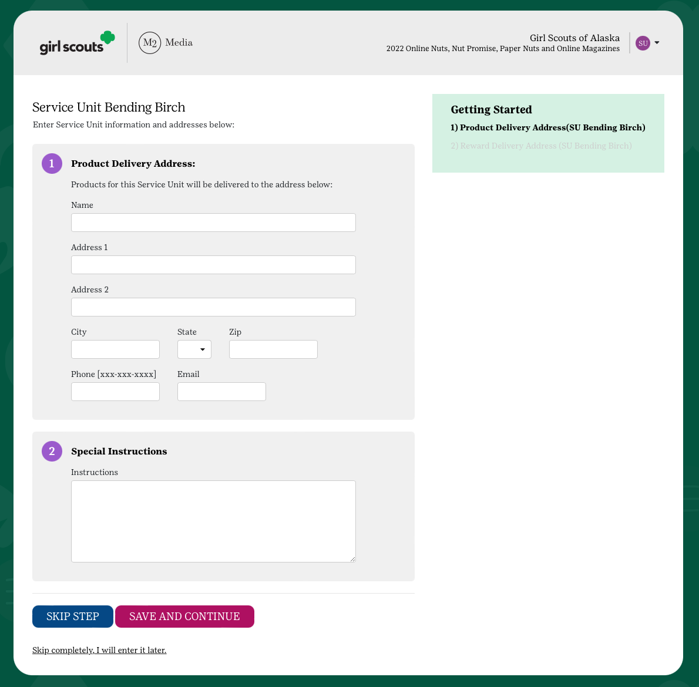
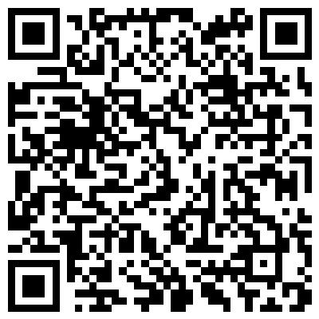
Additional Dates for SUPPM’s to Note
October 19th
Last day for SUPPM’s to enter, edit their delivery address
October 20th
Last day for troops to Opt Out of rewards
2 weeks from ship date
Last day for troops/suppm to report any product/recognition damages or shortages to council.
Note: these dates may differ from each other if recognitions are delayed.
December 1st
Deadline to submit Fall Refund Request forms
Scan here for online submission form.
Notes:
A few other dates that are important for you as SU PP Managers.
When you get into M2, please ensure you have entered your service unit’s delivery address for product and recognitions. October 19th is the deadline for entering, editing, and confirming these addresses. It is important that you CONFIRM this address as this is where M2 will deliver all products and rewards.
Cad/Sr/Amb troops have until October 20th to waive recognitions in lieu of more proceeds.
You have 2 weeks from the ship date of your service unit’s product and recognitions to report any damages or shortages to us.
And finally, we are providing a deadline this year for troops to get in their Fall Refund Requests. We have made it super easy to submit through an online form. The form is linked here but will also be available on our Fall Volunteer Resources Page of gswny.org
Be sure to share this information when you train your troops.

Slide 9

Fall Program Loading
…
Notes:
Now that we’ve got our dates down, let’s explore preparing for the program.

Slide 10
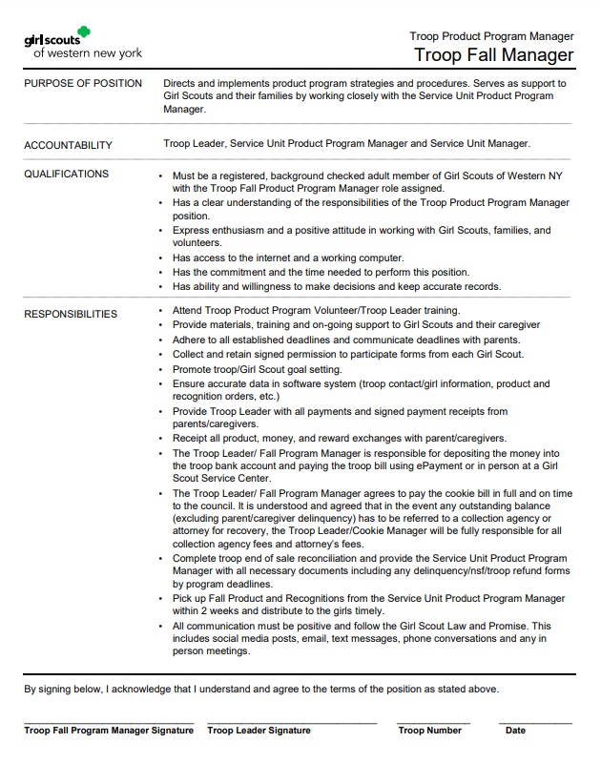

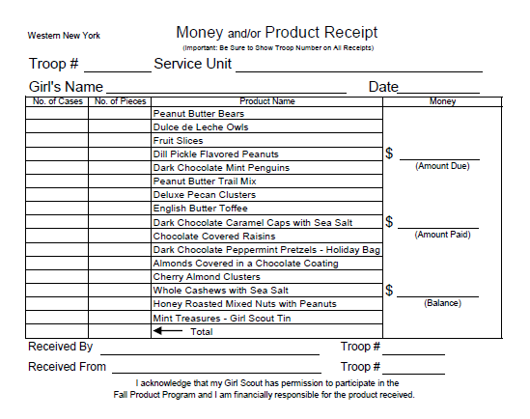
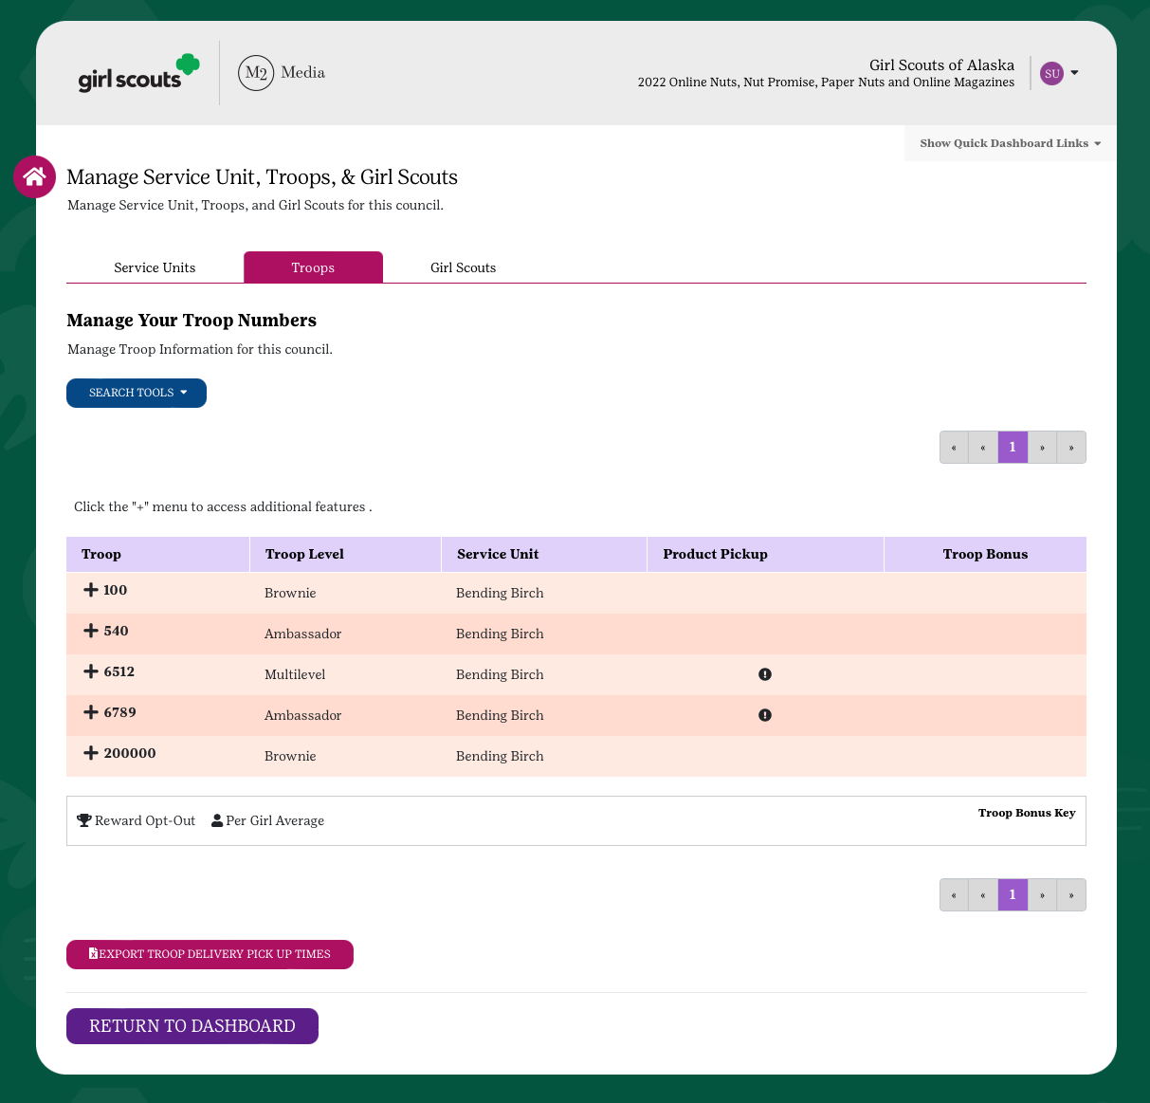
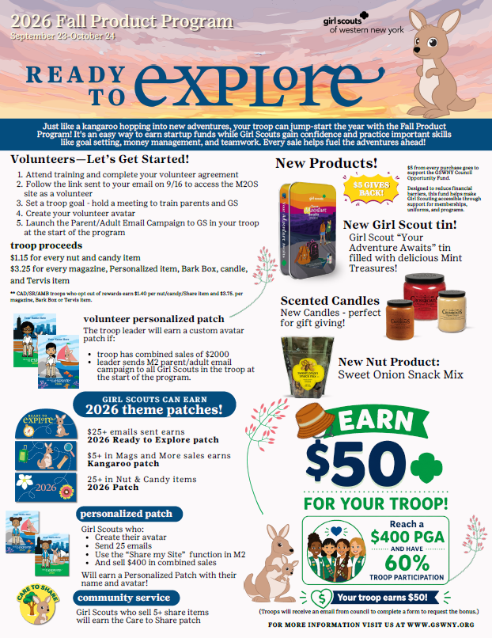
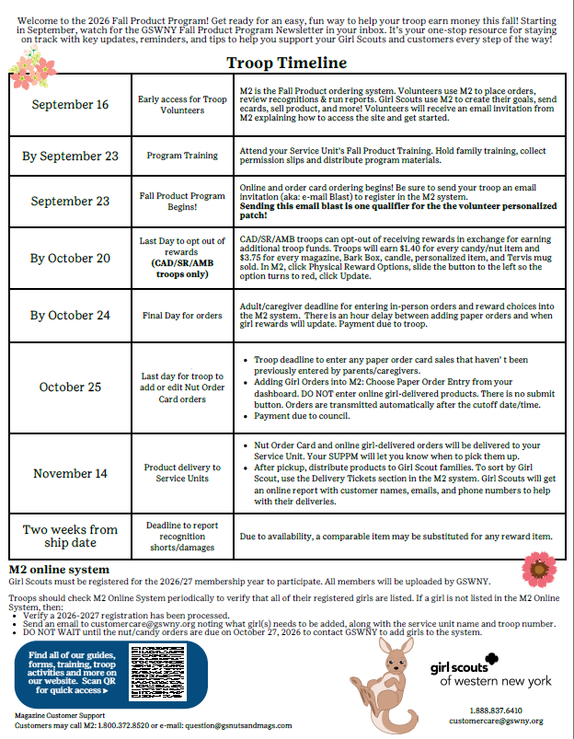
Are your troops ready to participate?
TROOP AGREEMENT
RENEWED
My27 GSUSA Adult Membership
My27 Co-leader Role
My27 Troop Fall Product Manager Role
TRAINING & MATERIALS
Receipt Book for inventory or payments
LISTED IN M2 ROSTER
Troop Guide with Timeline
Notes:
When prepping for your service unit to participate in the Fall Product Program, your first objective is getting troops ready. This first crucial step will make the entire process and program easier all the way down the line.
As suppm you are asked to:
Make sure any Troop Fall Product Program Managers have a My27 Membership as well as My27 co-leader and Troop Fall Product Manager Role assigned
Also, please ensure the correct leaders are listed in M2 once you get access to it (Initial uploads are done late August/early September. Leaders who are not renewed or have the role renewed or assigned by then may not be in M2 properly)
You’ll need to collect a Troop Fall Product Program Manager Agreement from each participating volunteer in a troop and retained these until the program is completely wrapped up.
And of course you’ll train the troops in your service unit and distribute the Fall Product Program materials to them.
Let’s go into a little more detail on these tasks…

Slide 11
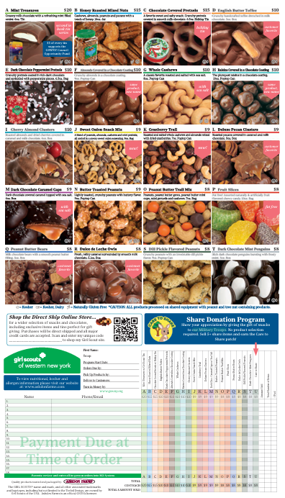

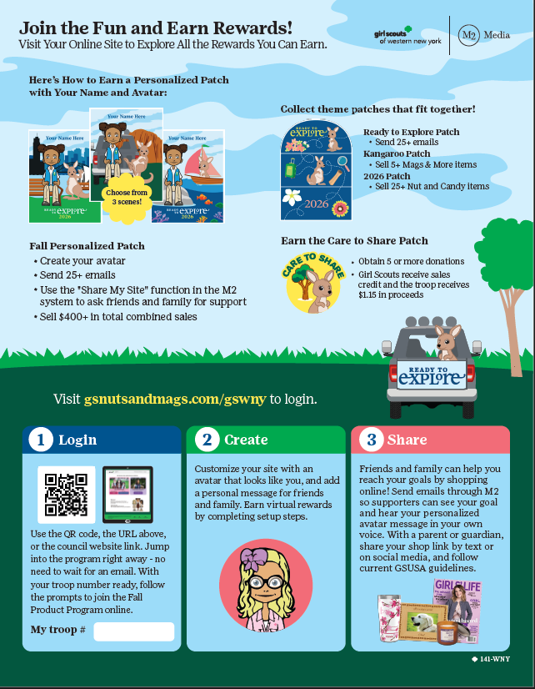
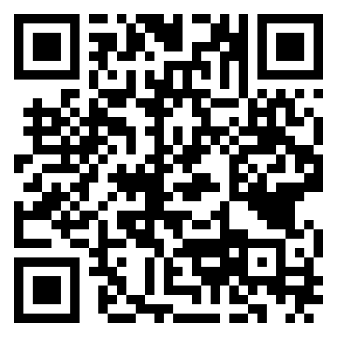
Troop Fall Product Program Manager Agreement
Paper Materials to Distribute
Digital versions of all printed materials will be available on GSWNY.org’s Fall Product Program Resources page.
TROOP
Receipt Book for inventory or payments
Troop Guide
with Timeline
FAMILY
Online Agreement available here →
Troops must email completed PDF to SUPPM
Getting Started Family Guide
Order Card & Recognition Flyer
Notes:
Troop Fall PP Managers for each troop are required to sign an agreement in order to oversee their troop’s program. This form should be submitted to the SUPPM where it is kept in a safe place until the troop has made their final payment to council AND has distributed all recognitions.
Copies of this form will be in your paper materials. This year, we have also provided an online jot form version of the Troop Fall PP Manager agreement. Either format can be used, HOWEVER we want to emphasize, that the online jot form is only meant as a way for troop volunteers to complete the form online. They will still be required to send you a copy of the pdf and will be told such multiple times when they follow the online link. Council will not be providing copies from the form. When a volunteer completes this form they will be able to download a copy from their confirmation screen. An email will also be sent to them with the completed form.
Paper materials are scheduled to arrive to you the week of August 31st.
Troop paper materials included a large envelope that features the Troop Guide and the program timeline as well as receipt books which troops can use when distributing product or when receipting payments from parents. M2 also offers printable receipting which can be accessed from a troop’s dashboard.
Girl Scout paper materials included in your shipment will include the Order Card which features our recognition flyer and the M2 Getting Started flyer. We’ve simplified materials for Girl Scouts this year by updating M2’s Getting Started Flyer to include any key information we would normally list on a family guide. Troops should receive one of each of these items per Girl Scout. Please remind them that ONLY Girl Scouts who have a signed permission form should receive these materials.
Finally you will receive 25 copies of the Girl Scout Caregiver Permission to Participate Form. As permission to participate in both Product Programs is now included on the Troop’s Annual Information Form, these forms can be distributed as needed.
Extras of all forms are available upon request at our service centers. So if you need more, just ask!

Slide 12
Key Points for Training
Troop Volunteer Slide Deck/ Recorded Training will be available on September 2nd!
Participation Readiness:
    Troop Setup: Memberships current, Roles Renewed, Girl Scout Roster correct?
    Troop Product Program Manager agreements understood and signed.
    Troop Proceeds and how they fund activities explained
    Financial Literacy and entrepreneurship learning for Girl Scouts
Timeline & Financials
    Deadlines matter: be mindful of Important Dates
    Finance Standards: Establish protocols for tracking, collecting and managing funds and product-receipts!
Program Support
    Reassure volunteers they are not alone and support is available.
    Resource Familiarity: Train volunteers to utilize paper materials provided and where to access online resources
    Availability: Clearly define communication methods and availability that works best for you
The Product Program Newsletter
    Encourage volunteers to watch for the Product Program Newsletter
    Newsletter content: In time information for that week. Fun promotions for troops and Girl Scouts and updates on what comes next
Tip!
Collect a signed Troop Volunteer Agreement before handing out materials!
Notes:
As the Service Unit Product Program Manager, one of your most important responsibilities is making sure every participating troop receives this year's Fall Product Program training—whether they attend your in-person session or watch the council's pre-recorded training. Even experienced volunteers benefit from training each year, since the program continues to evolve.
In-person trainings are a great opportunity to build excitement, collect troop agreements, distribute materials, answer questions, and connect with volunteers across your service unit. Council will provide both a training slide deck and a pre-recorded troop training, giving you flexibility to meet the needs of your volunteers. Keep in mind that newer volunteers may appreciate a little extra guidance along the way.
As you lead your training, be sure to cover the key topics on this slide. Help volunteers understand how the Fall Product Program gives troops an easy way to earn startup funds while introducing Girl Scouts to entrepreneurship and financial literacy.
Be sure to review the Volunteer Agreement, highlight important deadlines, explain how to properly receipt products and record finances, and introduce any new features or updates for this year's program.
Finally, encourage volunteers to use the materials and resources available to them throughout the program, including the online resources and the Product Program newsletter. That's where they'll find the latest information and answers to many common questions.
Our goal is for every volunteer—whether they're brand new or returning—to leave training feeling confident, prepared, and excited to get started. Encourage them to log into M2 early, verify their troop roster, and help their Girl Scouts create their avatars so they're ready for a successful season.

Slide 13
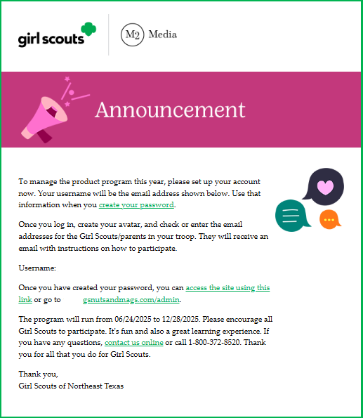
TROOP VOLUNTEER ACCESS
September 16th
Receive an email invitation to login
Watch Troop training video
Queue Parent/Adult Email Campaign
Create your volunteer avatar
NOTE:
GIRL SCOUT/FAMILY ACCESS
Is September 23rd
Notes:
On September 16th troops will receive an invitation to log in to the Admin site. Once logged in, troop volunteers will view a short training video that provides an overview of the program and introduces the key features of the M2 platform.
After completing the initial training, troops can access additional platform guidance directly within M2 to walk them through the next steps. Troops can then launch the Parent/Adult Email Campaign, which helps announce their participation and provides families with the information and links they need to get started. Throughout the program, encourage troop volunteers to create their own troop avatar and explore the tools available to support their Girl Scouts.
Please note: these emails do sometimes go into the spam/junk folder. Remind your troops to check there if they don’t see their email in the inbox.

Slide 14
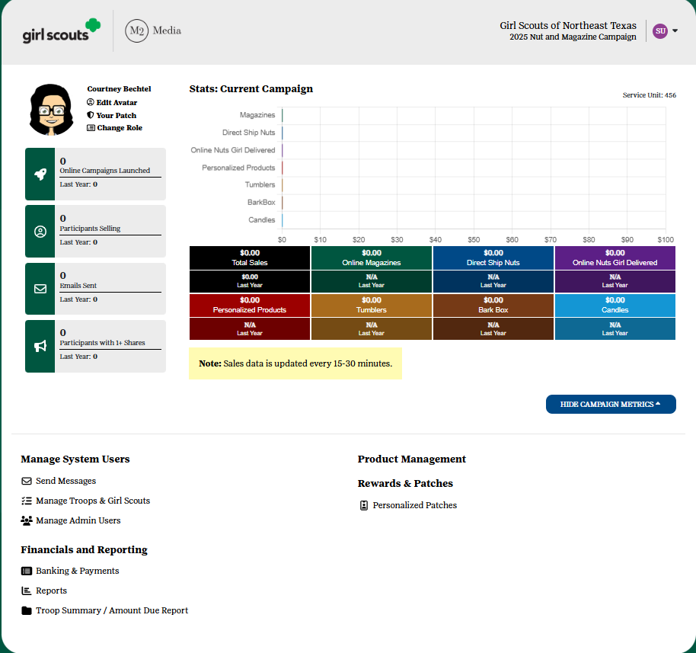
SERVICE UNIT DASHBOARD
Send Messages
Manage Paper Order entry
View sales reports
Banking and payments
Notes:
Service Unit Product Program Managers have access to tools designed to help support, monitor, and encourage participation across the entire Service Unit. From the volunteer admin site landing page, SUPPM can view overall program performance, access key statistics, and manage important program activities.
You can communicate directly with participating troops by sending messages to share program updates, encourage participation, and celebrate successes throughout the program. You can also assist by viewing, editing, or entering participant order card information as needed.
Service Unit access continues after the program ends, allowing volunteers to reference reports and banking information throughout the Girl Scout membership year."

Slide 15

Membership & Rosters
GSWNY initially uploads Girl scouts and volunteers in early September.
Looker is an online tool that provides current (within one business day) membership information for Girl Scout employees and volunteers.
As a service unit volunteer you have access to reports which provide:
Full Rosters
New members from the last 2 weeks
Troop Details & contact info
Notes:
Checking your troop volunteer rosters in M2 is easy! From your dashboard, go to Manage Troops and Girl Scouts, then click the Troops tab to see who is uploaded.
***We upload based on renewed membership and the presence of a co-leader and/or Troop Fall Product Manager role assigned to the volunteer. If they do not have a Troop Fall Product Manager role assigned, 2 leaders at random will be uploaded into M2.
***It is also important for troops to review their rosters in M2. Sometimes girls change troops but the system doesn’t recognize this change until 10/1 resulting in them uploading to their MY26 troop and not the new MY27 troop.
Your help in catching any troop inaccuracies reduces volunteer frustration as well as helps us ensure the correct people have access.
To assist in this, all suppm are provided access to Looker, our online reporting program that is directly linked to our membership information. All information found in Looker should be kept private. If you do not have access or are not sure how to login, please email customer care.
If you find information in M2 that needs to be corrected (i.e., someone not uploaded or a troop missing a volunteer), please reach out to customer care immediately.

Slide 16
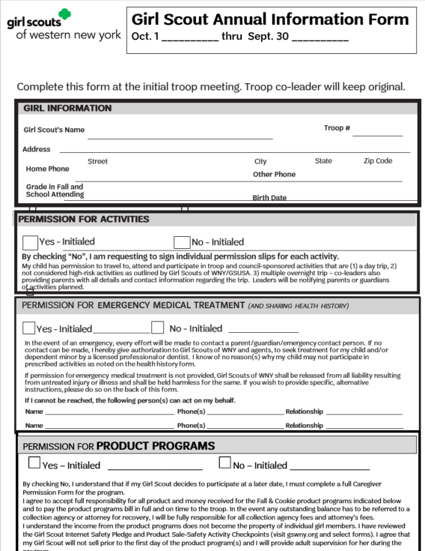


Troop Fall Product Program Managers ensure their Girl Scouts are ready!
PERMISSION FORM
Girl Scouts are registered for the My27 Girl Scout year.
Girl Scout is listed on the troop’s M2 roster
MyGS
Getting Started Family Guide
SET A GOAL
MATERIALS
Tip!
Only distribute materials WHEN you have a signed permission form
Order Card & Reward Flyer
Notes:
Troop Fall Product Program Managers ensure their Girl Scouts are ready to participate!
Membership- Just like you, Girl Scouts need to have a My27 membership to be uploaded into the M2 site. Troop Fall PP Managers should review their roster in M2 to account for all troop members. If someone is missing, they should confirm they are registered, then reach out to customercare@gswny.org to have the Girl Scout added to M2. A Girl Scout can only be moved to another troop in M2 if they have NOT begun selling. Also, we will not remove Girl Scouts from a roster because they are not participating in troop activities.
Permission Form- Girl Scouts also need permission to participate from their caregiver. Permission to participate in the Product Programs is included on the Girl Scout Annual Information From. NOTE- this form was updated last year. Please remind your troops to use the correct form. --- If needed, a troop can use one of the Caregiver Permission to Participate Forms instead.
Each Girl Scout should receive an order card (with reward flyer) and a Getting Started M2 flyer. The flyer this year includes tear off “Shop my site” tickets Girl Scouts can use to share their M2 site. They will need to add their Unique Site code to these which can be found at the top of their dashboard.
Set a Goal- Troops should work with their Girl Scouts to set a Troop Goal and encourage girls to set individual goals with their family. Rewards are a great tangible way for younger Girl Scouts to use in goal setting. More on that in a minute.

Slide 17



Independently Registered Girl Scouts
IRGs, Juliettes, Independents
A 99*** troop (99+su #, for example 99610)is uploaded for each service unit
Managed by the service unit/suppm (includes collecting permission forms)
Payment in full (includes proceeds) from caregivers should be deposited into the service unit account for Juliette/IRG fund
Service Unit/SUPPM are responsible for making final payment to council
Notes:
Independently Registered Girl Scouts (also known as IRG’s or Juliettes) can participate in the Fall Program under the service unit’s management.
As SUPPM, we ask that you- or the service unit volunteer who will manage IRG’s – engage IRG’s to gauge their interest and offer the necessary support to them to succeed.
You can find a list of your Juliettes in Looker. The suppm acts as the troop leader in M2 for all IRG’s participating in the Fall PP, you will find you have access to your 99 troop upon logging into your M2 account. Juliette’s are not automatically uploaded into M2. You will need to contact Customer Care if you have an IRG looking to participate.
For IRG protocol and guidelines, along with the Financial Request form visit gswny.org, Fall Product Program Resources page. Feel free to connect with your council PP Manager with any questions you may have about IRG’s and the program.

Slide 18
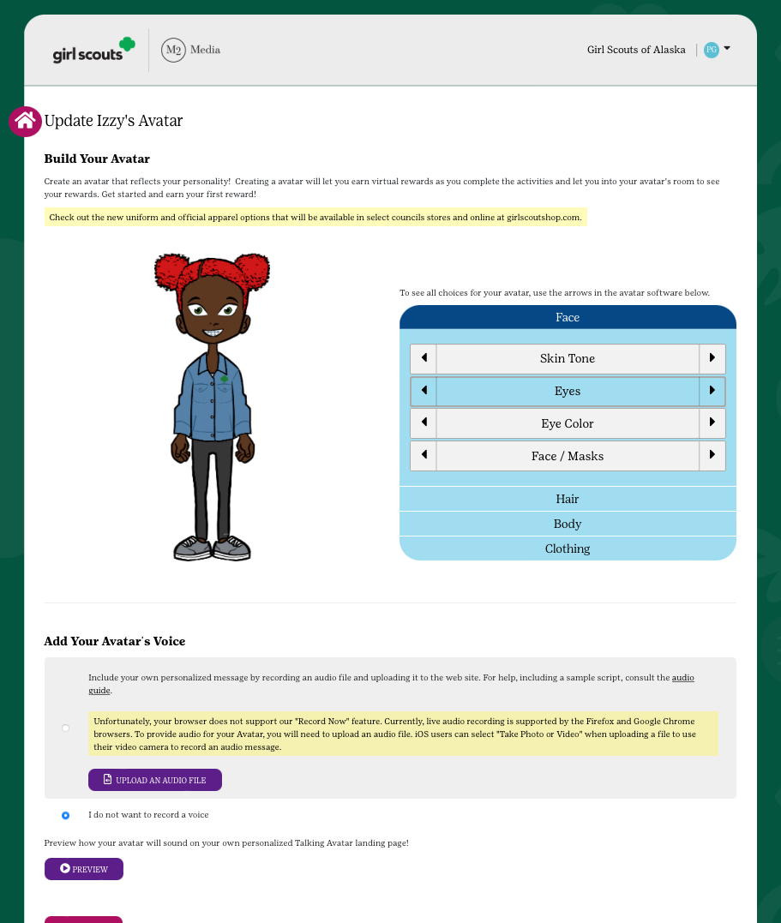
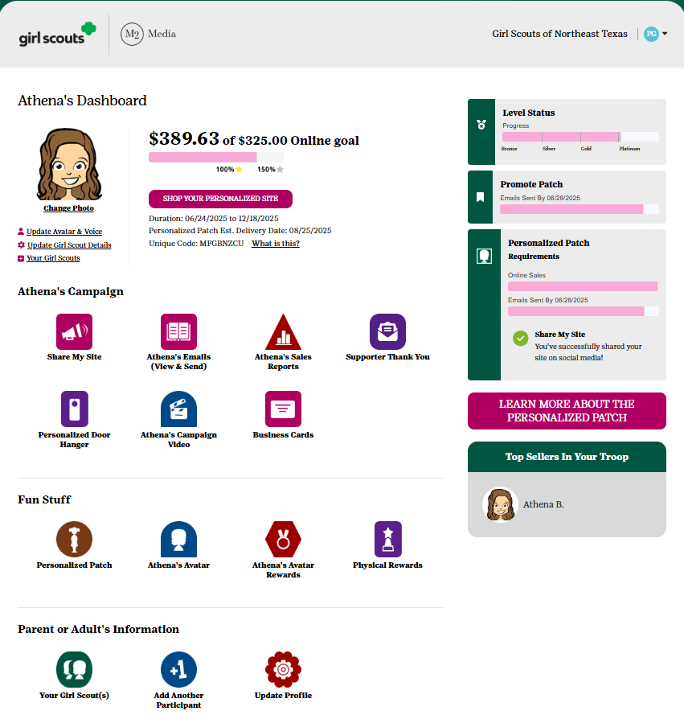
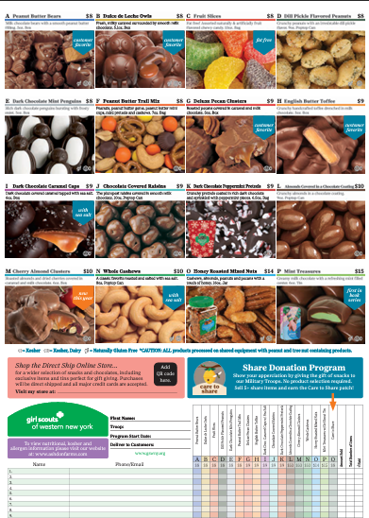
Girl Scout M2 access begins Sept 23rd
Online Personalized Site
Create an Avatar & track goals
Send emails
Share your link
Print business cards & door hangers
Take Girl Delivery (varieties on nut card only) or Direct Shipped orders
Online Girl Delivery can only be removed by unselecting the “Girl Delivery” checkbox next a customer prior to sending them an email via M2.
Nut & Candy Card
Collect payment upfront
Place order via M2 site & pay troop
SUPPM’s distribute product to Troop Leader
Notes:
Girl Scout Caregivers will receive an invitation to login to M2 on September 23rd.
Remember, only Girl Scouts with a My27 membership will be uploaded. In addition, M2 requires us to upload the girls first, then the troops, and lastly the volunteer- so I’m going to reiterate one more time that you and your troop volunteer’s review of the rosters very important.
The Product Program team performs several uploads throughout the program as we know many families wait to renew until the last possible moment. SUPPM or Troop Leaders can request a missing registered Girl Scout to be uploaded by emailing customercare@gswny.org.
Girl Scouts have the choice to take orders online or in person within the Fall Program. The nut and candy order card will include all varieties available for Girl Delivery.
The M2 platform allows Girl Scouts to create an online personalized selling site. From this site they can take Girl Delivery orders for those same nuts & candies, but customers can also order a variety of direct shipped items such as bark boxes, magazines, candles, and more!
Troops can choose how they are going to participate. If a troop chooses, they can forgo Girl Delivery and instead participate online only, offering the Direct Shipped option to customers.
It’s important that troops understand the only way to do this is by instructing parents to UNSELECT the Girl Delivery option when they send emails to customers. There is no way to fully “turn off” the Girl Delivery option in M2.

Slide 19



Ready to Explore?
Notes:
So we’ve got your troops and Girl Scouts all set up for the program. Now it’s time to explore all the FUN the Fall PP has to offer! As a reminder, there will be plenty more new & exciting things announced at the Vendor showcase on 9/2!

Slide 20
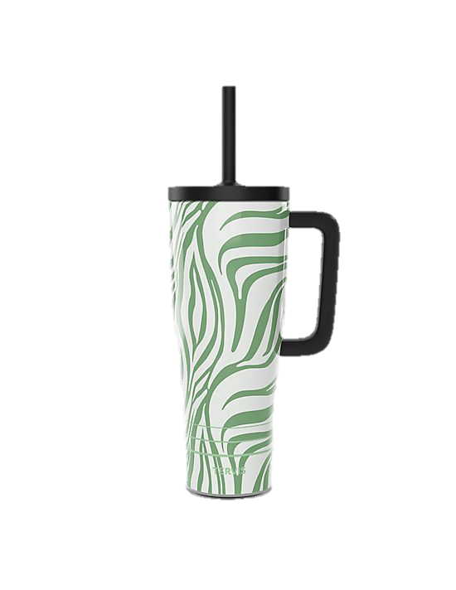
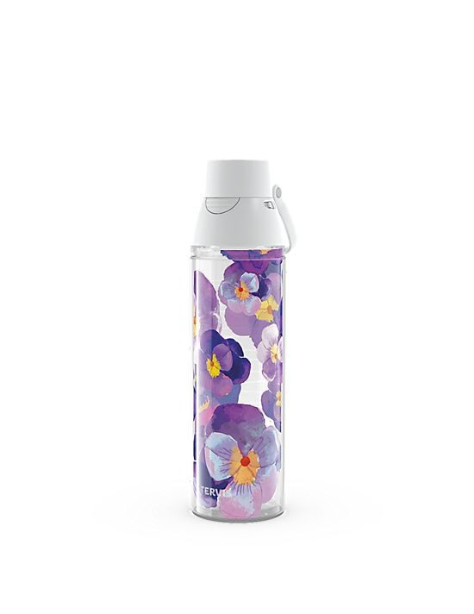
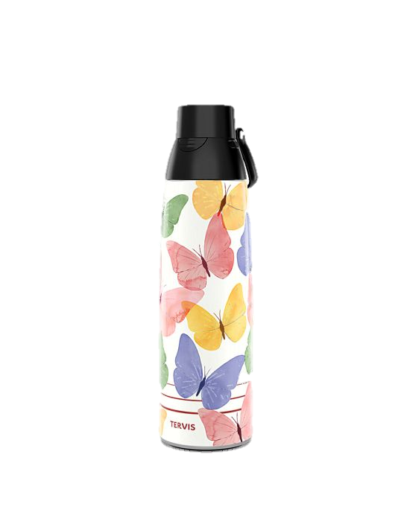

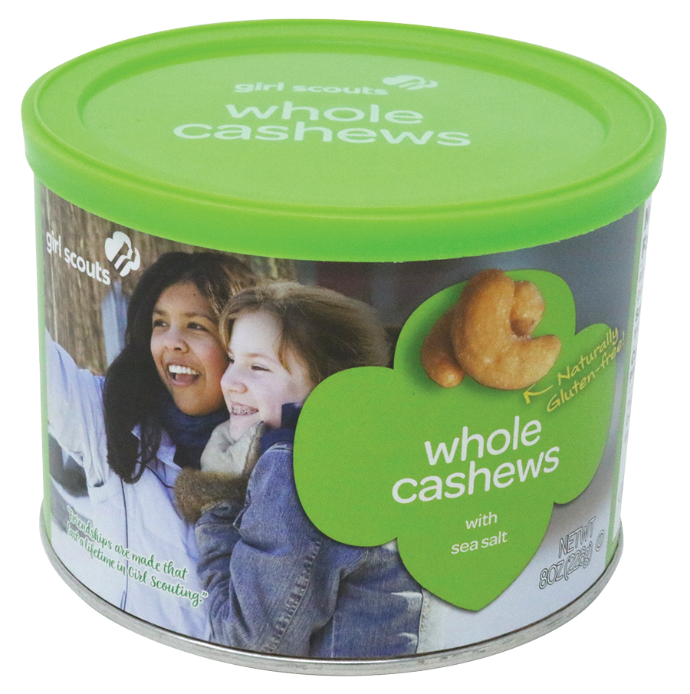
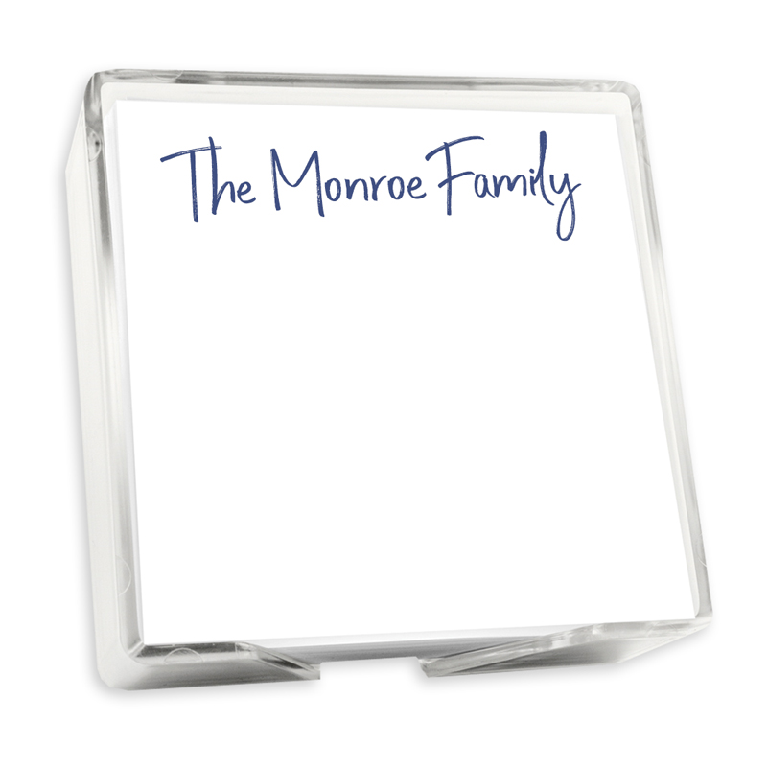




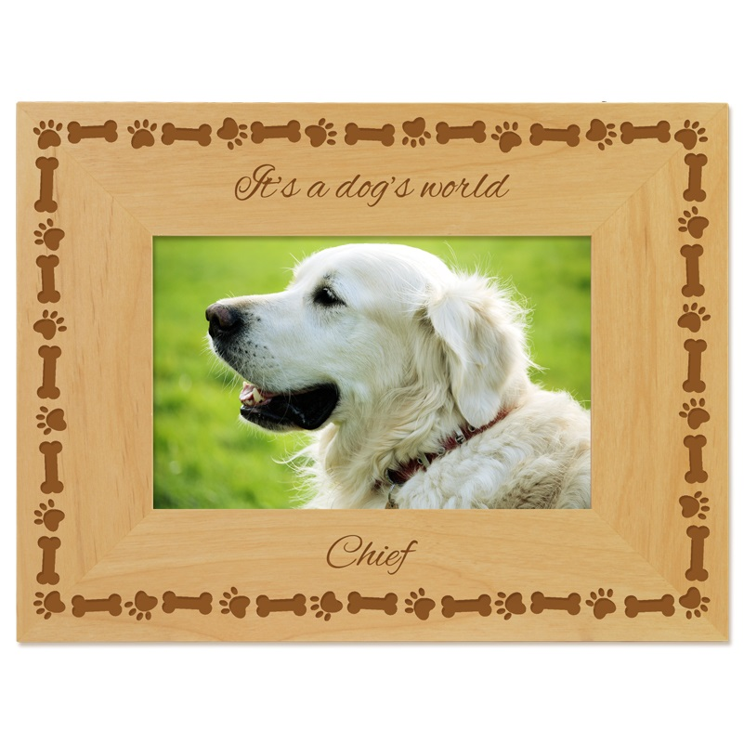
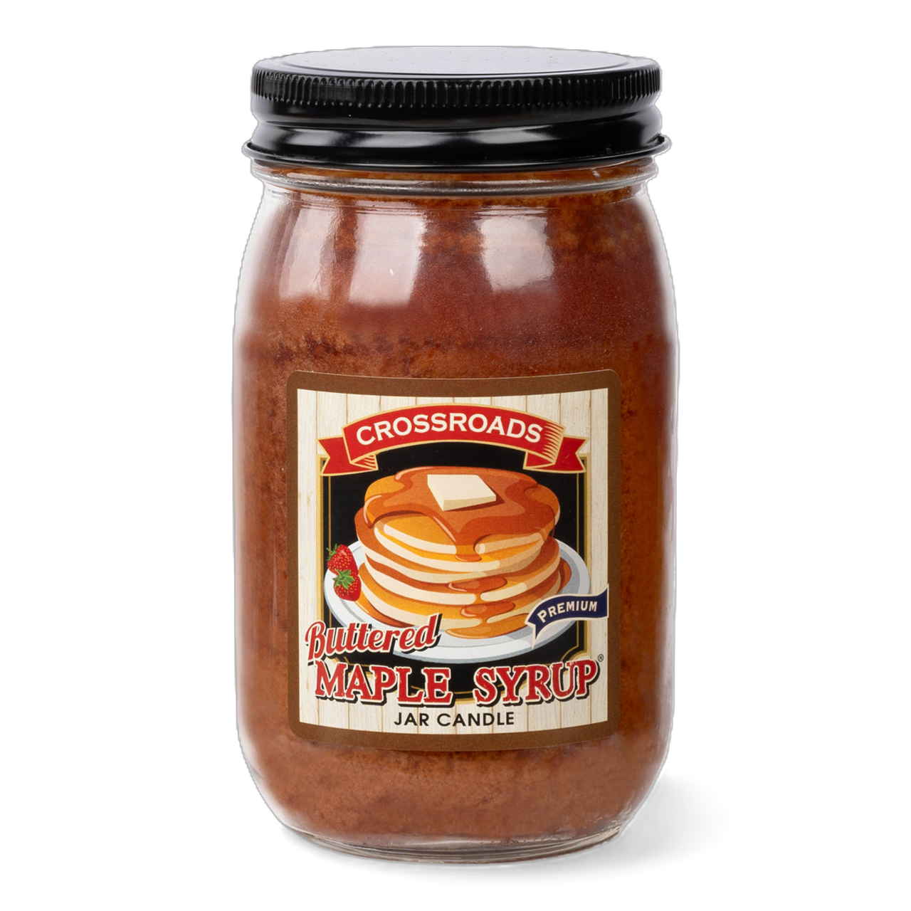
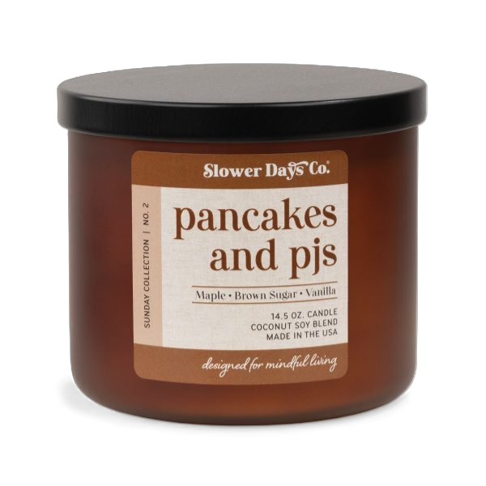
Fall Program Products
GSWNY Girl Scouts sell a variety of products
Nuts, Chocolate, and Candy
(select assortment available for Girl Delivery)
Magazine Subscriptions
Personalized Products
Tumblers
Candles
Girl Scout themed Bark Boxes for pets
GSWNY 2026 Sales Breakdown
Notes:
If you didn’t already know, the Fall Program provides a variety of products for the Girl Scouts to sell.
Through their online store, Girl Scouts can sell nuts, chocolate, candy, magazine subscriptions, personalized products like frames & stationary, tumblers including some of their favorite sports teams, candles, and the popular Girl Scout themed Bark Boxes for dogs.
Via their online store and their order card, they can also take Girl Deliver orders on a variety of nuts, chocolate, and candy items.
The pie chart on the right gives you a breakdown of how popular certain items were based off of last year’s sales in Western NY.
As you can see, a LOT of Girl Scouts utilize their orders cards in our council! Caregivers are able to enter the total of each variety needed to fill Order Card orders into M2 before the close of the program.
From there, both Troop Leaders and SUPPM will have the ability to edit these orders through their close out date.
Money is collected at the time of sale, so payment to the troop is required before orders are placed by the troop.

Slide 21





CARE TO SHARE
Girl Scouts ask their customers to purchase “Care to Share” packages to support “Shredding Hunger, Inc..”
Shredding Hunger’s mission is to fight hunger by making high-quality, affordable food accessible to everyone. Their organization supports food banks in Western NY and across the United States.
When customers purchase a “Care to Share” package the Girl Scout and their troop get credit for the purchase.
Care to Share can be ordered on a Girl Scout’s order card or via their online site. Products are distributed by council and are not delivered to troops/girls.
Troops earn proceeds and girls who sell 5+ Care to Share items earn a special patch and credit towards other rewards
$5 DONATED to the
GSWNY COUNCIL OPPORTUNITY FUND
With every 2026 Mint Treasures purchase
The Council Opportunity Fund (COF) is a financial assistance program provided by the Girl Scouts of Western New York (GSWNY).
This fund removes financial barriers for local Girl Scouts by assisting with membership dues, uniforms, and council-sponsored trips and events.
Notes:
We’ve got some updates to how Girl Scouts and their customers can practice philanthropy within the Fall Product Program.
Our Care to Share program will continue this year, with Care to Share item being $8. When customers purchase a Care to Share item the Girl Scout & troop gets credit for a nut/candy item being sold. Our partners at Ashton Farms then donates the nut or candy items.
This year we’ve chosen to have these donated to Shredding Hunger. This organization’s mission is to fight hunger by making high quality, affordable food accessible to everyone. Their organization supports food banks across Western NY and the United States.
Care to share items can be ordered via the order card or a Girl Scout’s online store.
You’ll also notice some updated pricing to our 2026 Mint Treasures tin. This is because $5 of every 2026 Mint Treasure tin will be donated to the GSWNY Council Opportunity Fund. If you didn’t know, this is the fund that allows our council to offer financial assistance to Girl Scouts to cover things such as membership fees, uniforms, and more.

Slide 22


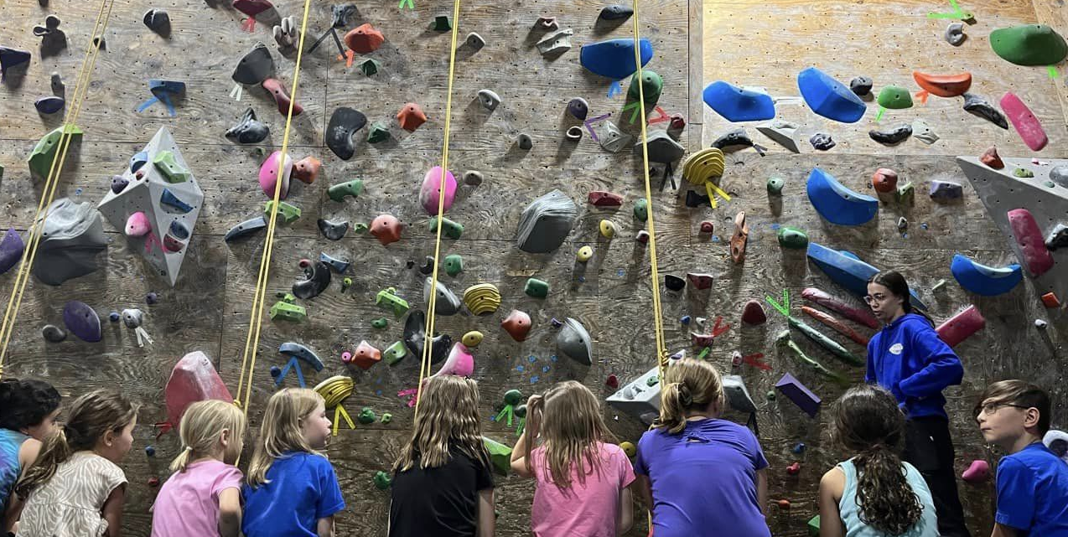

Troop Proceeds
Older Level Reward Waiver
C/S/A level only
$1.15 for every nut, chocolate and candy item
$1.40 for every nut, chocolate and candy item
$3.25 for every magazine, Bark Box, personalized gifts, candles, and Tervis Tumblers
$3.75 for every magazine,
Bark Box, personalized gifts, candles, and Tervis Tumblers
BONUS $50 Troop Reward!
Troops with a $400 PGA & 60% participation by October 26th will receive $50 bonus proceeds.
Notes:
Troops who participate in the Fall PP are also eligible for troop proceeds and can earn a Troop Bonus Reward!
Encourage your troops to set a troop goal for proceeds. This is a great time to talk budgeting and what they want to do within the MY27 year.
Older level troops may waive their recognitions in exchange for more proceeds. They must complete a waiver form which includes signatures from all members of the troop, the troop retains the form for their records.
The troop leader can then adjust their recognition plan in M2.
This year troops can also earn a $50 bonus troop reward! By ending the program with a $400 pga and 60% participation, troops will receive $50 to put towards their troop adventures.

Slide 23






EXCLUSIVE!
2026 Fall Program Patches
Fall Girl Scout Personalized Patch
Create your Avatar
Send 25+ emails
Sell $400+ in total combined sales
Send 25+ Emails in M2
VOLUNTEERS! Earn your own Personalized Patch
Schedule your M2 Parent/Adult Campaign Email prior to 9/23
Troop has combined sales $2000+
Sell 5+ Magazine & More Items
(Includes BARK Boxes, Tervis, Personalized Items, Candles, and Magazine Subscriptions)
Sell 25+ Nut/Chocolate/Candy Items
(Online or Order Card)
Earn alongside $350+ in Combined Sales recognition
Sell 5+ Care to Share
Notes:
Our 2026 exclusive Fall PP patches are designed to help your Girl Scouts reach their goals! Starting off, you can earn the 2026 Themed patch just by sending 25+ emails in M2.
Sell 5 or more of the bark boxes, tervis tumblers, personalized items, candles or magazine subscriptions to earn the big Kangaroo patch. And sell 25 or more nut/chocolate/candy items for the 2026 patch.
Girl Scouts can also get a personalized patch with their M2 avatar. To earn this patch they’ll need to create their avatar, send 25+ emails and sell $400 or more in combined sales. Volunteers can also earn one if their troop has combined sales of $2000 and they schedule their Parent/Adult email campaign.
Of course you just learned about Care to Share. If a Girl Scout sells 5 or more she’ll earn the care to share patch!.
Remember, troops who waive recognitions in lieu of more proceeds are still eligible for the patches.

Slide 24
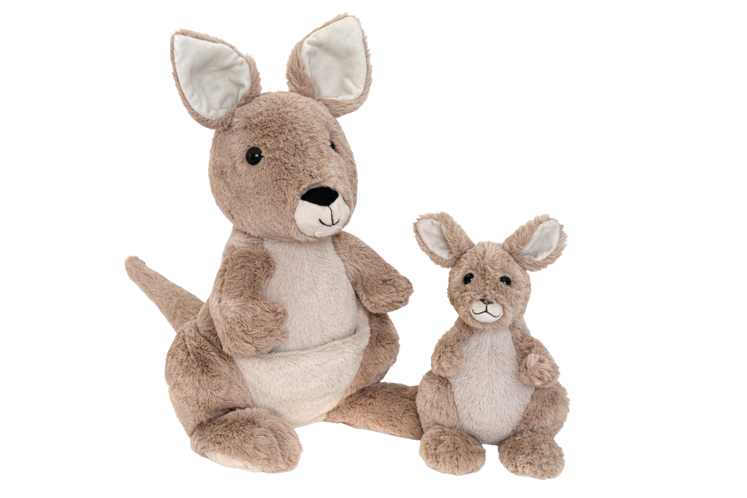

Girl Scout Rewards
2027/28 GSUSA
Membership Recognition
Earn $20 OFF* your My28 Membership by selling $900+ in the Fall Product Program!
**NEW**
Reward calculations will be rounded UP to the nearest dollar
Notes:
In addition to patches, the Girl Scouts can earn additional rewards based on their combined sales.
Rewards are cumulative, the more the Girl Scout sells the more she earns . M2 has made some positive changes to reward calculations as well! This year the total amount sold will be rounded up to the nearest dollar when the system calculates which recognitions a Girl Scout has earned.
There are several levels that require the caregiver to make a selection of which reward the Girl Scout wants. Volunteers will be able to edit these selections as well through their review date.
We’ve also brought back the opportunity to earn part of your My28 Girl Scout membership by participating in the Fall Program. This year Girl Scouts who earn and select this reward will receive $20 off their My28 membership. The discount will be automatically applied to the Girl Scout’s account in MyGS and is non-transferrable.

Slide 25

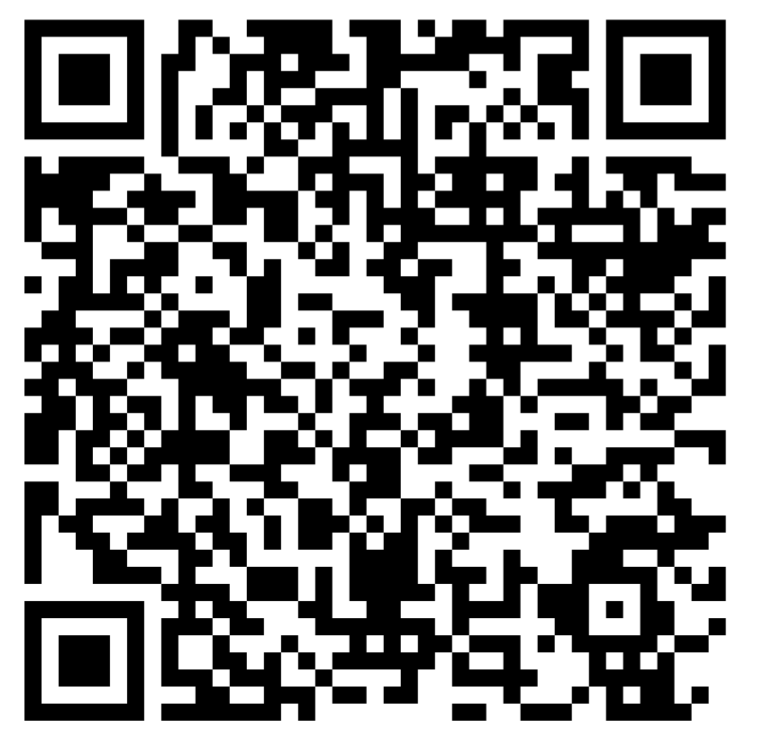
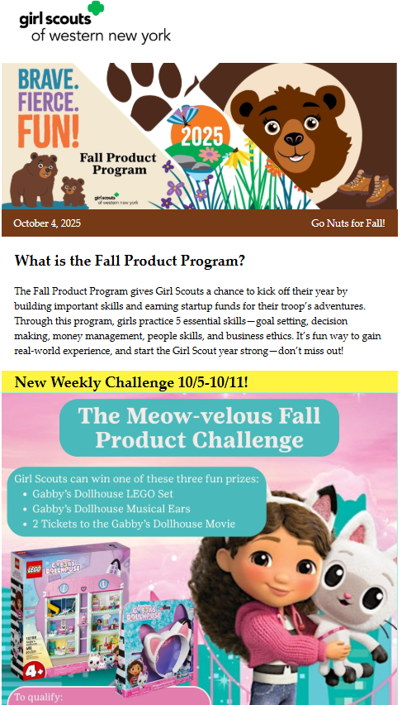
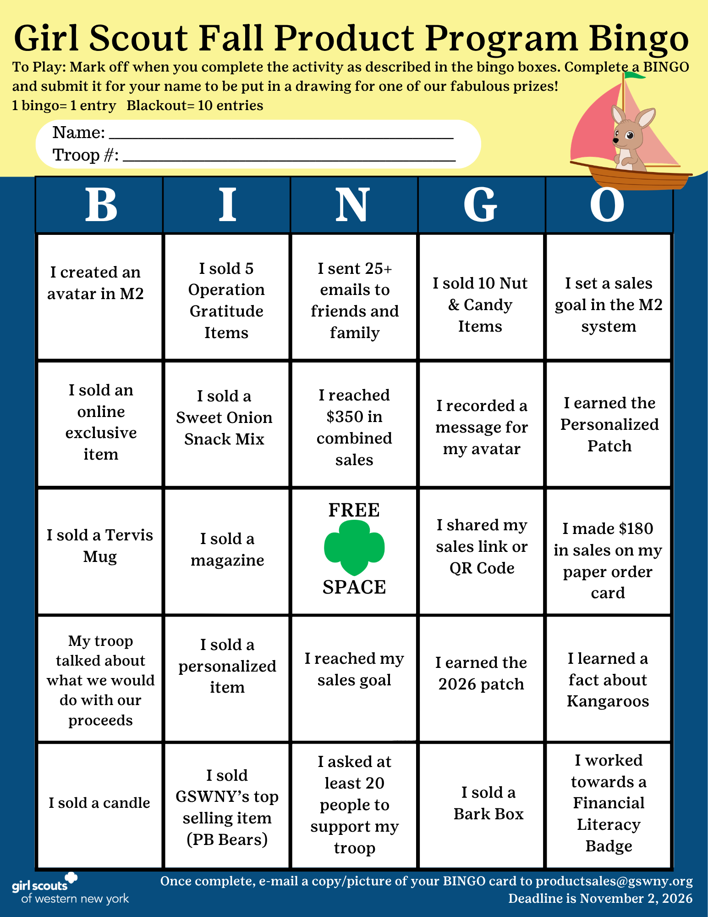
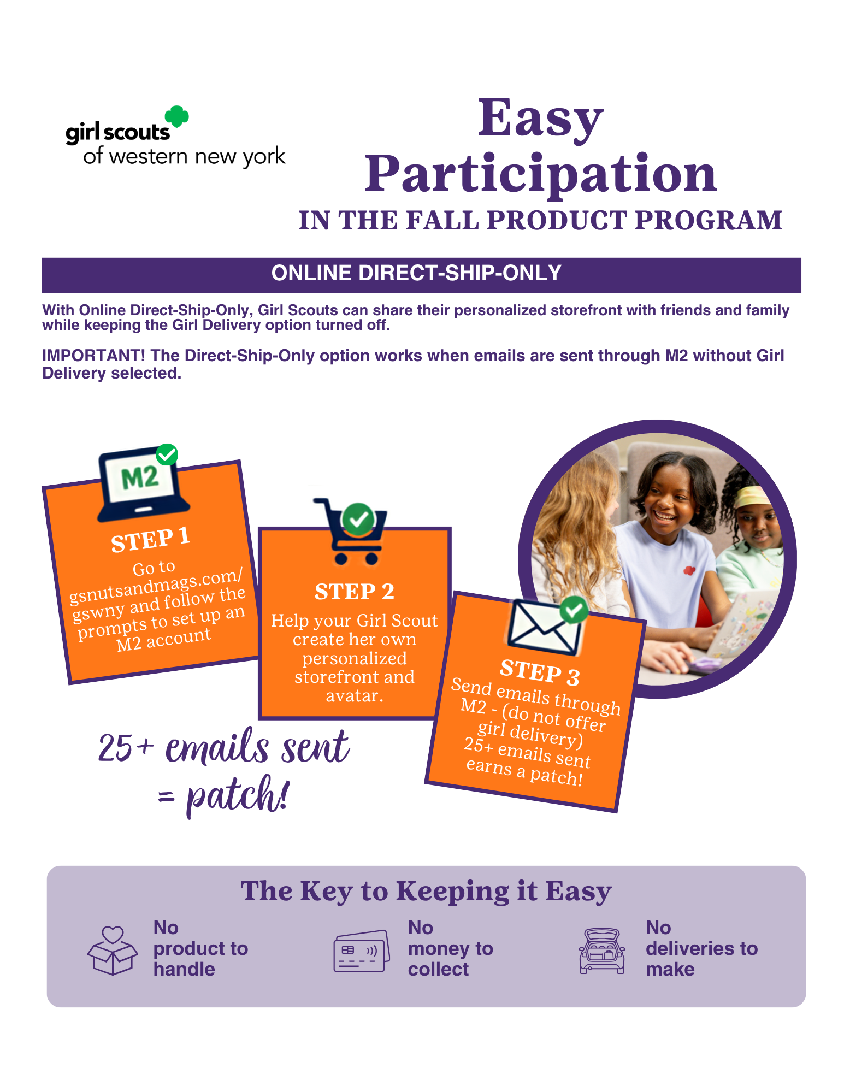
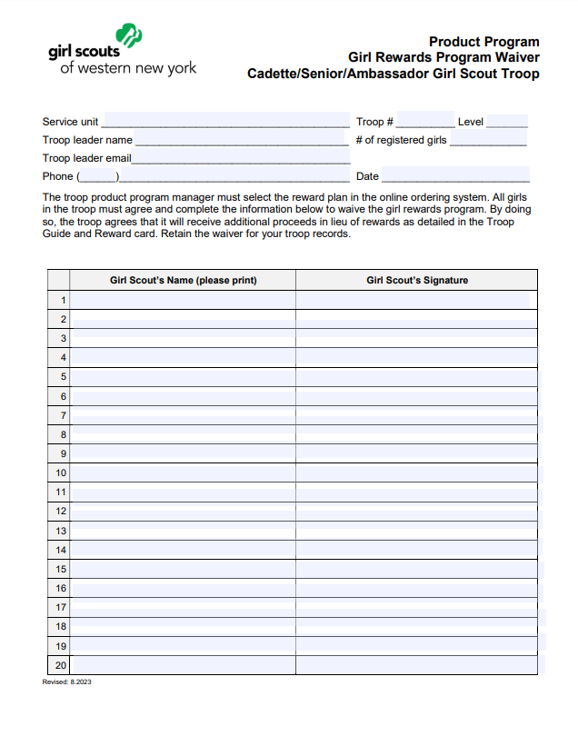

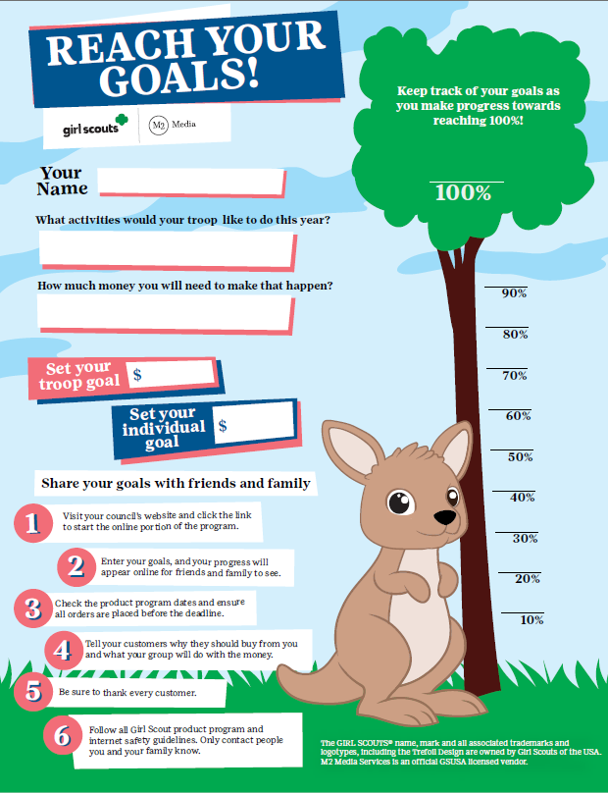


Scan here to view Fall Resources on GSWNY.org
Online Resources
Check your inbox for our
Fall Product Program Newsletter!
Program Updates - Next Steps – Program Contests & Promos
For Girl Scouts & Caregivers
For Troop Volunteers
Notes:
On gswny.org we have a Fall Resources page that includes a TON of digital resources for this program. There are activities, flyers on getting started and council promos such as the BINGO board, any form you will need, and MOST OF ALL links to the M2 video tutorials.
This information is provided in the troop training. M2 has videos that guide them through pretty much anything they need to do on the site. And they have another set just for caregivers.
The goal is to make this program about more than just selling. We want families of our Girl Scouts to see the value in participating and the learning that can happen.

Slide 26

Program Wrap Up
Notes:
And finally, we wanted to touch on wrap up as it relates to your role as SUPPM.

Slide 27
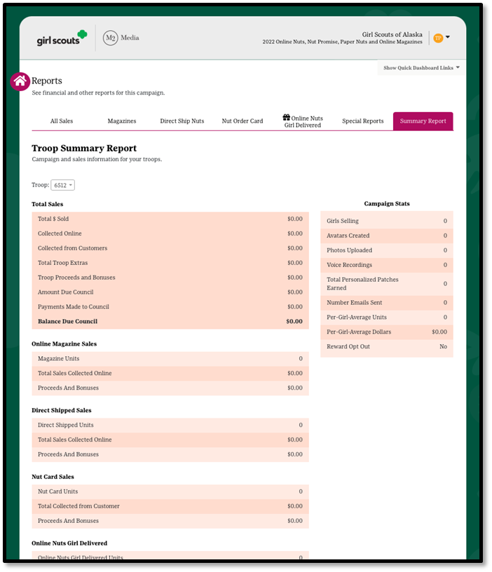
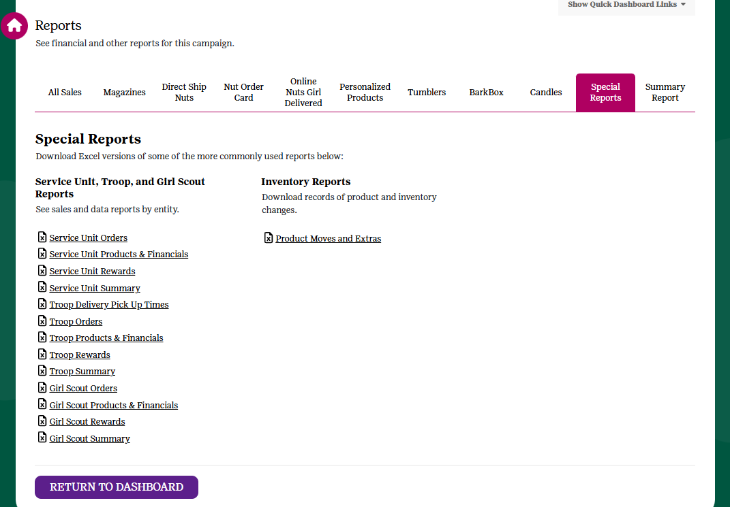
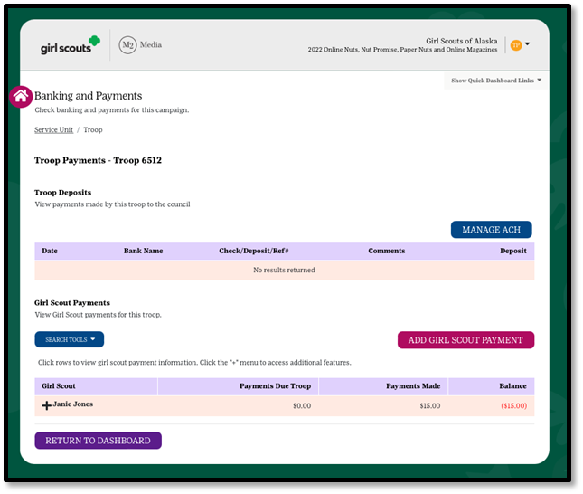
SUPPM Review Day
Troop Orders, Products & Financials
Notes:
At the end of the program, troops will have 1 day after caregivers can no longer make changes to review their troop’s product and rewards and to edit orders.
The SUPPM will have 1 day after troops are locked out to check and ensure this has been done.
Since online storefronts don’t close until October 26th for direct shipped orders, troops will have through 10/28 to make their payment in full. The report screen will include a Troop Summary Report, which shows balances and refunds due, as well as a slew of reports to help make this task easier.
SUPPM’s should monitor troop balances to ensure all are paid in full. Troops cannot receive product if they have a balance due.
note: Our epayment system has changed. Troops will need to have their checking account number and routing number to complete the transaction.
Troop Refunds should be requested by 12/1/2026.

Slide 28
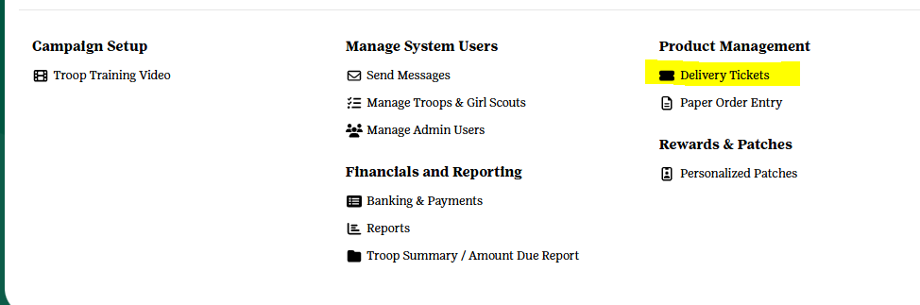
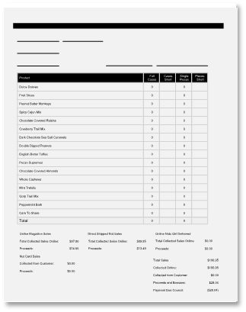
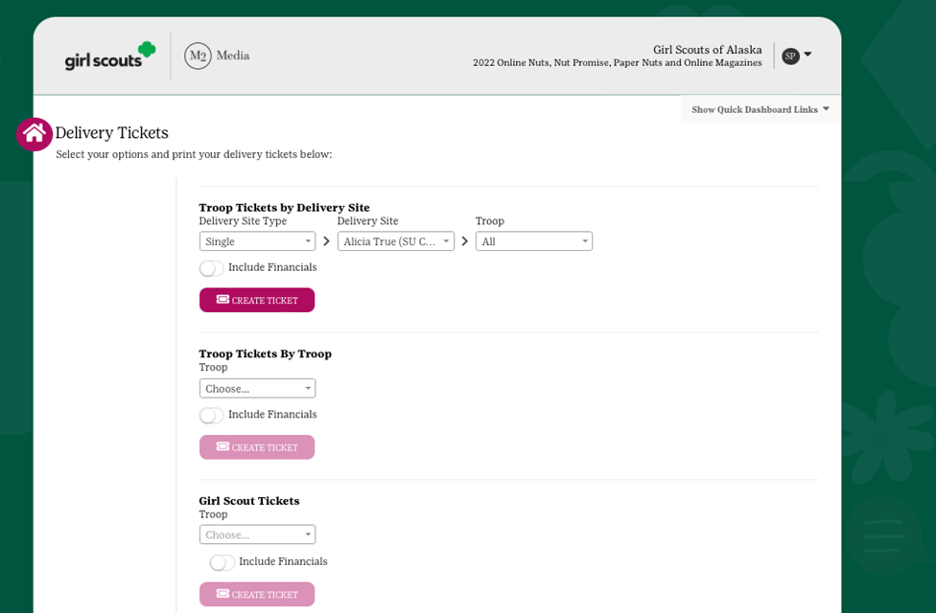
Distributing Rewards
Delivery Tickets
Scroll down to run reward delivery tickets.
Receipt all product/reward pick ups using these reports.
Notes:
Beginning October 28th, the delivery tickets feature will be available from your M2 dashboard. This report screen allows both suppm and troop volunteers to print pick up tickets for product and rewards pick up.
It’s very important that you receipt pick up of both.

Slide 29
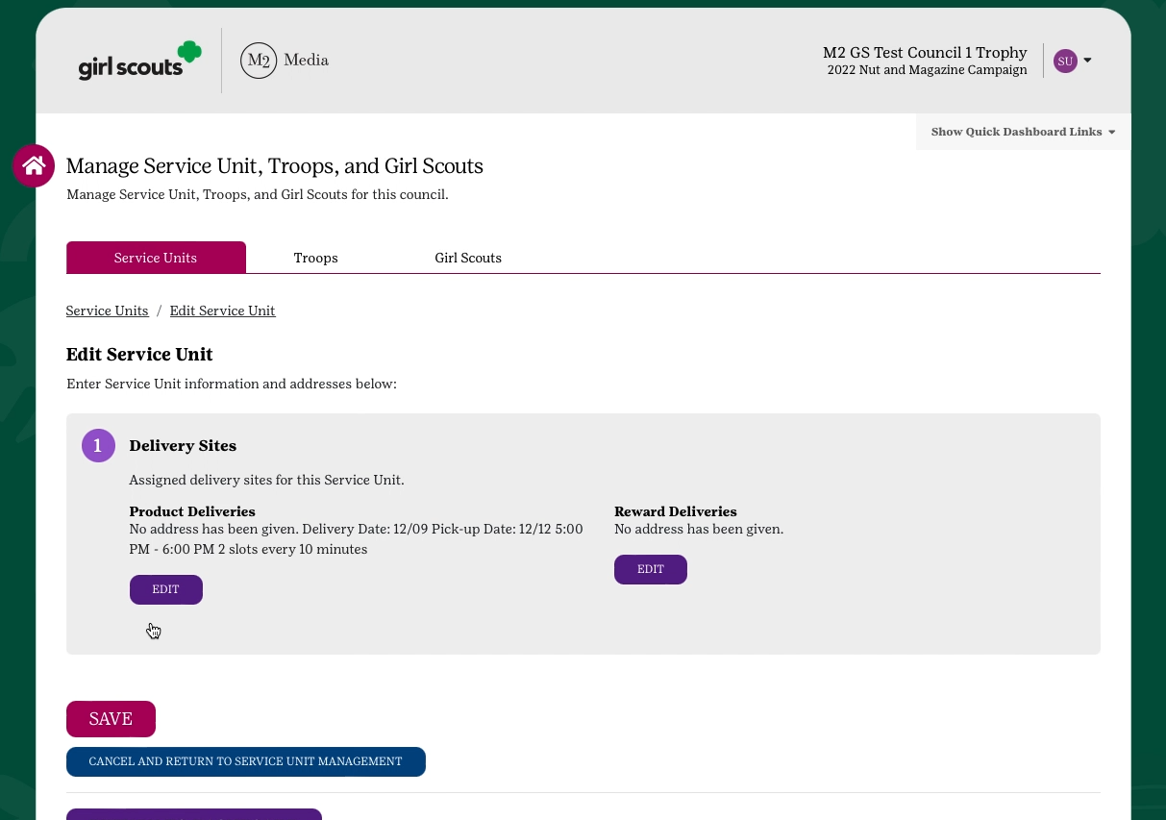
M2 Scheduler
Use M2 to coordinate troops picking up product/rewards
Select Manage SU/Troops/Girl Scouts
Under SU, click the + next to your SU number
Click edit then enter the delivery location and time slots.
Click Save
Troops who log in will not get a notification to schedule a pick up time!
Notes:
M2 also offers a scheduler at the su level to coordinate troop product pickups. The tool is under Manage Service Unit and allows you to schedule product pickup timeslots which troops can select.
Once set up, the troop volunteer will get a request to pick a time slot when they next log in to M2. Service units using this feature may want to remind troop volunteers to log back into M2 and pick a time.

Slide 30

Questions?
M2’S Customer Care team is cross-trained to handle tech support, volunteer/participant and customer inquiries. Support is available through phone, chat and email!
100% customer satisfaction guarantee
Council
Product Program Manager
S
U
P
P
M
Service Unit Product Program Manager
Troop Fall Program Manager
Girl Scouts &
their Caregivers
GSWNY Customer Care :
CustomerCare@gswny.org
1-888-837-6410
Notes:
A reminder that your Product Program team is here to support you in your role! In the same way, please support your troops with questions they have about the program. Following our circles of support helps ensure each level feels supported in the Fall PP.
Customer care is also available to assist with most questions or concerns.
You may also want to take note of the M2 help line and support site. Both are a great place to direct customers who have questions about their online order or volunteers who have technical questions about M2.

Slide 31
FAQ’S
How do I reset my password?
From the login page, click the Forgot Your Password link. Remember that if you are also a parent, you must log into the participant section to manage your Girl Scout’s account. If you are also the troop/SU manager, you will need to login to the admin site. You can set up each site to use the same login and password for both!
How do I get a new registration email sent to a Girl Scout in my troop?
Troop Fall Program Managers can resend registration emails to a caregiver through their M2 Admin login. From your dashboard, go to Parent/Adult Email Campaign. From here you can click the resend button next to the corresponding caregiver.
When can a supporter expect a direct ship nut order placed online?
The supporter will receive a confirmation email of the order and then another email when the order ships with tracking details.
When will a participant receive their Personalized Patch?
The personalized patch will arrive about 8 to 10 weeks after being sent to the patch company for production. On the participant dashboard, you will see an ETA date so you can anticipate when your patch should arrive.
What if a participant didn’t find their name as they log into the platform?
That’s not a problem! Any Girl Scout who doesn’t know their troop number or see their name, can add themselves to the system. After a participant sets up an account, there will be a brief delay while the council confirms their GSUSA membership. Once that task is completed, council will release the participant from the holding tank and their customers will then have access to make purchases.
When can I expect my online girl delivery items?
Because timelines may vary, please have customers inquiring about their online girl delivered items reach out directly to the Girl Scout from whom they purchased for more details.”
Notes:
You may also be asked some of these questions by troop leaders throughout the program. This page is here for your reference when helping troop volunteers.

Slide 32

THANK YOU!
Please stop by your local Council Service Center to pick up your SUPPM Gift and product samples!
Scan here to complete your SUPPM Agreement & RSVP for the Sept 2nd LIVE Virtual Fall Vendor Showcase
Next Steps:
Collect & Retain Troop Fall Program Manager Agreements
Train Troops & Distribute Materials
Check your M2 Rosters
Excite Troops to Participate
Support Troops in the Program
Notes:
Now that you’ve completed part 1 of your training, here’s a short list of your next steps as SUPPM!
If you haven’t done so already, please scan the qr code and complete your SUPPM Agreement and RSVP for part 2 of training, the Sept 2nd LIVE Virtual Fall Vendor Showcase!
Thank you for all you do and we will see you on September 2nd!

